Slide 1
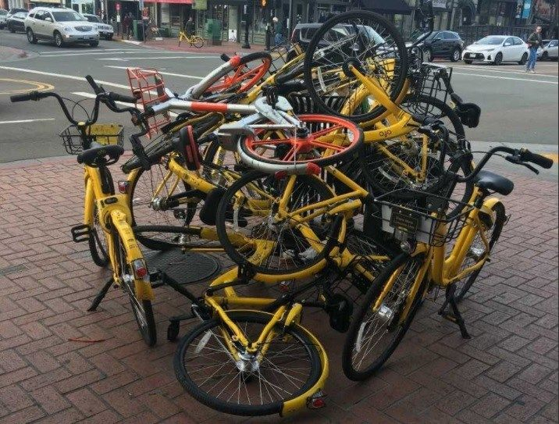
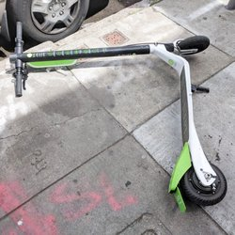
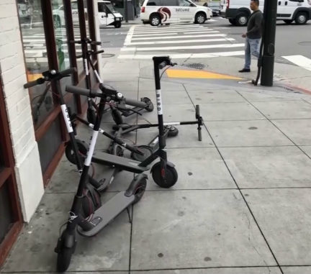
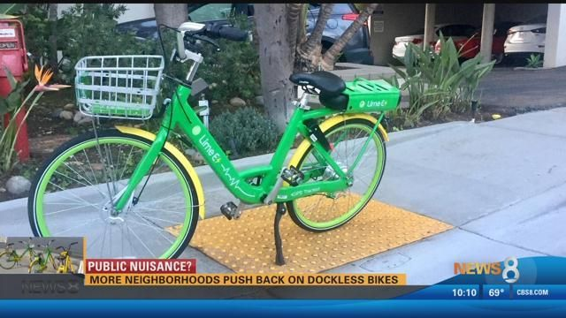

Slide 2
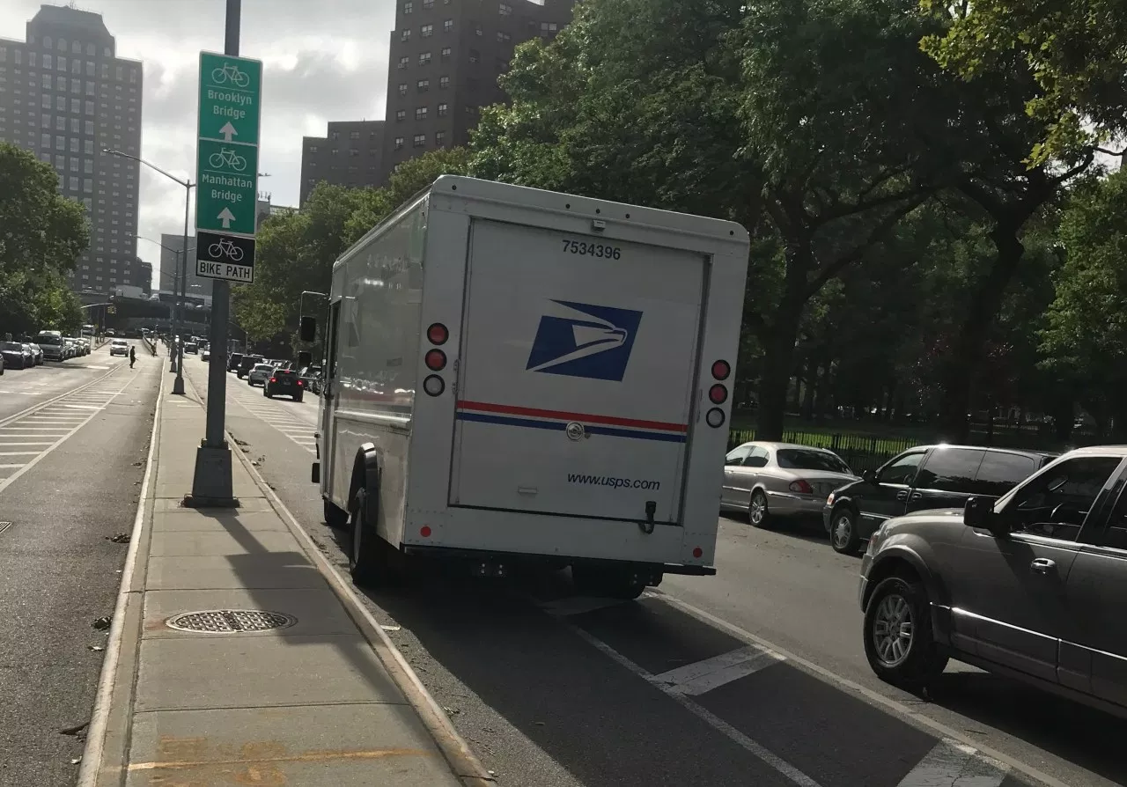
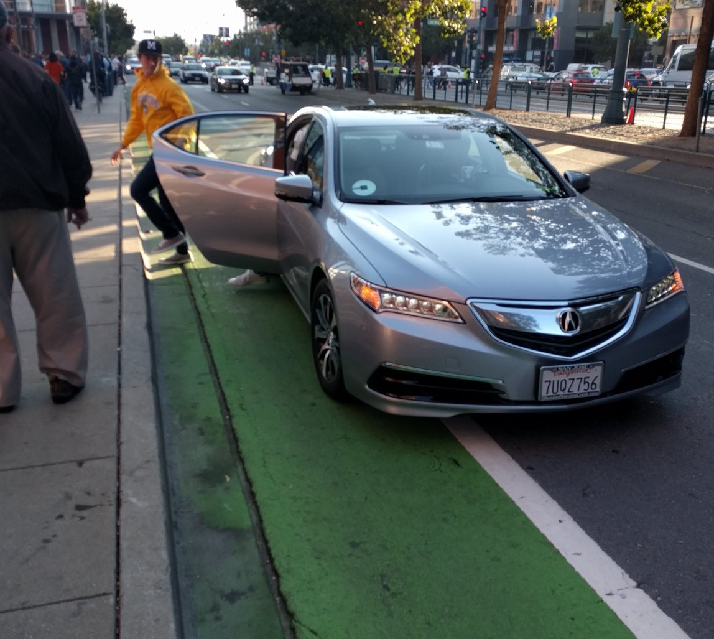
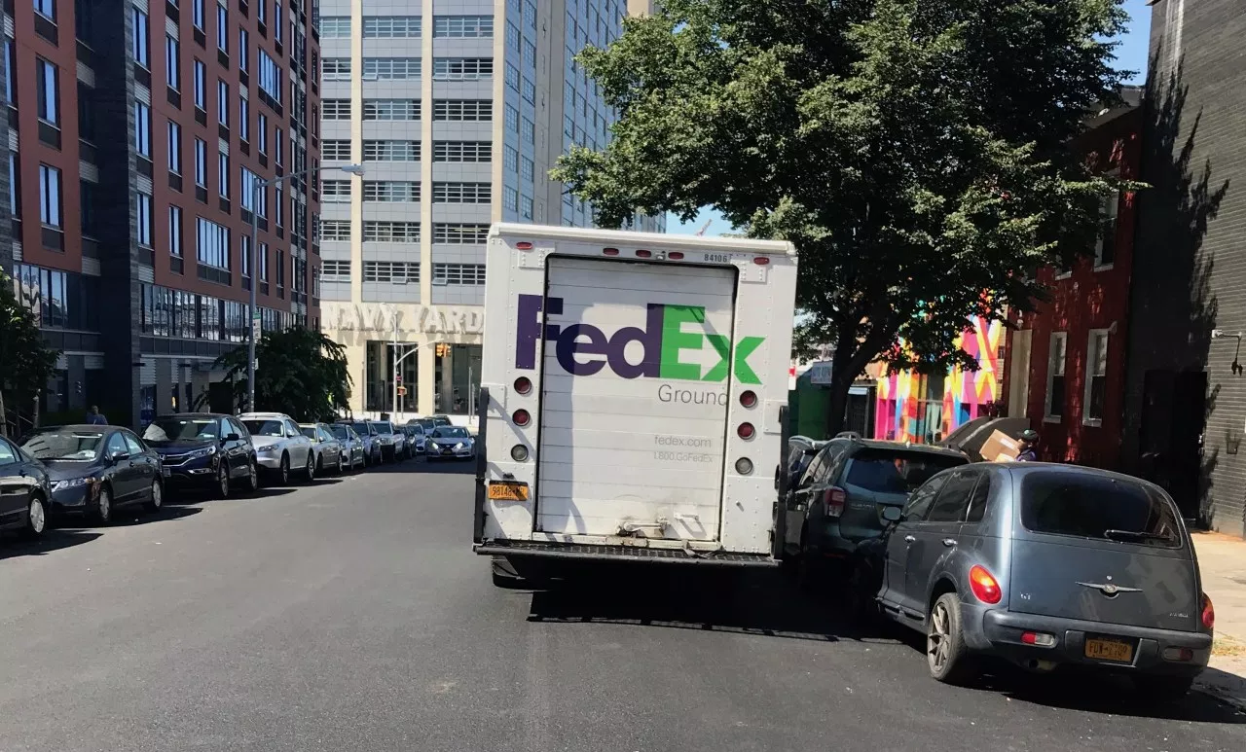

Slide 3
CURBSIDE MANAGEMENT
& TNCs
Ingrid Ballús Armet
ITE San Diego
October 11, 2018

Slide 4
TABLE OF CONTENTS.
1
What is Curbside Management?
2
NACTO Curb Appeal Guidance
3
ITE Practitioner’s Guide
4
TNCs & the Curb
5
Questions
CURBSIDE MANAGEMENT
Notes:
Steve

Slide 5
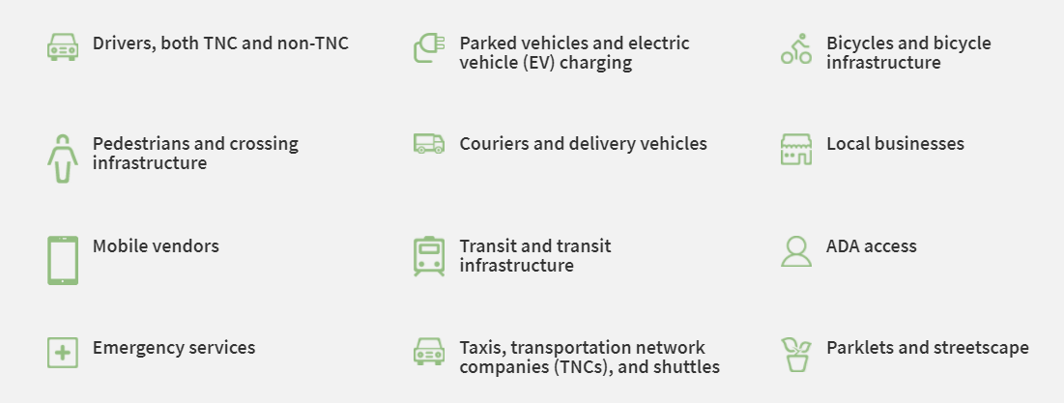
1. What is Curbside Management?
CURBSIDE MANAGEMENT
Notes:
High demand for the curb from by all modes; space needed for transit, bikes, ada access, parking, emergency vehicle access, food trucks, etc
– particularly with more recent increase in TNC use and urban freight deliveries due to the increase of e-commerce, and in the future with AVs
Increase safety concerns as all these modes meet at the curb.
Need for management of this space. Many cities are struggling with this and there isn’t one “how-to” guide written on it yet, but there have been different white papers and studies written on the topic. Also, some of the larger cities in the US have started developing frameworks and are piloting different strategies.

Slide 6
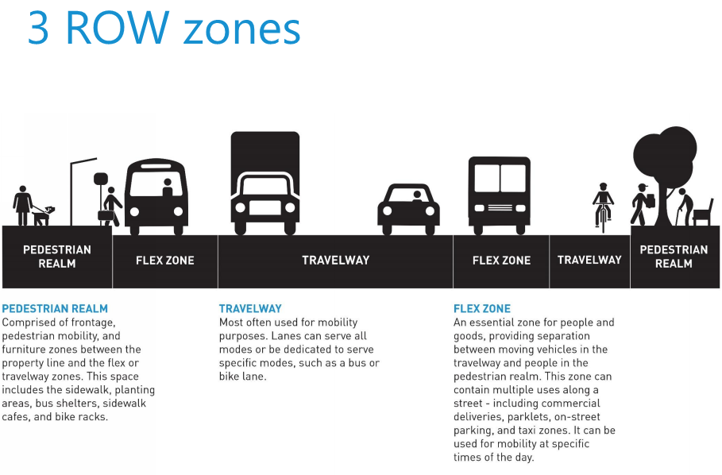
1. What is Curbside Management?
CURBSIDE MANAGEMENT
Notes:
Defining “the curb” – defined by presenting the 3 ROW zones
curbspace = curbside = flex zone
Flex zone can then have many different functions

Slide 7
1. What is Curbside Management?
CURBSIDE MANAGEMENT
Notes:
Essential right-of-way/curbside functions (as defined by Seattle)

Slide 8
2. NACTO Curb Appeal Guidance
Shifting from Parking Lane to Flex Zone
Clearing the Way for Transit
Moving Loading and Access Nearby
Looking Beyond the Corridor
CURBSIDE MANAGEMENT
Notes:
Curb Appeal white paper from NACTO released last fall. First document that attempts to provide some guidance on curbside management and introduces the concept of “Flex Zone” and how to better optimize that space, particularly for transit. Some of the tools it presents are queue jumps, transit-only lanes, opportunities for transit boarding islands

Slide 9
3. ITE Web Resource
•
Practitioner’s Guide
COMING SOON!
•
Case Studies
•
Resource Library
CURBSIDE MANAGEMENT
Notes:
ITE CSC is developing a curbside management web resource, which will include a practitioners’ guide, case studies, and a resource library.
This is intended to address key gaps in the existing guidance.
This guide includes case studies, currently for four cities (San Francisco, Seattle, Toronto, DC)
Resource Library
The Web resource will be unveiled in November 2018 and it is intended to be refined and updated as successes and lessons learned from implemented practices continue to emerge.

Slide 10
3. ITE Web Resource
Practitioner’s Guide
Planning Considerations
Available Tools and Treatments
Treatment Selection Process
Performance Measurement
CURBSIDE MANAGEMENT
Notes:
intended to provide guidance on best practices for curbspace allocation policy and implementation based primarily upon the outcomes of tested strategies.
It includes planning and implementation considerations for curbside management, policy development, prioritization, available tools and treatments, and evaluation metrics.
How to measure curbside performance
How to identify and resolve trade-off considerations
How to explain the value of curb uses to stakeholders

Slide 11
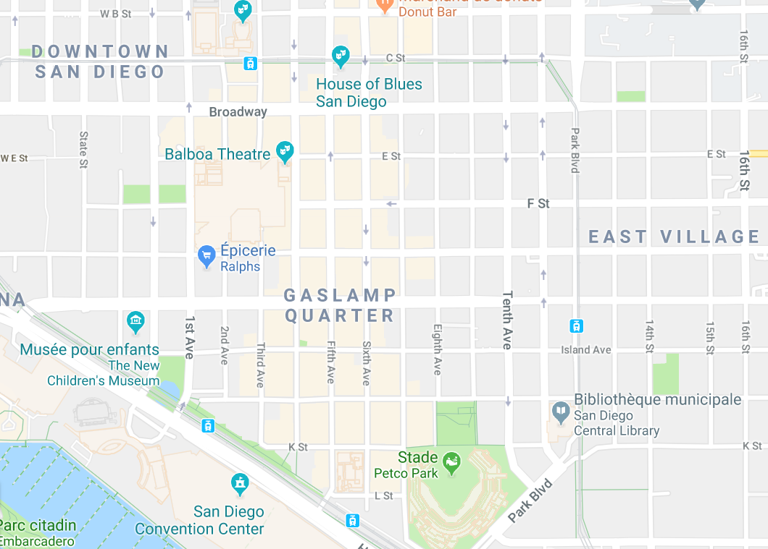
3. ITE Web Resource
Planning Considerations
Identify service area
Identify curb needs and demands
Establish priorities
CURBSIDE MANAGEMENT
Notes:
Identify scale of curb service area i.e. who/what area(s) is this curb space going to serve?
Identify curb needs in the service area: commercial loading, passenger loading, …
Identify priorities for each block/road segment - i.e. if there is a trade-off to be made, what wins?
Includes city policies, community input…

Slide 12
4. TNCs & the Curb
Quantify TNC Curb Demand
CURBSIDE MANAGEMENT
Notes:
What's your accumulation? (i.e. how many simultaneous events do you have?)
Number of events: based on video data collection or data from TNCs, if available
Arrival pattern
Dwell times - based on video data collection or data from TNCs, if available (but mostly 30 seconds to 2 mins, can use engineering judgement)

Slide 13
4. TNCs & the Curb
Quantify TNC Curb Demand
Accumulation - how many simultaneous pick-ups/drop-offs?
Number of events
Arrival pattern (peaked, random, uniform)
Dwell time
CURBSIDE MANAGEMENT
Notes:
What's your accumulation? (i.e. how many simultaneous events do you have?)
Number of events: based on video data collection or data from TNCs, if available
Arrival pattern
Dwell times - based on video data collection or data from TNCs, if available (but mostly 30 seconds to 2 mins, can use engineering judgement)

Slide 14
4. TNCs & the Curb
Quantify TNC Curb Demand
How much space is needed?
CURBSIDE MANAGEMENT
Notes:
Space needed to pull in & out of the curb (include Geoff's graphic for explanation)
Higher levels require more sophisticated analysis due to friction

Slide 15
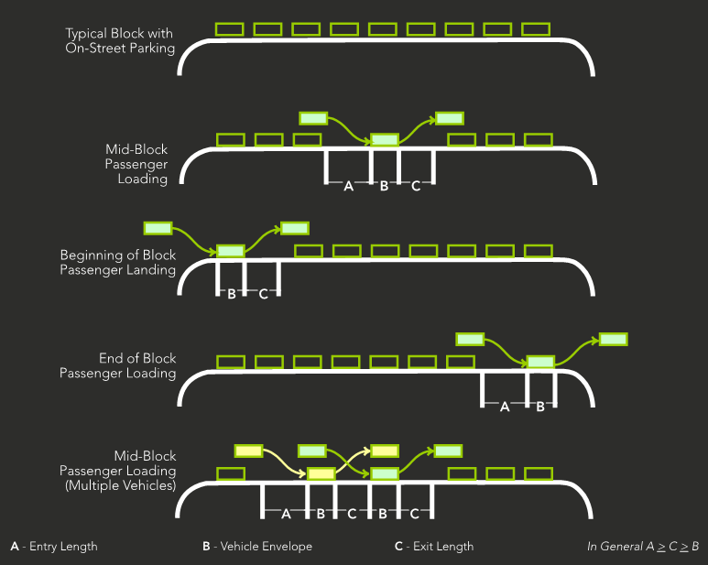
4. TNCs & the Curb
Quantify TNC Curb Demand
CURBSIDE MANAGEMENT
Notes:
Space needed to pull in & out of the curb
Higher levels require more sophisticated analysis due to friction

Slide 16
4. TNCs & the Curb
Different Demands = Different Approaches
CURBSIDE MANAGEMENT
Notes:
Very high & very peaked: large event (e.g. music festival)/stadium = special event analysis & curb designation
Geofencing needed
Provide staging area for vehicles to store awaiting the end of the event
Provide dedicated curb space for the event times only
Consider separating TNCs, from taxis, from private vehicle pu/do, from shuttles based on type of event and expected demand for each mode
e.g. Justin Bieber concert is likely to have more parents (i.e. private vehicle) pu/do than a music festival which is likely to be mostly TNCs (outside lands festival had a 40% mode share of TNCs)
FIFO - matching with codes (taxi stand)

Slide 17
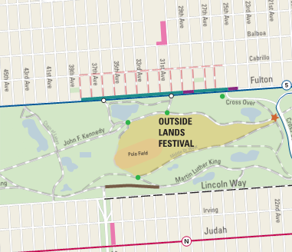
4. TNCs & the Curb
Different Demands = Different Approaches
Very High & Very Peaked
(stadiums)
CURBSIDE MANAGEMENT
Notes:
Very high & very peaked: large event (e.g. music festival)/stadium = special event analysis & curb designation
Geofencing needed
Provide staging area for vehicles to store awaiting the end of the event
Provide dedicated curb space for the event times only
Consider separating TNCs, from taxis, from private vehicle pu/do, from shuttles based on type of event and expected demand for each mode
e.g. Justin Bieber concert is likely to have more parents (i.e. private vehicle) pu/do than a music festival which is likely to be mostly TNCs (outside lands festival had a 40% mode share of TNCs)
FIFO - matching with codes (taxi stand)

Slide 18
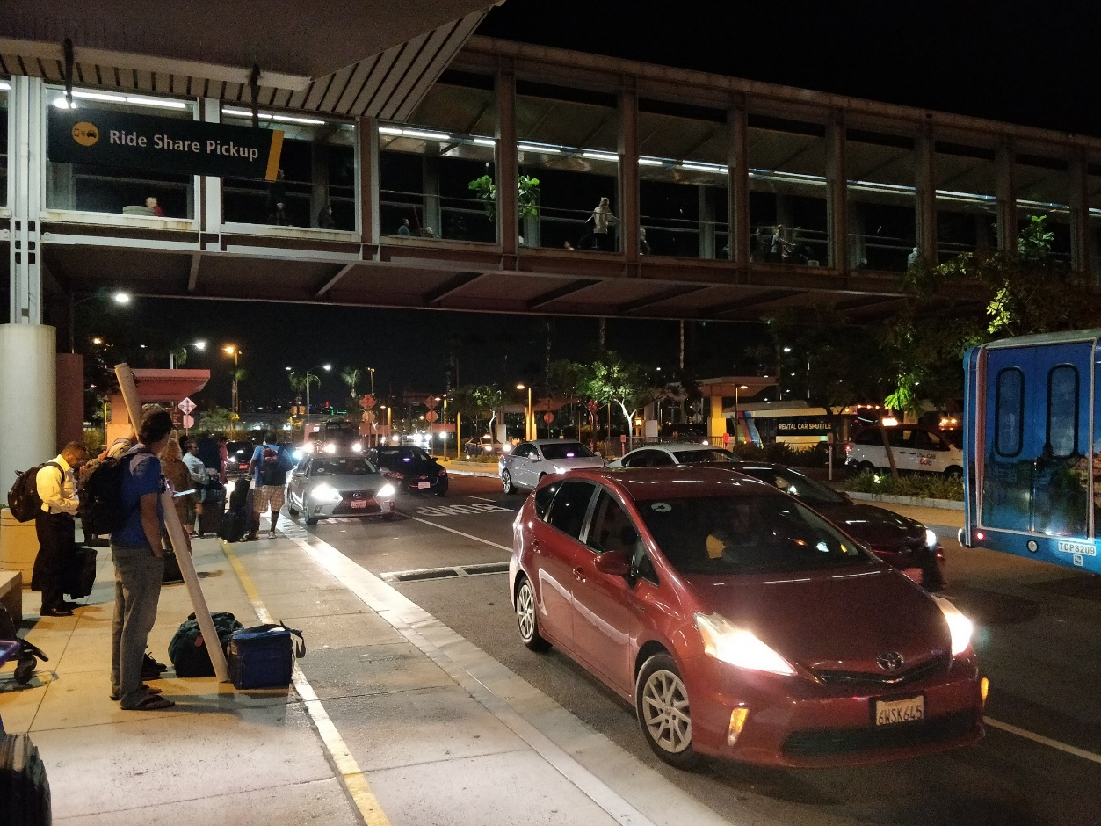
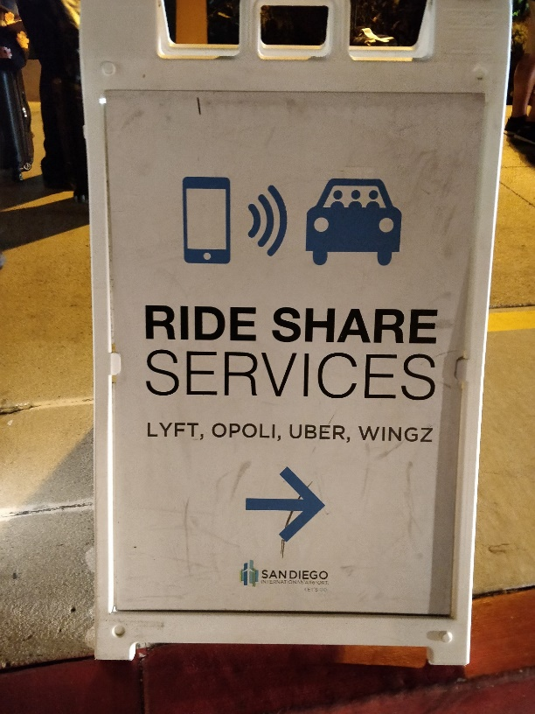
4. TNCs & the Curb
Different Demands = Different Approaches
Very High & Uniform
(airports)
CURBSIDE MANAGEMENT
Notes:
Very high/High and mostly steady: airport
Provide staging area
Geofencing + wayfinding
Provide large dedicated space, separate from other modes
Example SD airport: 150 Lyfts in 15mins --> 10 Lyfts every minute

Slide 19
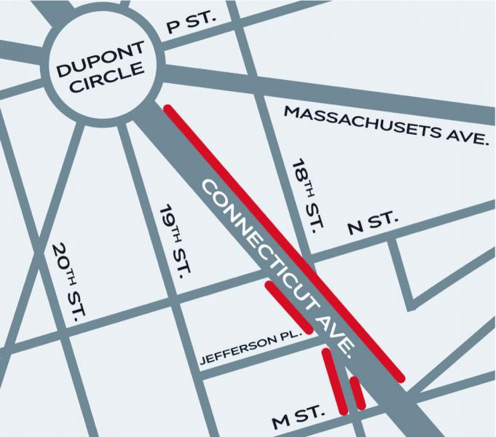
4. TNCs & the Curb
Different Demands = Different Approaches
High & Peaked
(transit hub, FiDi)
CURBSIDE MANAGEMENT
Notes:
High & peaked: transit hub, financial district area with high TNC activity, nightlife area
Consider geofencing + wayfinding and/OR providing the dedicated curb space at the point of interest
Provide dedicated curb space with time of day restrictions if space is tight
Consider separating TNCs, from taxis, from private vehicle pu/do
Example of Dupont Circle

Slide 20
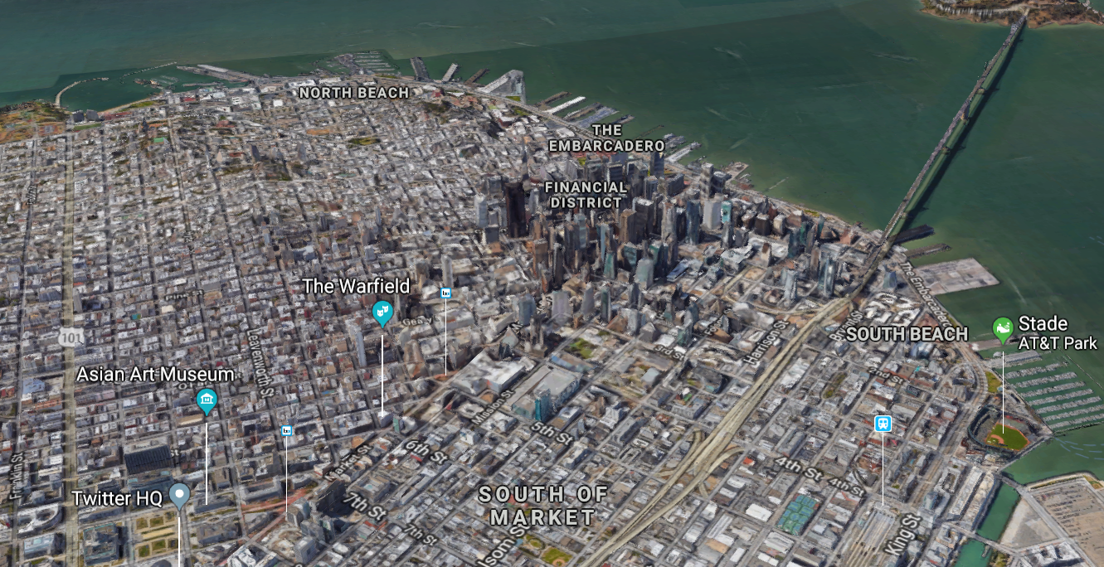
4. TNCs & the Curb
Different Demands = Different Approaches
Medium & Random/Uniform (downtown)
CURBSIDE MANAGEMENT
Notes:
Medium & random or steady: downtown areas
Look at priorities IDed during planning process to identify best location for a passenger loading zone, since some of these corridors may need to prioritize transit uses, or activation (parklets) - may not be directly in front of point of interest --> determine a reasonable proximity to each destination
Example: Market Street in San Francisco, Uber/Lyft not allowed

Slide 21
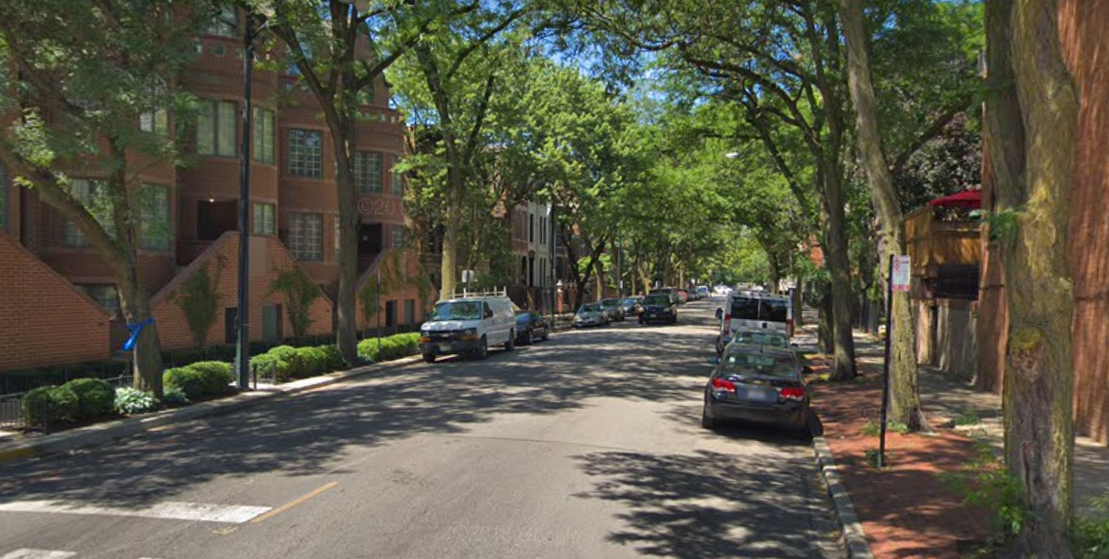
4. TNCs & the Curb
Different Demands = Different Approaches
Low & Random (residential areas)
CURBSIDE MANAGEMENT
Notes:
Low & random: residential neighborhoods
May not require a dedicated loading zone
lower overall activity, so impacts to through vehicles will be minimal
Removal of on-street parking may be difficult for communities

Slide 22
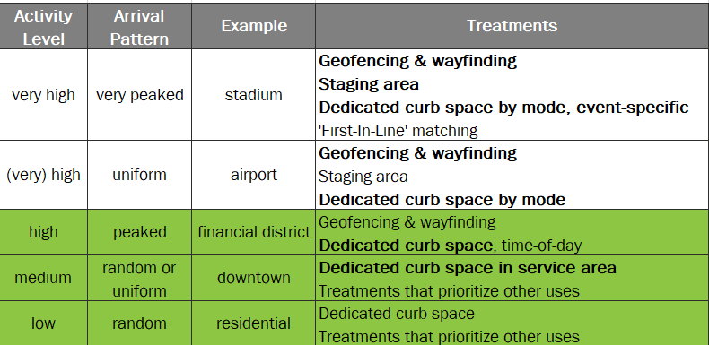
4. TNCs & the Curb
Different Demands = Different Approaches
CURBSIDE MANAGEMENT

Slide 23
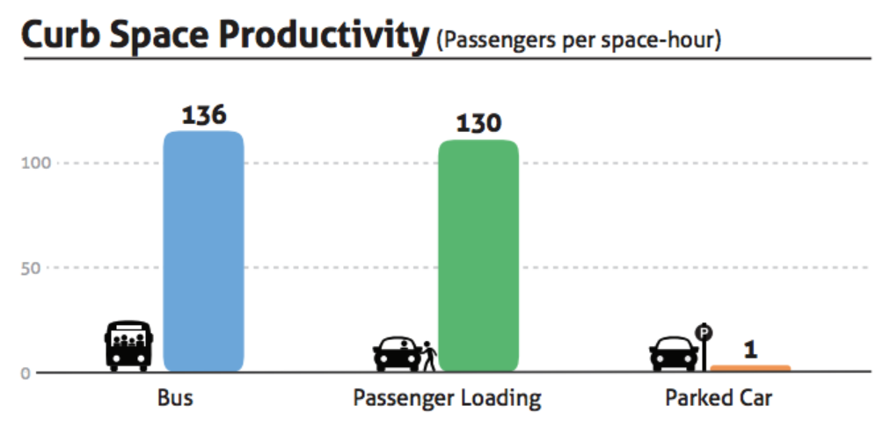
4. TNCs & the Curb
Curb Productivity Index – Passenger Throughput
Curb Productivity Index = $\frac{Activity}{Time x Space}$
San Francisco Curb Study, Uber and Fehr & Peers
CURBSIDE MANAGEMENT

Slide 24
5. Questions
Ingrid Ballús Armet
Transportation Engineer
i.ballusarmet@fehrandpeers.com
CURBSIDE MANAGEMENT
Notes:
Steve

