Slide 1
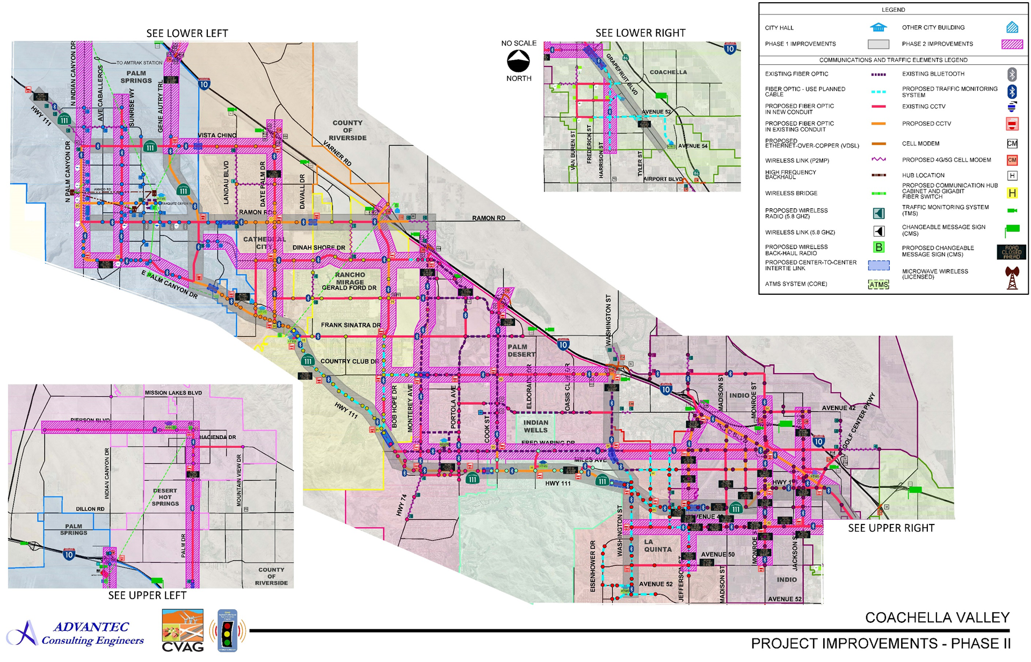
PREPARING THE COACHELLA VALLEY FOR A SMART REGION
APPROVED
PHASE II
PRIORITY CORRIDORS

Slide 2
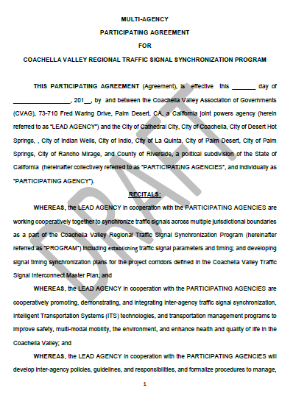
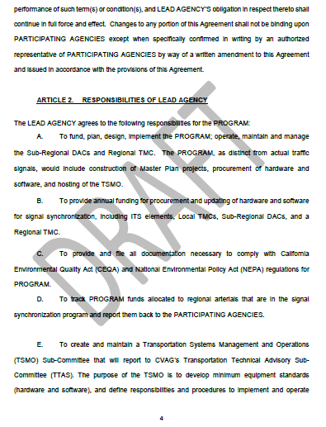
PREPARING THE COACHELLA VALLEY FOR A SMART REGION
APPROVED
PARTNERING AGREEMENT
8 Cities, County, CVAG
Traffic Signal Synchronization Program
Promoting, Demonstrating and Integrating TSS, ITS, and Transportation Management Programs
CVAG – Fund, Design, Implement, Operate, Maintain, and Manage a Regional TMC and DACs
CVAG – Fund, Design, and Implement Local TMCs
Regional Transportation Funding for Implementation of Inter-agency TSS, Transportation Management Systems, and ITS Technologies

Slide 3
PREPARING THE COACHELLA VALLEY FOR A SMART REGION
CVAG – Provide Annual Funding for Procurement and Updating of Hardware, Software, ITS Elements, Local TMCs, Sub-Regional DACs, and Regional TMC
CVAG – Create and Maintain a Transportation Systems Management and Operations (TSMO) Sub-Committee
TSMO –
Develop minimum equipment standards (hardware and software)
Define responsibilities and procedures to implement and operate Coachella Valley intelligent transportation systems including inter-agency signal synchronization, arterial management systems, special events management systems, integrated corridor management systems, and ITS technologies
Develop, oversee, manage, maintain, and update the Regional Traffic Signal Synchronization Operations and Maintenance Manual
APPROVED
PARTNERING AGREEMENT

Slide 4
PREPARING THE COACHELLA VALLEY FOR A SMART REGION
Share real-time arterial and intersection traffic data and traffic video images/streams with CVAG and PARTICIPATING AGENCIES
Authorize CVAG to share travel information to the public and media via mobile applications
Authorize CVAG to plan and prepare upcoming integration of connected/autonomous/automated vehicles and smart cities technologies
Authorize CVAG to share traffic data including Signal Phasing and Timing (SPaT) to the automobile industry or their representatives for integration of connected/autonomous/automated vehicles
To provide training to PARTICIPATING AGENCIES on the next generation of intelligent transportation technologies and programs, including connected/autonomous/automated vehicles and smart cities technologies and provide updates as advances are made in these areas
APPROVED
PARTNERING AGREEMENT

Slide 5
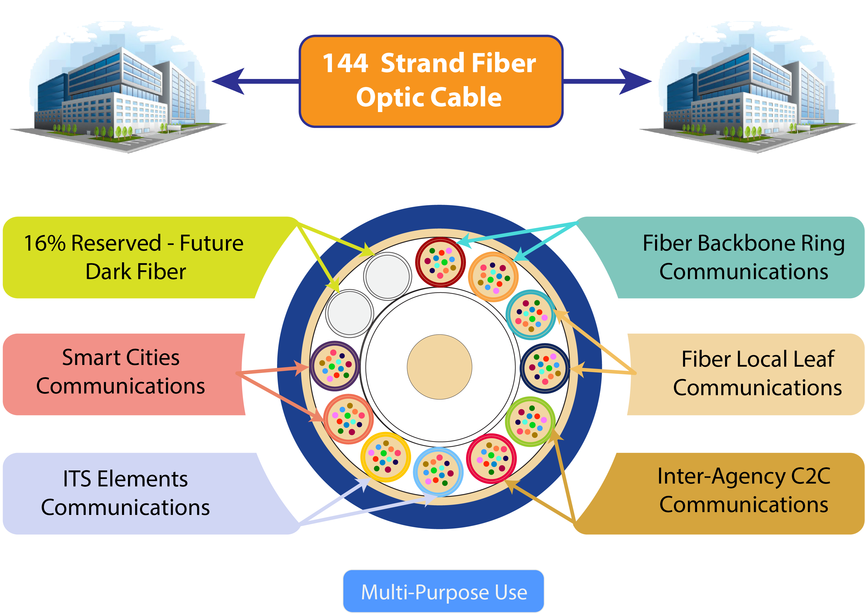
PREPARING THE COACHELLA VALLEY FOR A SMART REGION
Ethernet Communications:
Ring Topology
ITS Elements
Inter-Agency Center-to-Center Communications
Cloud Back-up System
CAV Technologies
and Smart Cities Technologies

Slide 6
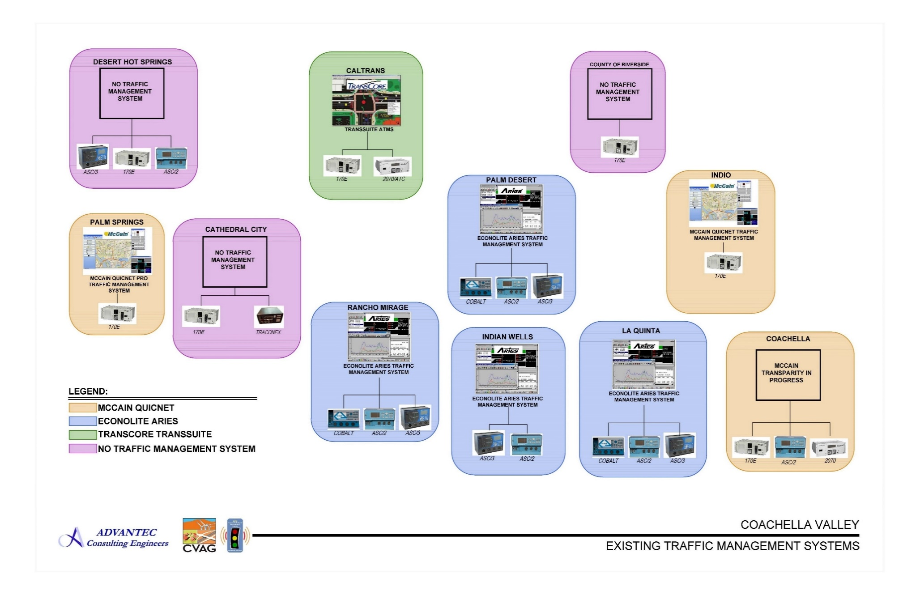
PREPARING THE COACHELLA VALLEY FOR A SMART REGION
EXISTING ANALOG TRAFFIC MANAGEMENT INFRASTRUCTURE

Slide 7
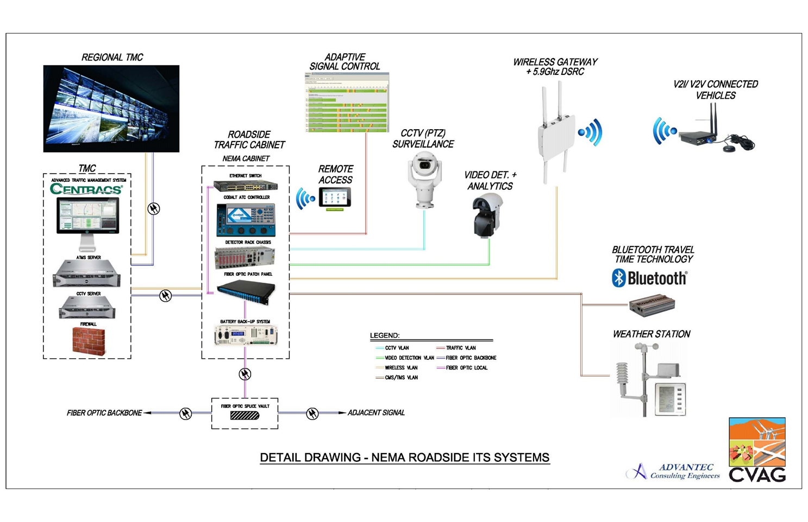
PREPARING THE COACHELLA VALLEY FOR A SMART REGION
NEW
STATE-OF-THE-ART
ITS TECHNOLOGIES
ITS Roadway Technologies:
2070 Advanced Transportation Controllers (ATC)
Intelligent CCTV Cameras with Analytics
Pedestrian/Bicyclists/Vehicle Detection
Bluetooth/Wi Fi Arterial Management Systems
DMS/CMS
Ready for DRSC (V2I Communication)

Slide 8
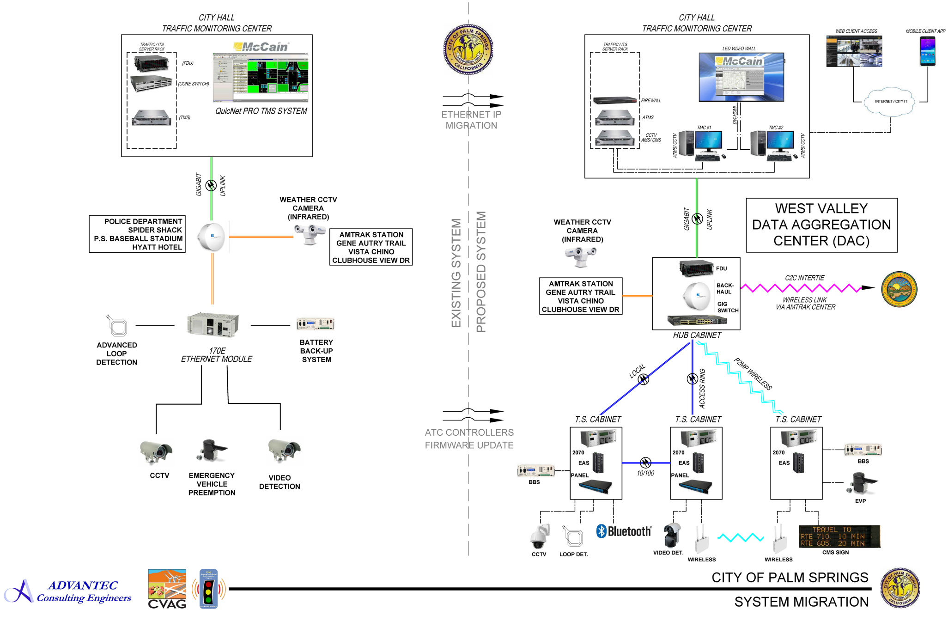
PREPARING THE COACHELLA VALLEY FOR A SMART REGION
STATE-OF-THE-ART LOCAL
TRAFFIC MANAGEMENT CENTERS – CITY OF PALM SPRINGS (upgrade)

Slide 9
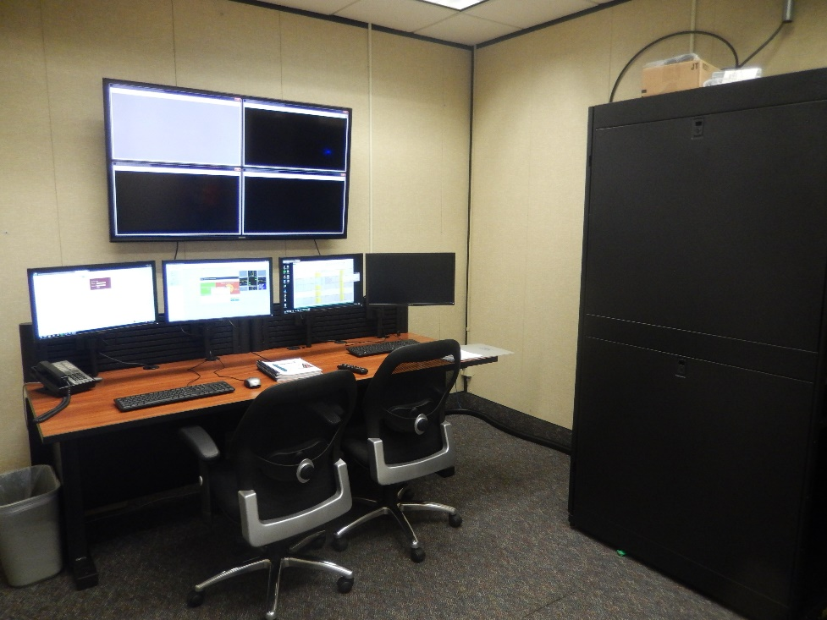
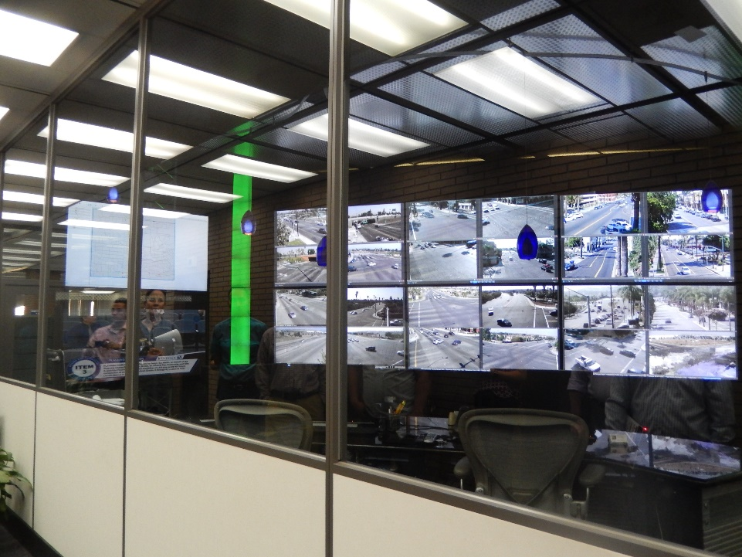
PREPARING THE COACHELLA VALLEY FOR A SMART REGION
STATE-OF-THE-ART LOCAL
TRAFFIC MANAGEMENT CENTERS – CITY OF PALM SPRINGS (upgrade)
Existing TMC
Tentative TMC Upgrades

Slide 10
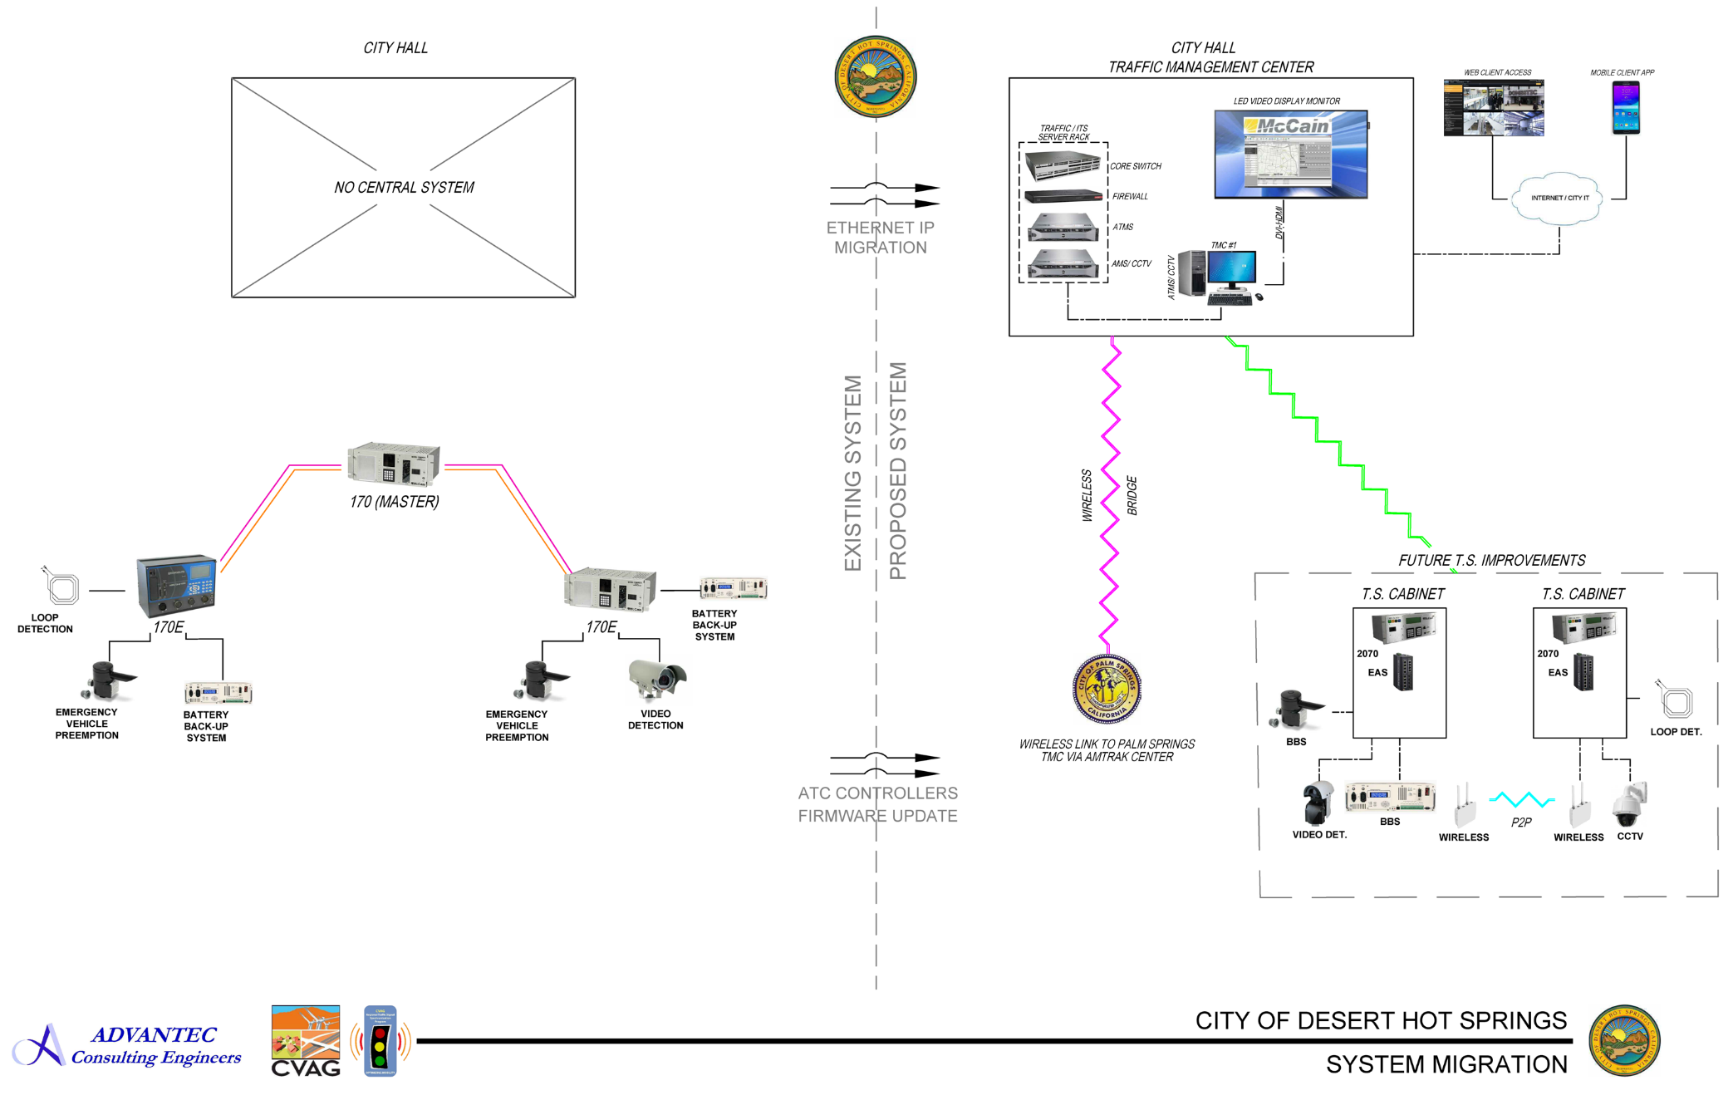
PREPARING THE COACHELLA VALLEY FOR A SMART REGION
STATE-OF-THE-ART LOCAL
TRAFFIC MANAGEMENT CENTERS – CITY OF DESERT HOT SPRINGS (New)

Slide 11
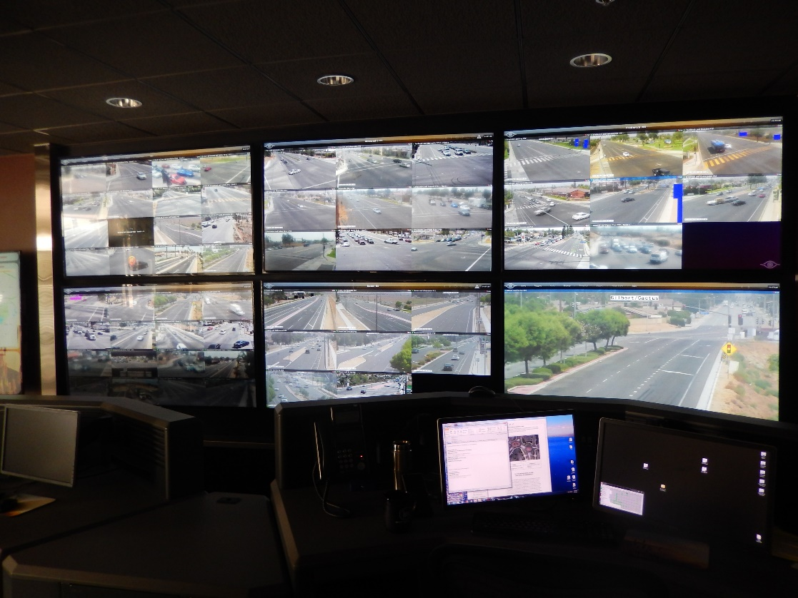
PREPARING THE COACHELLA VALLEY FOR A SMART REGION
STATE-OF-THE-ART LOCAL
TRAFFIC MANAGEMENT CENTERS – CITY OF DESERT HOT SPRINGS (New)
No Existing TMC
New TMC

Slide 12
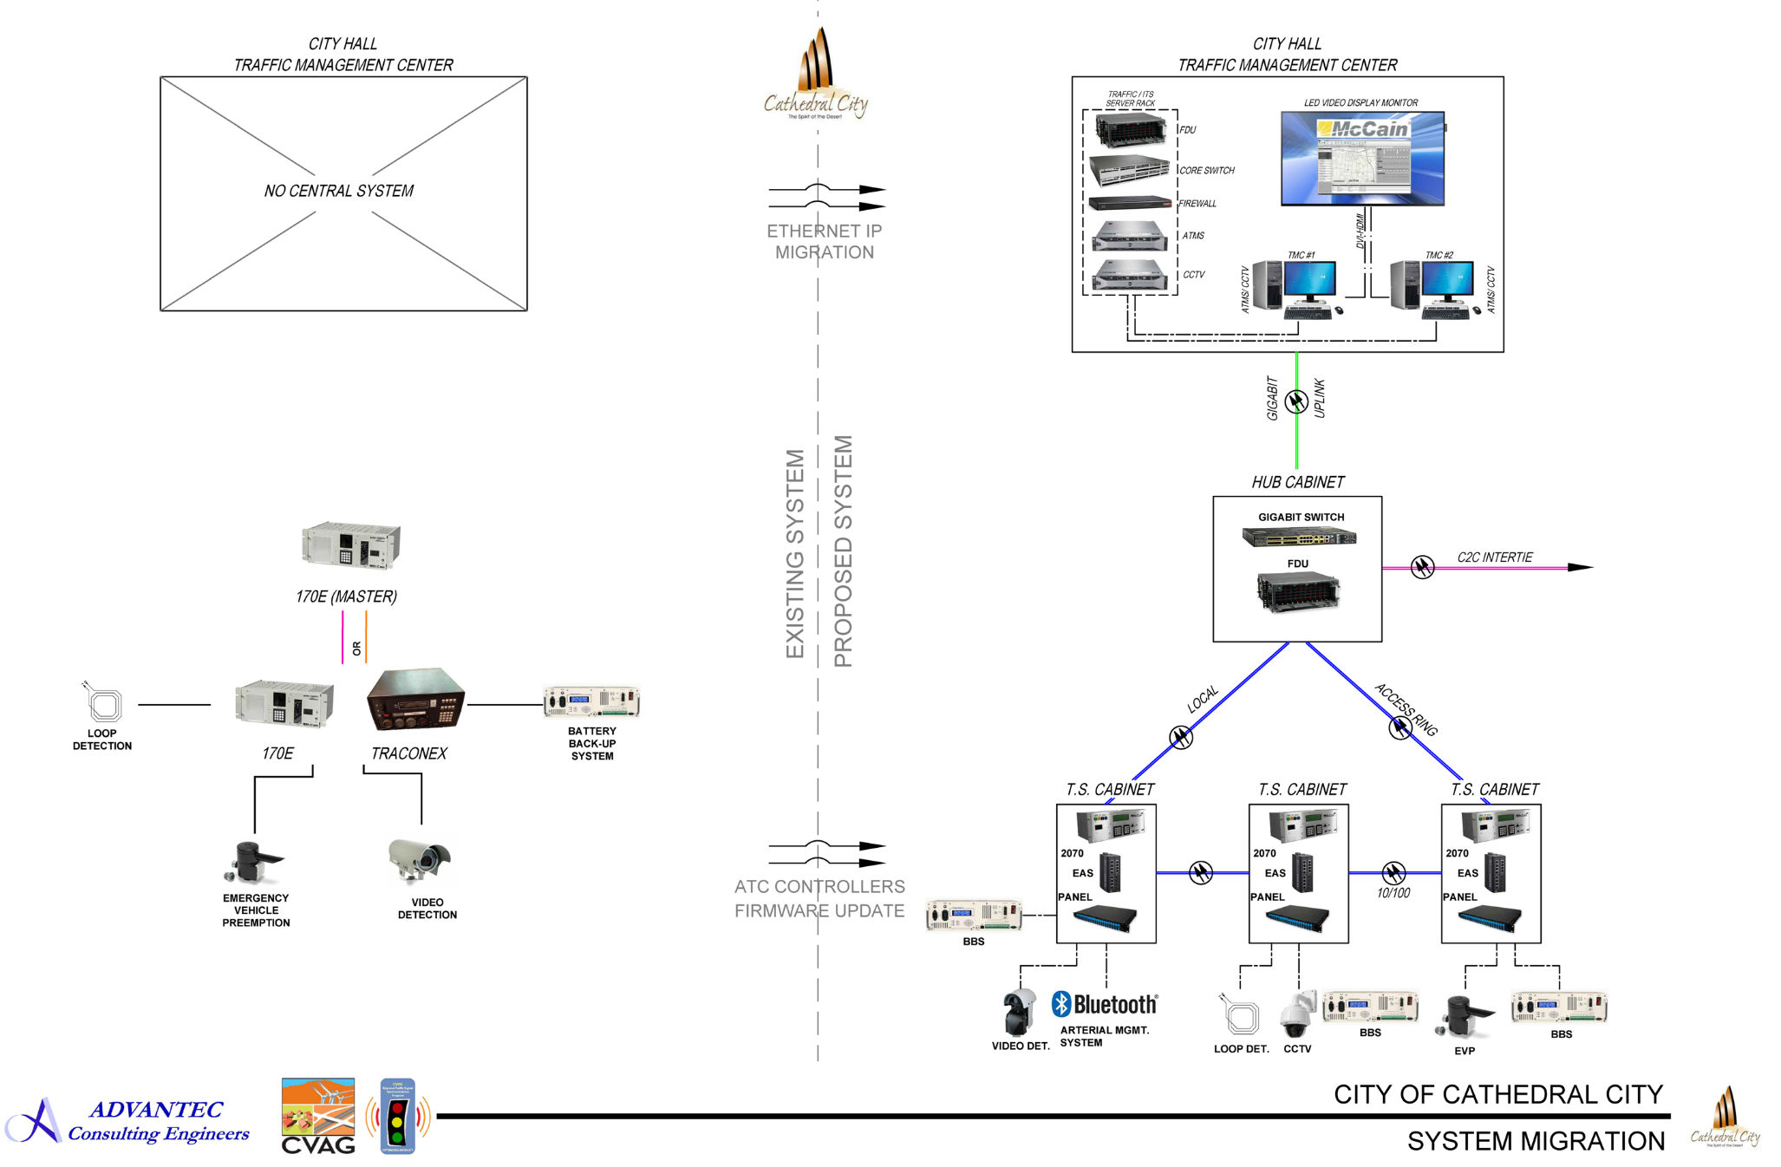
PREPARING THE COACHELLA VALLEY FOR A SMART REGION
STATE-OF-THE-ART LOCAL
TRAFFIC MANAGEMENT CENTERS – CITY OF CATHEDRAL CITY (New)

Slide 13
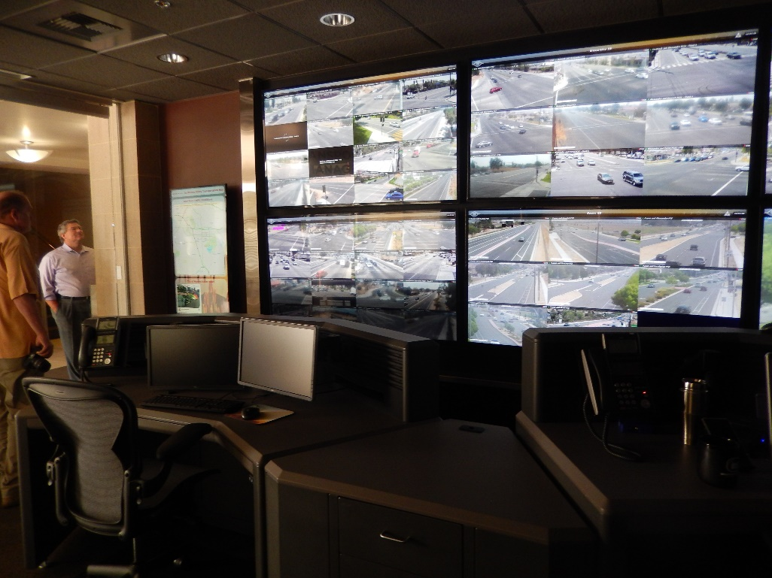
PREPARING THE COACHELLA VALLEY FOR A SMART REGION
STATE-OF-THE-ART LOCAL
TRAFFIC MANAGEMENT CENTERS – CITY OF CATHEDRAL CITY (New)
No Existing TMC
New TMC

Slide 14
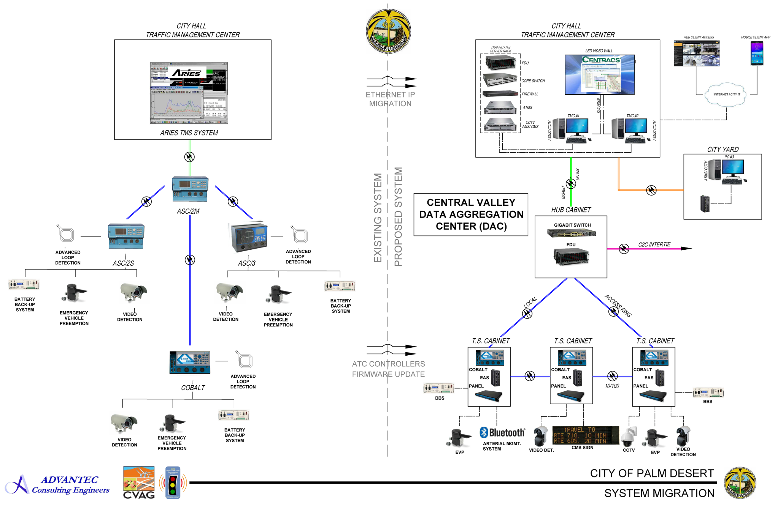
PREPARING THE COACHELLA VALLEY FOR A SMART REGION
STATE-OF-THE-ART LOCAL
TRAFFIC MANAGEMENT CENTERS – CITY OF PALM DESERT
(Upgrade)

Slide 15
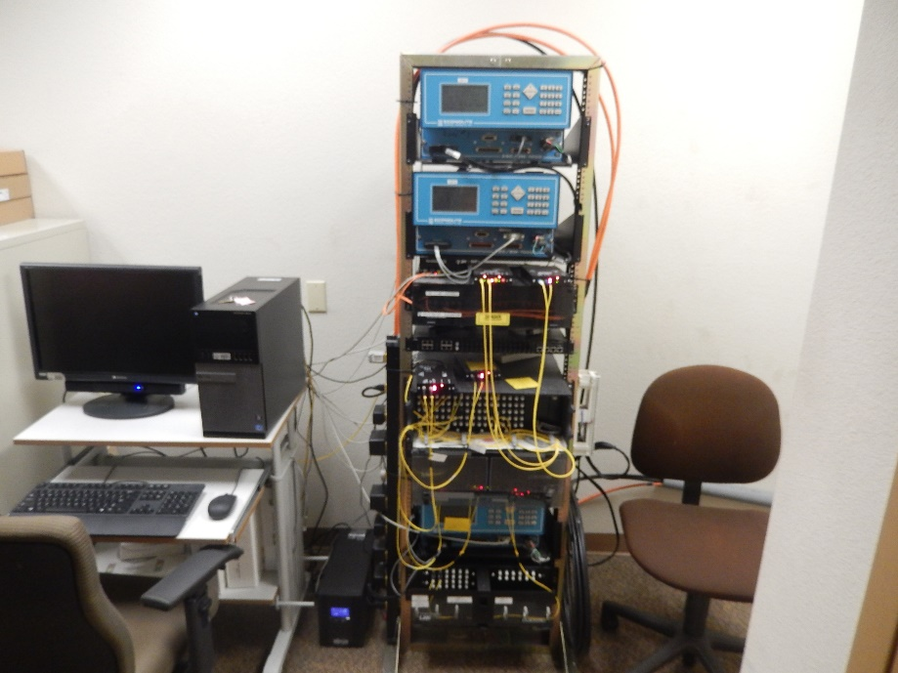
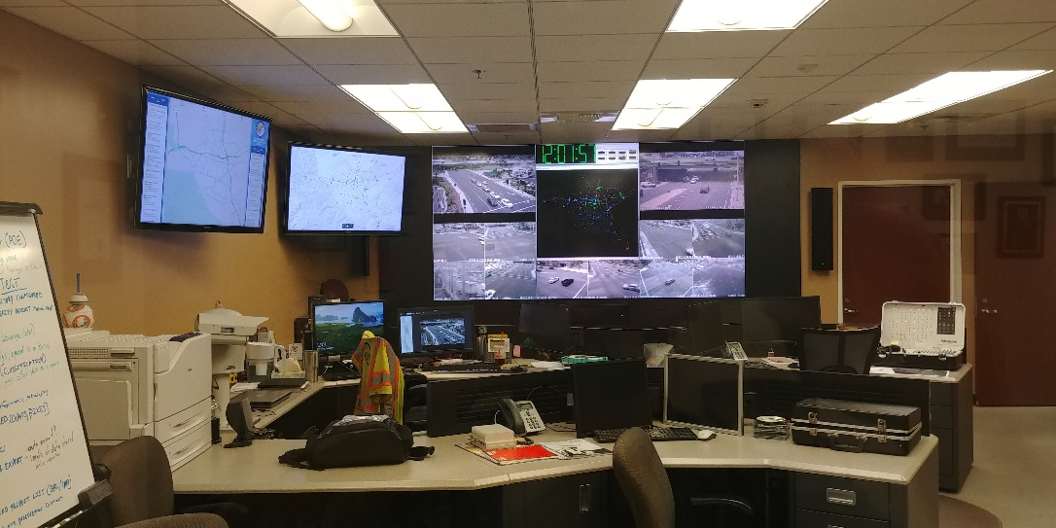
PREPARING THE COACHELLA VALLEY FOR A SMART REGION
STATE-OF-THE-ART LOCAL
TRAFFIC MANAGEMENT CENTERS – CITY OF PALM DESERT
(Upgrade)
Existing TMC
Tentative TMC Upgrades

Slide 16
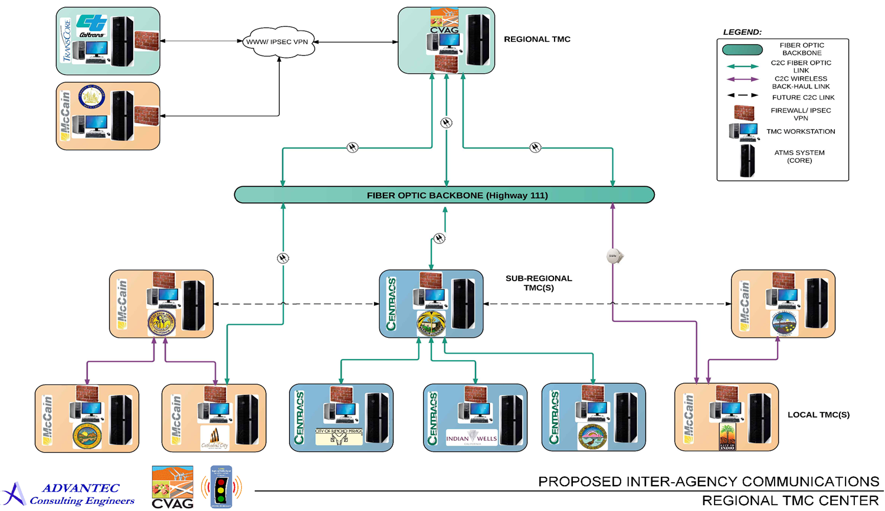
PREPARING THE COACHELLA VALLEY FOR A SMART REGION
REGIONAL
TRAFFIC MANAGEMENT CENTER – CVAG

Slide 17
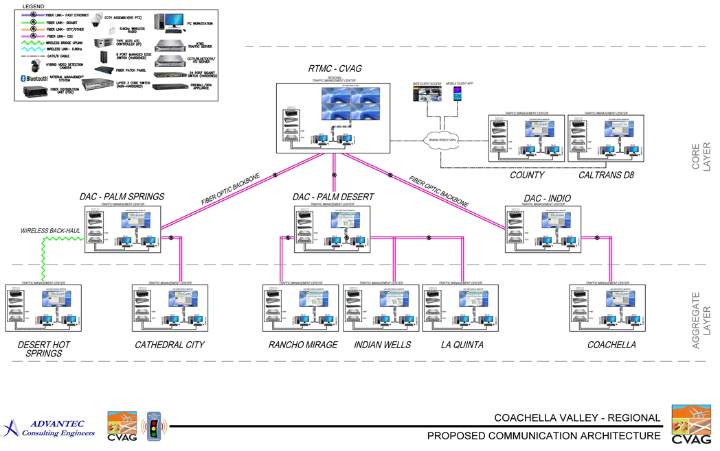
PREPARING THE COACHELLA VALLEY FOR A SMART REGION
REGIONAL
TRAFFIC MANAGEMENT CENTER – CVAG

Slide 18
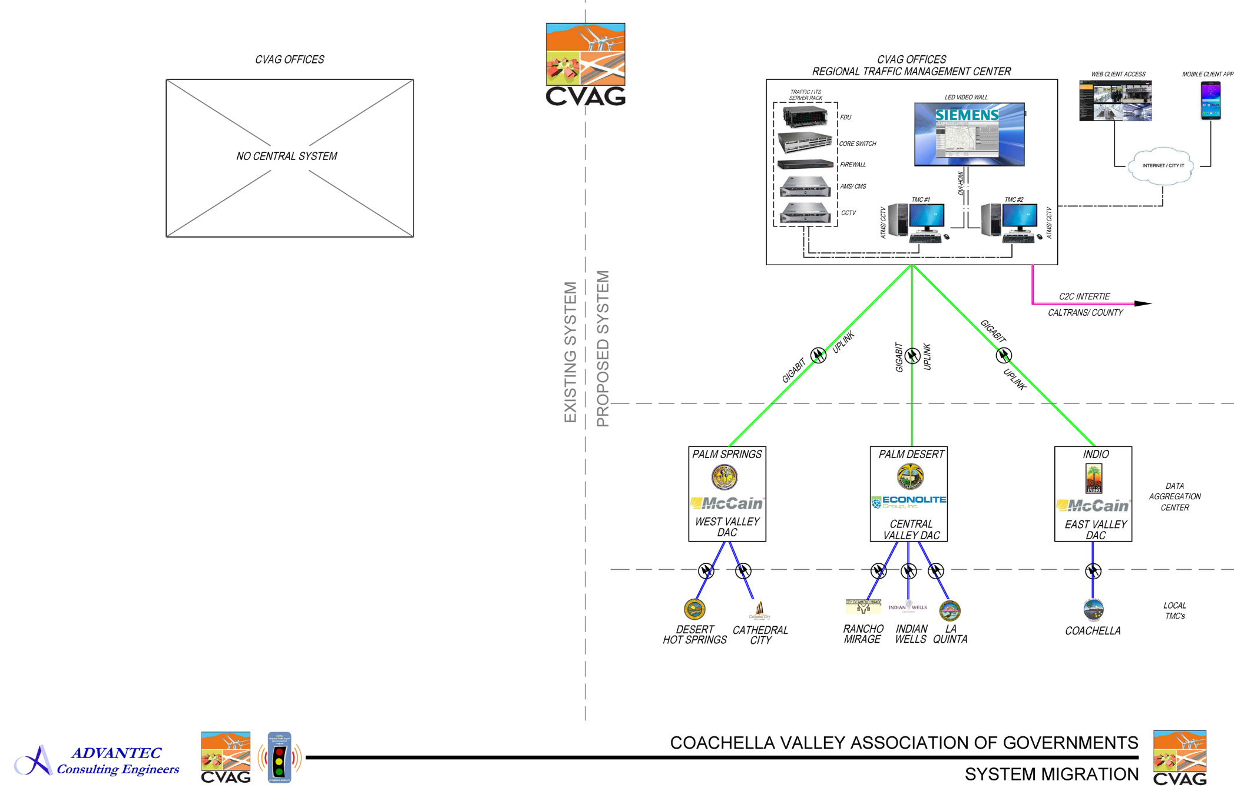
PREPARING THE COACHELLA VALLEY FOR A SMART REGION
REGIONAL
TRAFFIC MANAGEMENT CENTER – CVAG

Slide 19
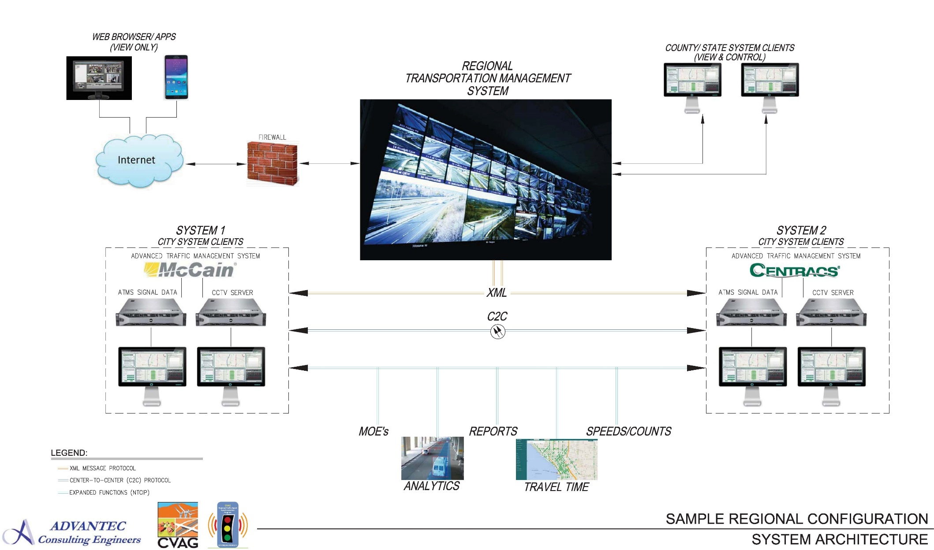
PREPARING THE COACHELLA VALLEY FOR A SMART REGION
REGIONAL
TRAFFIC MANAGEMENT CENTER – CVAG

Slide 20
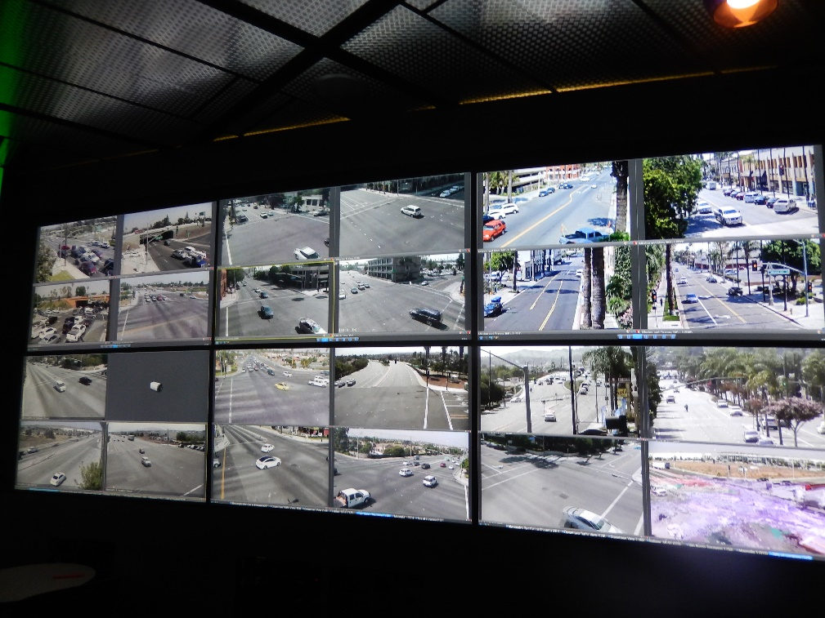
COACHELLA VALLEY TRAFFIC SIGNAL SYNCHRONIZATION PROGRAM – PREPARING THE COACHELLA VALLEY FOR A SMART REGION
REGIONAL
TRAFFIC MANAGEMENT CENTER – CVAG
No Existing TMC
New TMC

