Slide 1
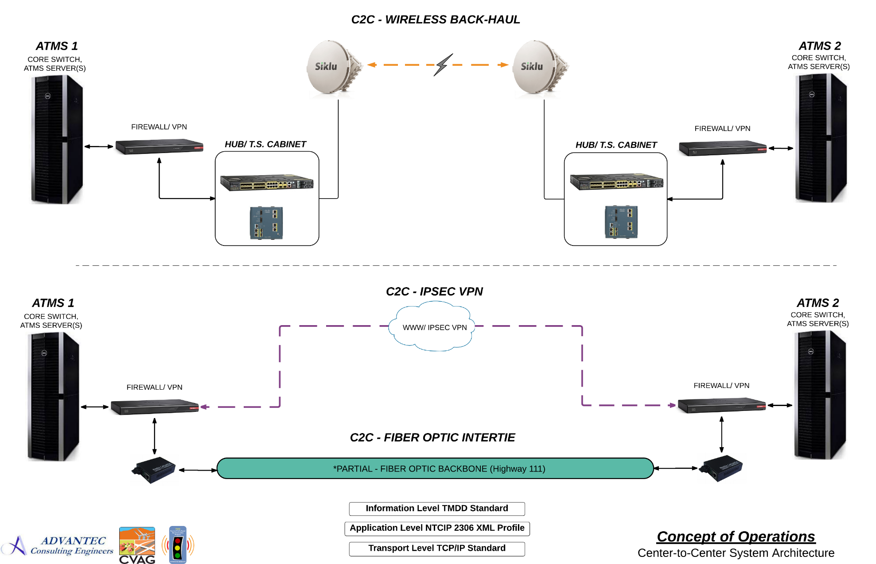

PREPARING THE COACHELLA VALLEY FOR A SMART REGION
CENTER-TO-CENTER COMMUNICATIONS (C2C)

Slide 2
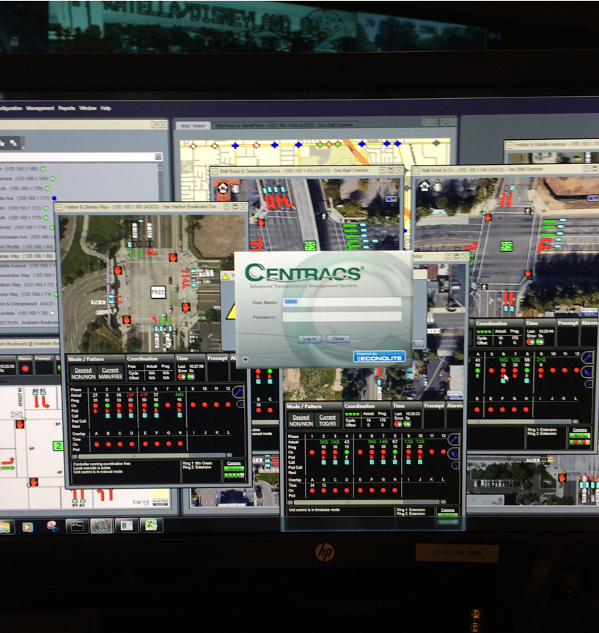
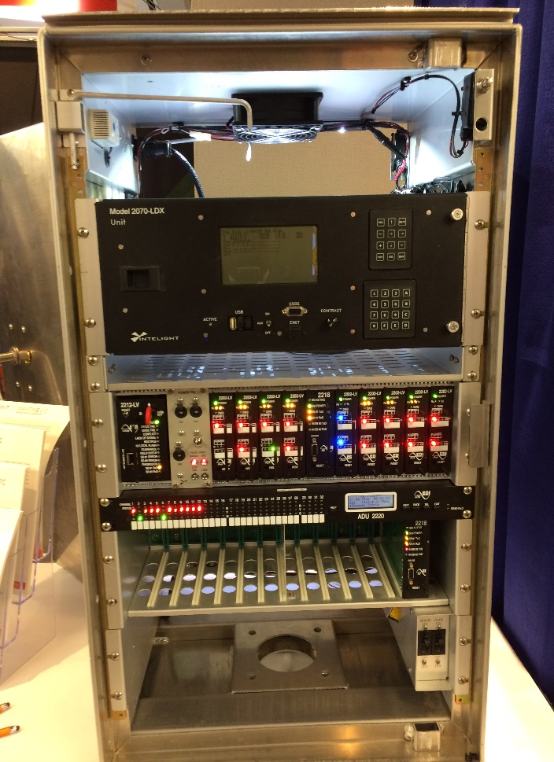
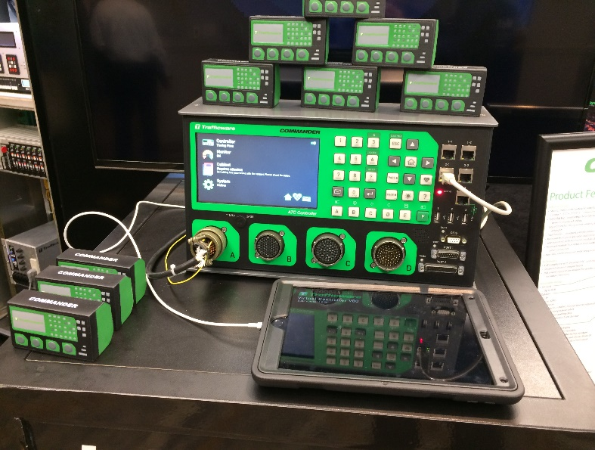

PREPARING THE COACHELLA VALLEY FOR A SMART REGION
NEW ATC
2070 ATC TRAFFIC SIGNAL CONTROLLERS
AND
CENTRALIZED TRAFFIC MANAGEMENT SYSTEMS

Slide 3
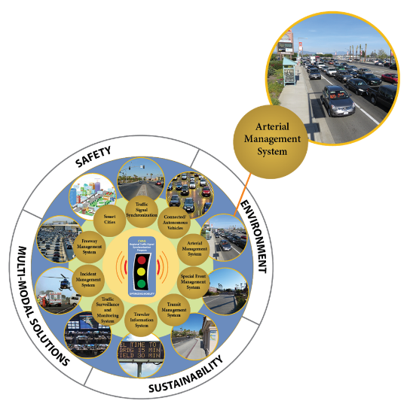
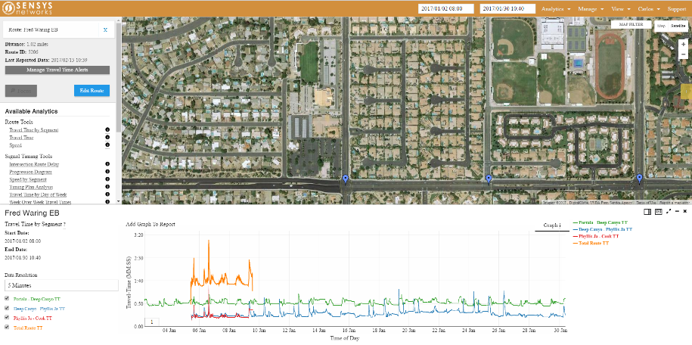
PREPARING THE COACHELLA VALLEY FOR A SMART REGION
REGIONAL
ARTERIAL PERFORMANCE MEASUREMENTS SYSTEMS (APEMS)

Slide 4
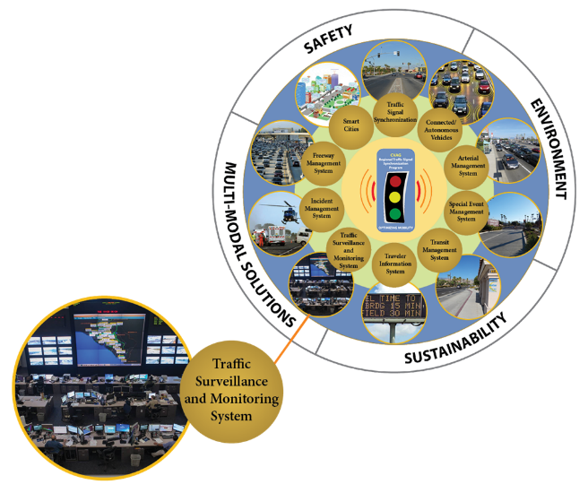
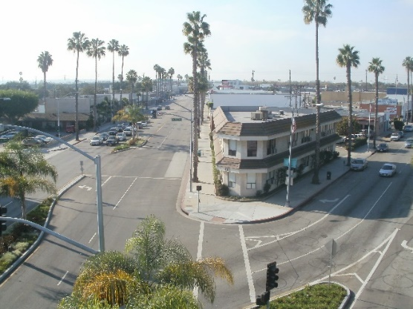
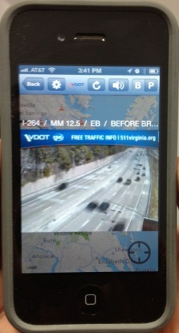
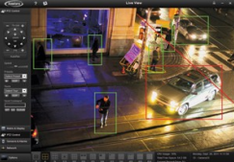
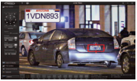
PREPARING THE COACHELLA VALLEY FOR A SMART REGION
REGIONAL
TRAFFIC SURVEILLANCE AND MONITORING SYSTEMS

Slide 5
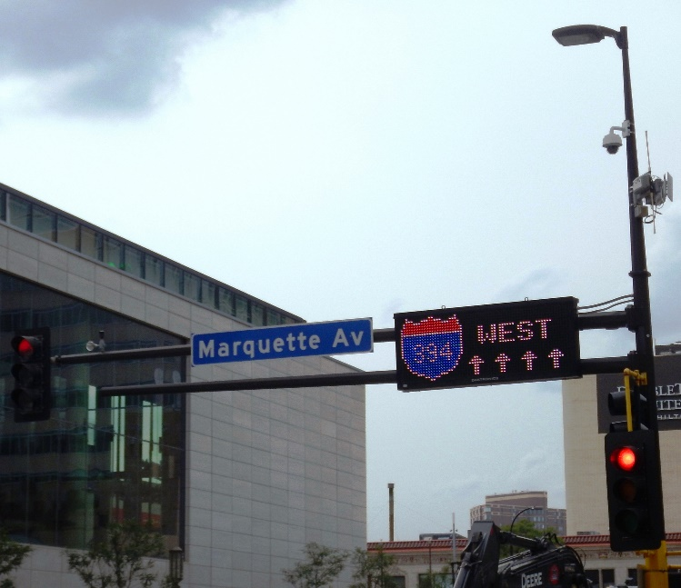
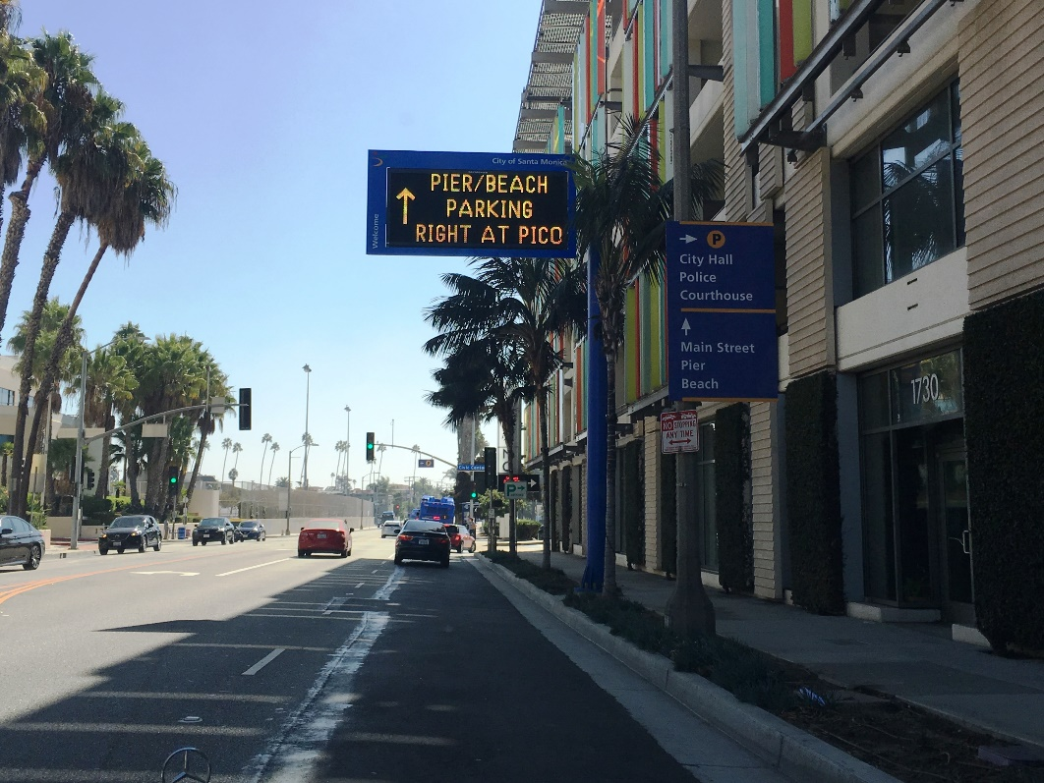
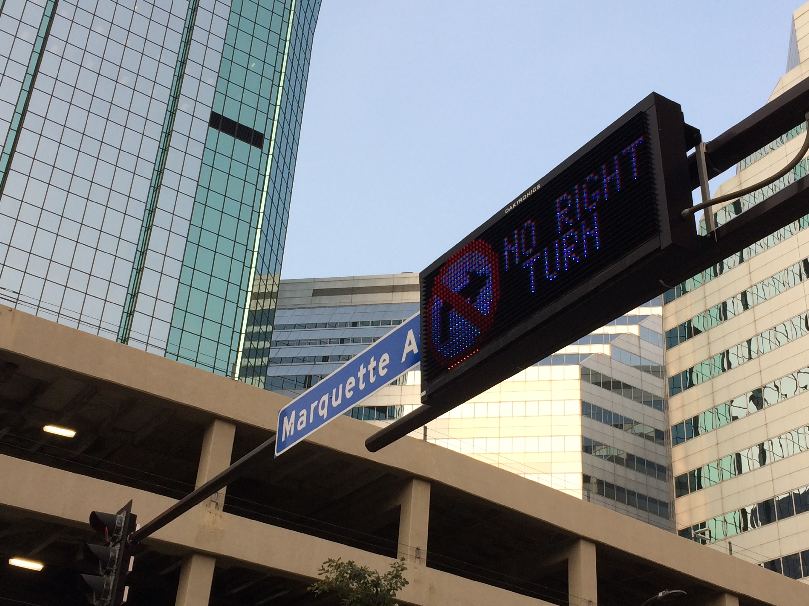
PREPARING THE COACHELLA VALLEY FOR A SMART REGION
CHANGEABLE MESSAGE SIGNS / DYNAMINC MESSAGE SIGNS (CMS/DMS)

Slide 6
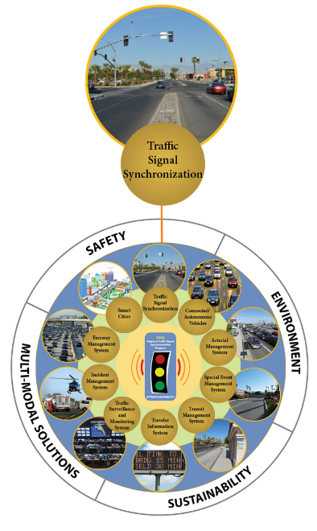
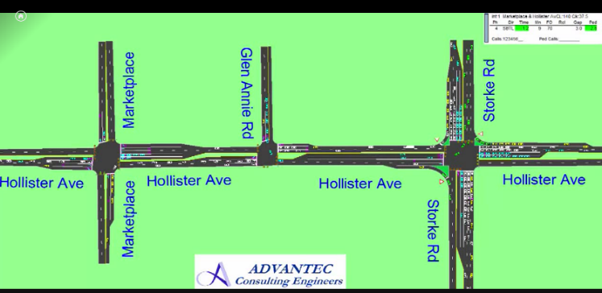
PREPARING THE COACHELLA VALLEY FOR A SMART REGION
REGIONAL
TRAFFIC SIGNAL SYNCHRONIZATION

Slide 7
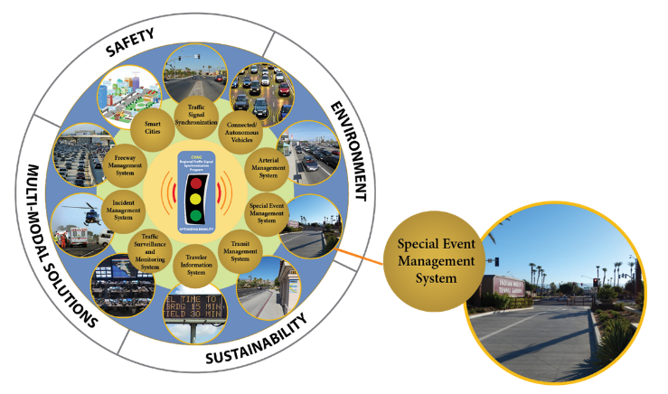
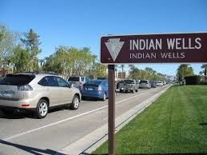

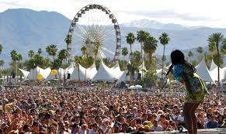
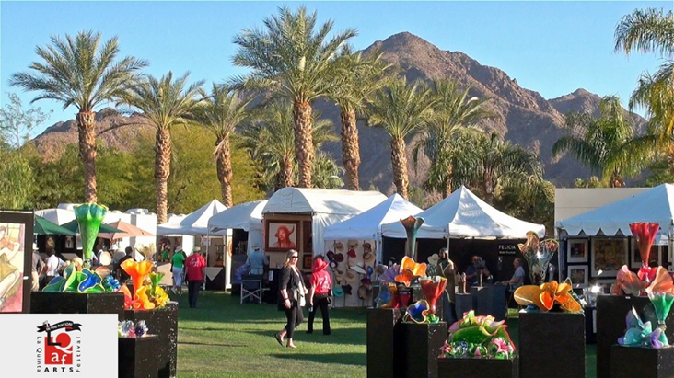
PREPARING THE COACHELLA VALLEY FOR A SMART REGION
REGIONAL
SPECIAL EVENT MANAGEMENT

Slide 8

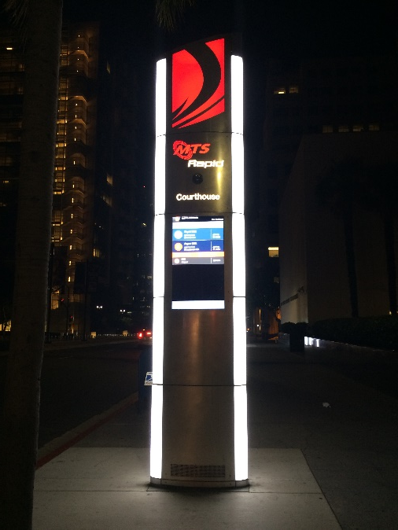
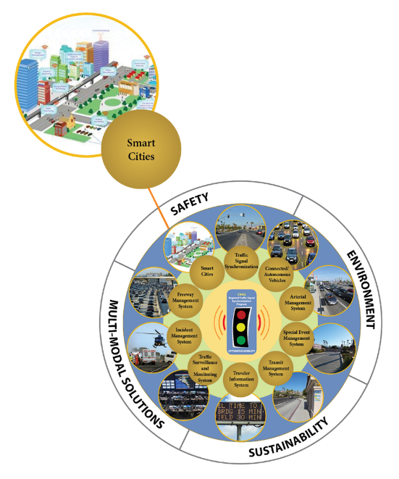
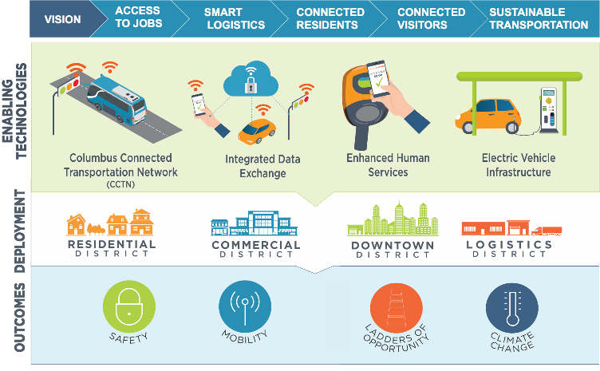
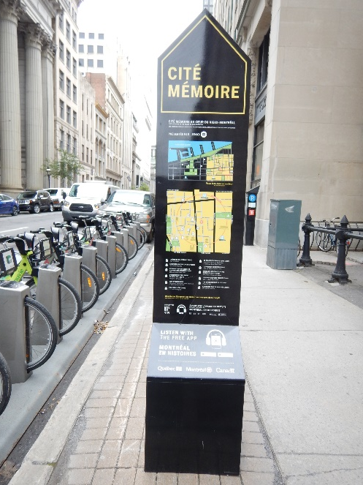
PREPARING THE COACHELLA VALLEY FOR A SMART REGION
SMART REGION (CITIES) TRANSPORTATION TECHNOLOGIES

Slide 9
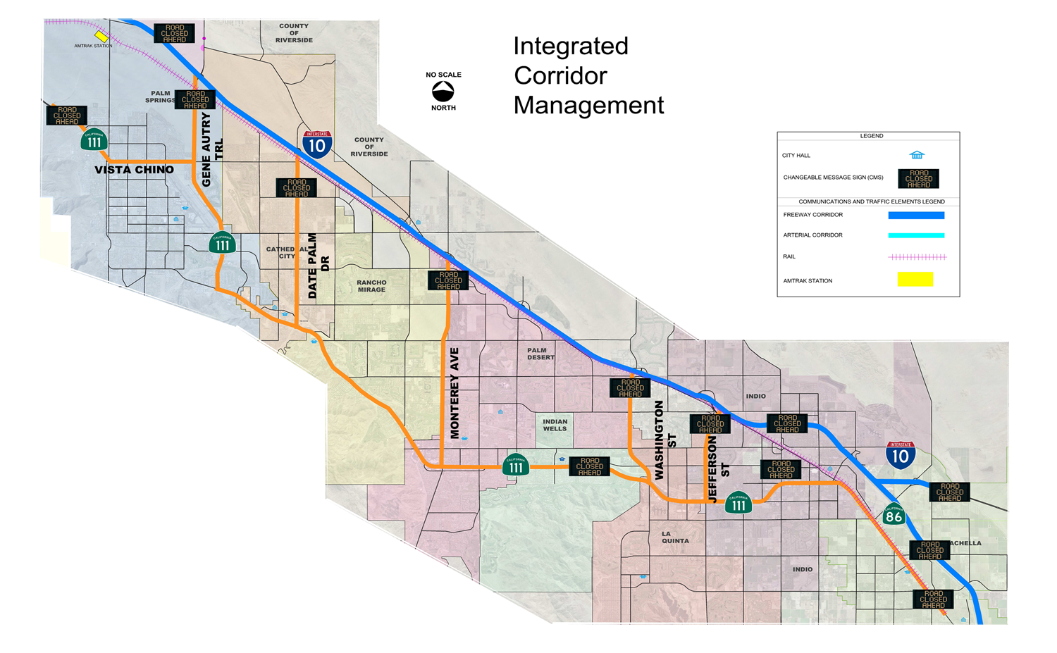
PREPARING THE COACHELLA VALLEY FOR A SMART REGION
OPPORTUNITIES FOR INTEGRATED CORRIDOR MANAGEMENT (ICM)

Slide 10
PREPARING THE COACHELLA VALLEY FOR A SMART REGION
SMART CITIES (REGION) -
TRANSPORTATION SYSTEMS MANAGEMENT AND OPERATIONS (TSM&O) COMMITTEE

