Slide 1
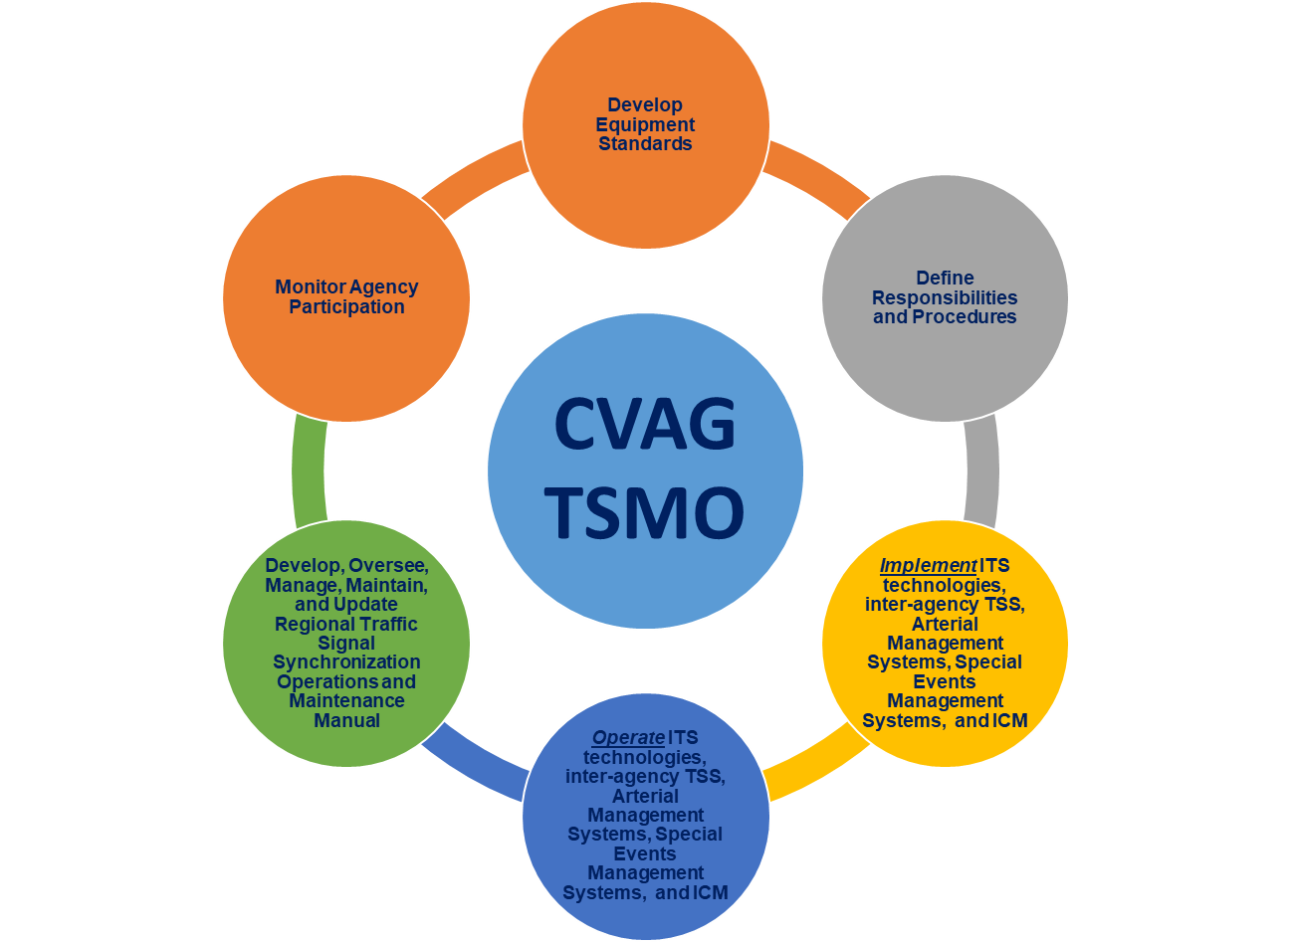
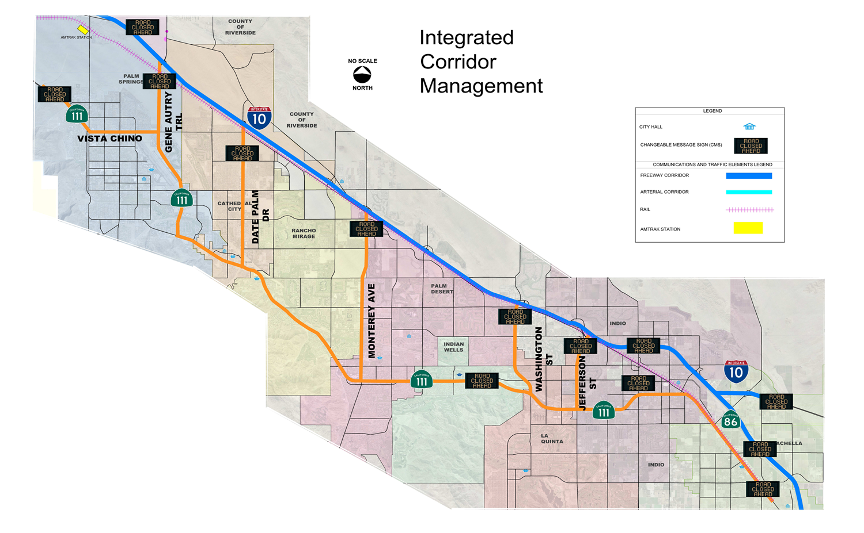
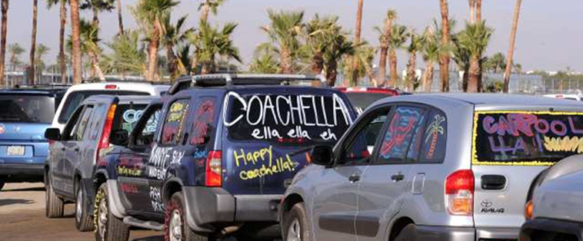
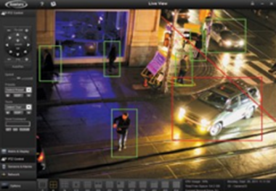
PREPARING THE COACHELLA VALLEY FOR A SMART REGION
TRANSPORTATION SYSTEMS MANAGEMENT AND OPERATIONS (TSM&O) COMMITTEE

Slide 2
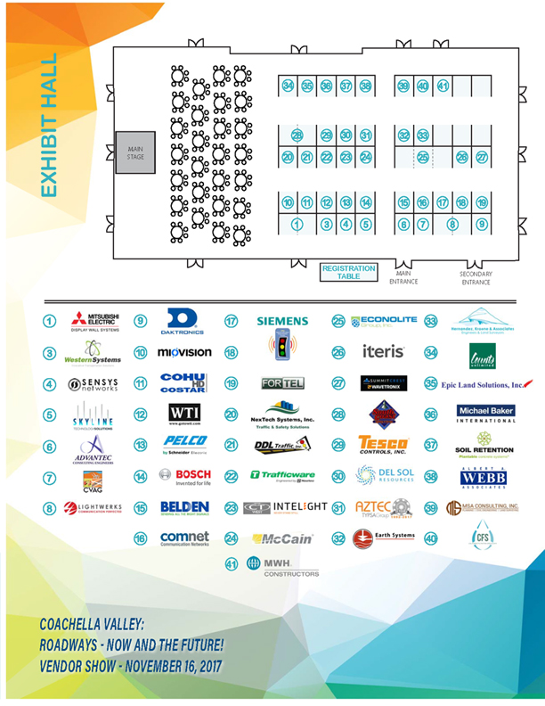
PREPARING THE COACHELLA VALLEY FOR A SMART REGION
TRANSPORTATION SYSTEMS MANAGEMENT AND OPERATIONS (TSM&O) COMMITTEE
November 16, 2017 Vendor Show

Slide 3
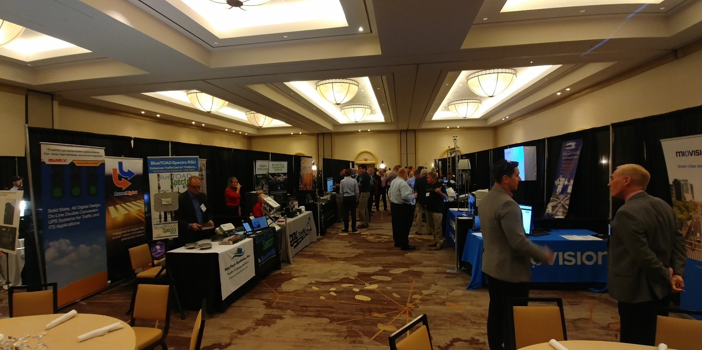
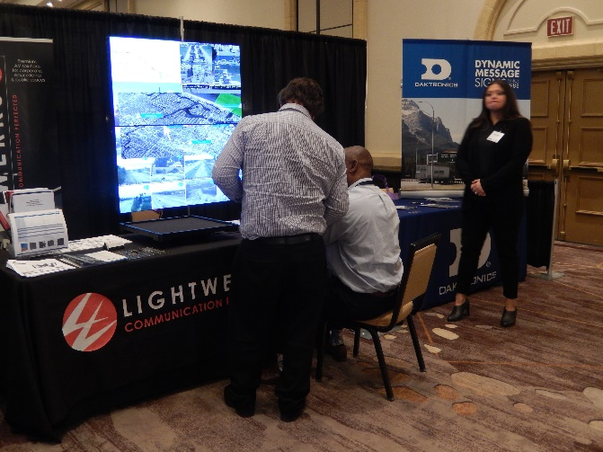
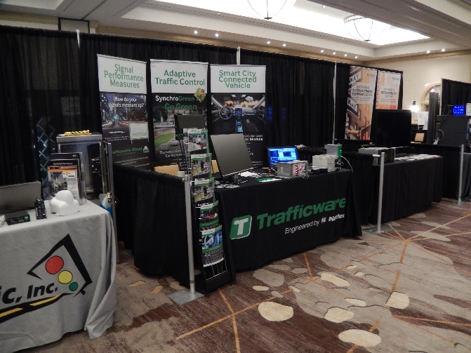
PREPARING THE COACHELLA VALLEY FOR A SMART REGION
TRANSPORTATION SYSTEMS MANAGEMENT AND OPERATIONS (TSM&O) COMMITTEE
November 16, 2017 Vendor Show

Slide 4
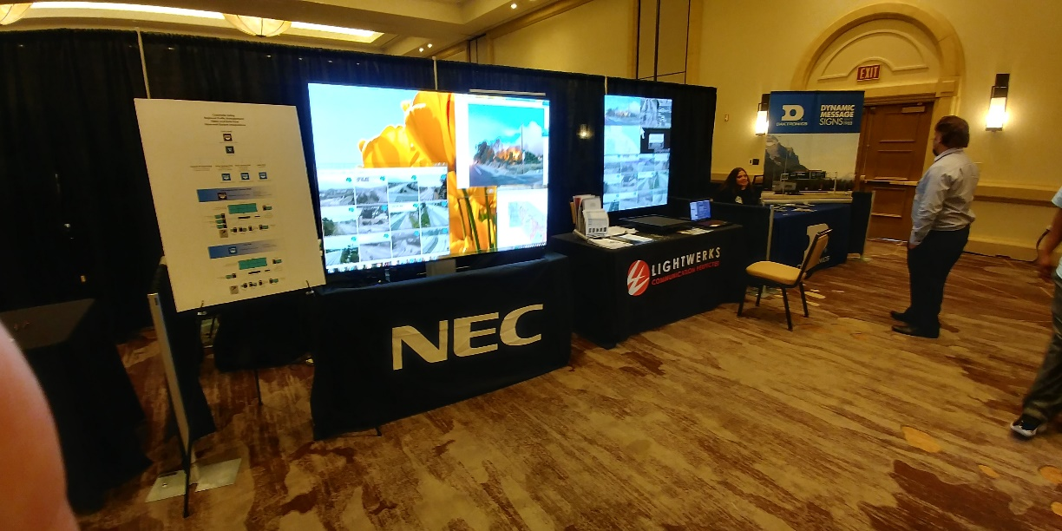
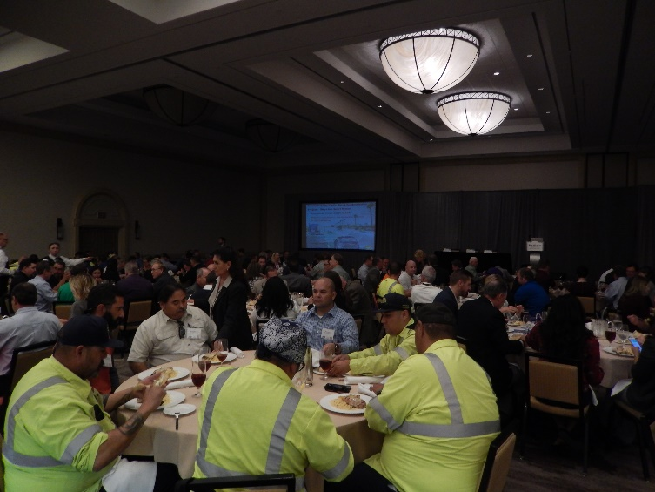
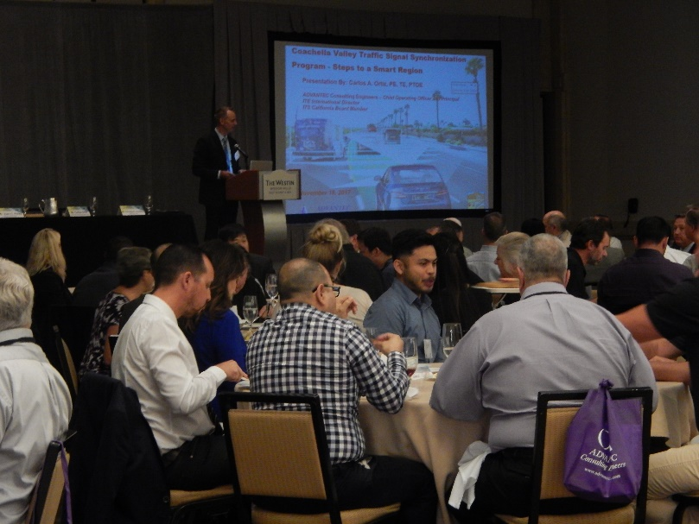
PREPARING THE COACHELLA VALLEY FOR A SMART REGION
TRANSPORTATION SYSTEMS MANAGEMENT AND OPERATIONS (TSM&O) COMMITTEE
November 16, 2017 Vendor Show

Slide 5
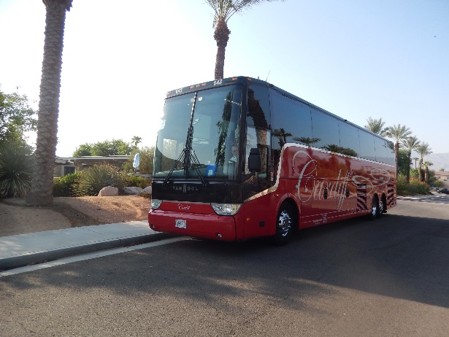
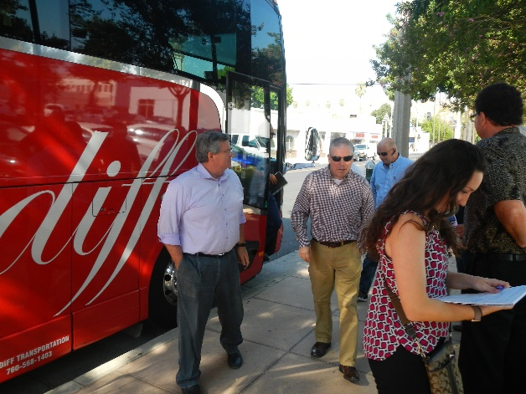
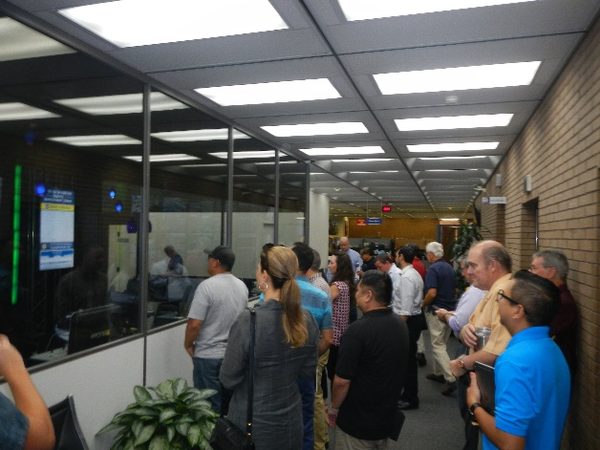
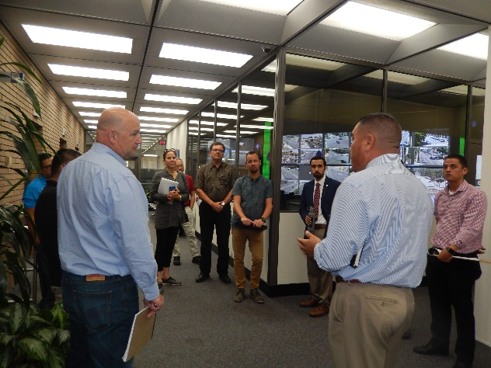
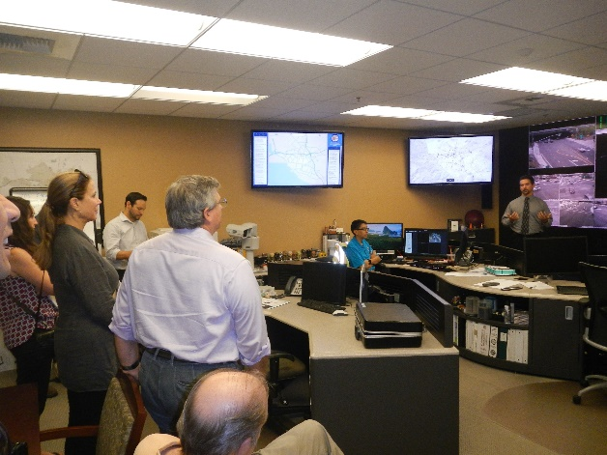
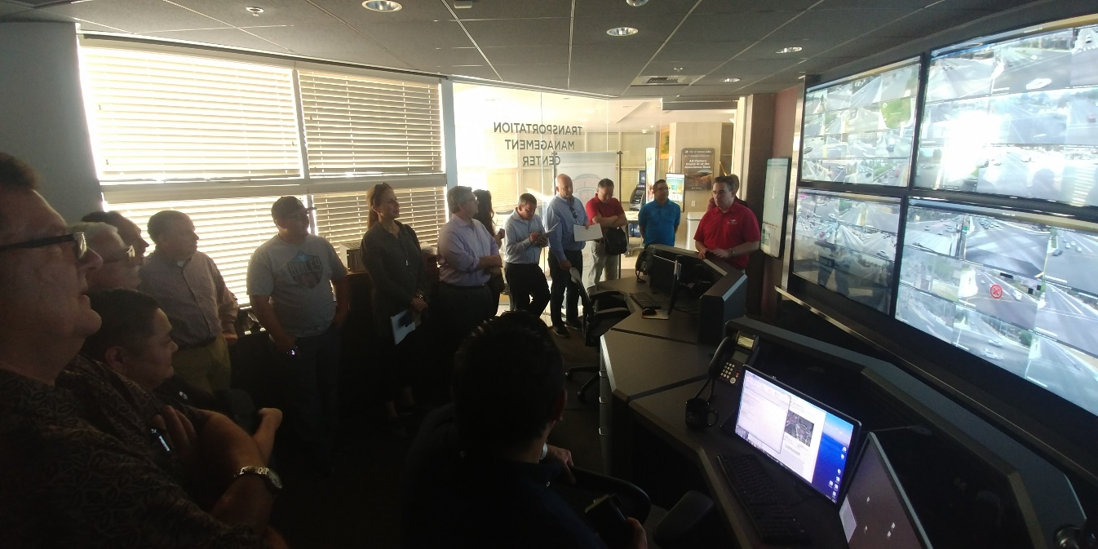
PREPARING THE COACHELLA VALLEY FOR A SMART REGION
TRANSPORTATION SYSTEMS MANAGEMENT AND OPERATIONS (TSM&O) COMMITTEE
TMCs TOUR

Slide 6
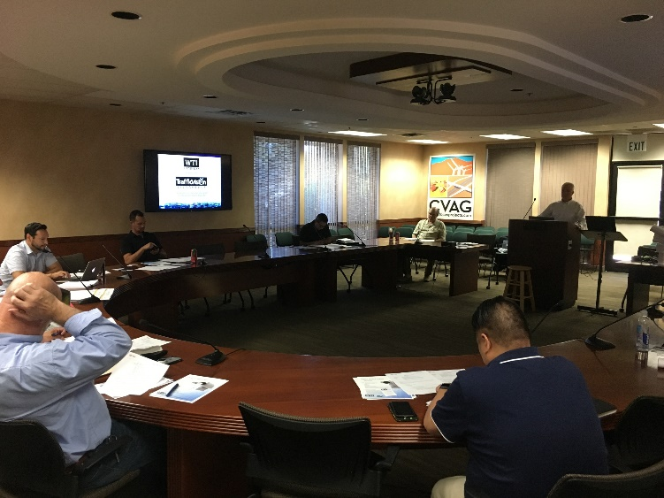
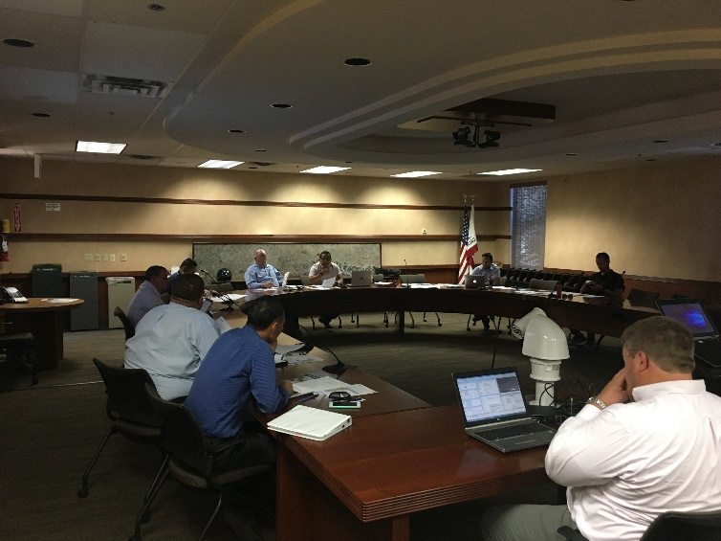
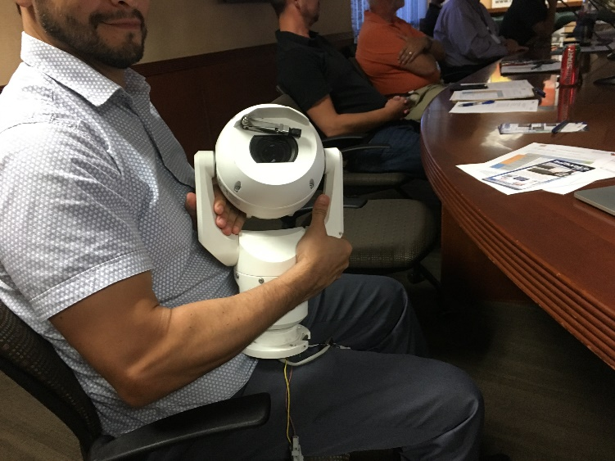
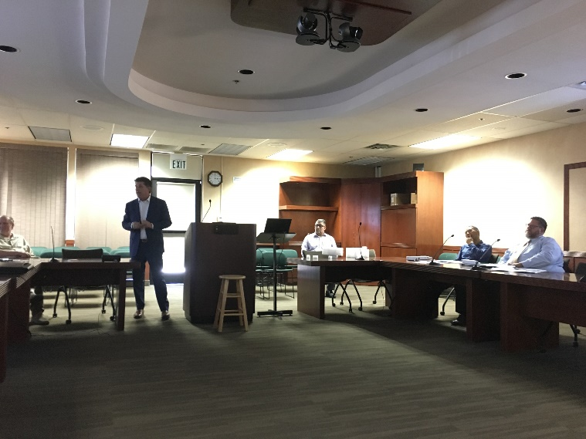
PREPARING THE COACHELLA VALLEY FOR A SMART REGION
TRANSPORTATION SYSTEMS MANAGEMENT AND OPERATIONS (TSM&O) COMMITTEE
TECHNOLOGIES’ ASSESSMENT

Slide 7
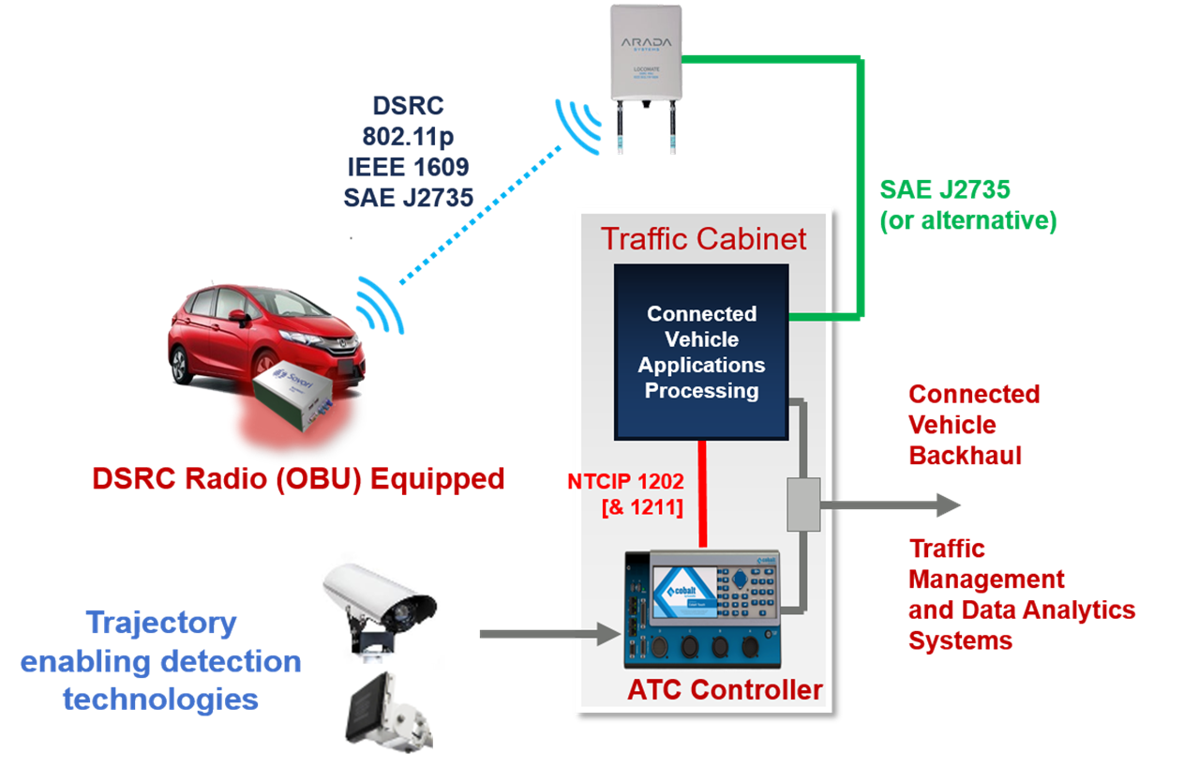
PREPARING THE COACHELLA VALLEY FOR A SMART REGION
CONNECTED VEHICLE (CV) TECHNOLOGIES
CV Ready for DRSC (V2I Communication)
2070 Controllers
Cabinets
Communications
Regional TMC
Provide SPaT to Automobile Industry

Slide 8
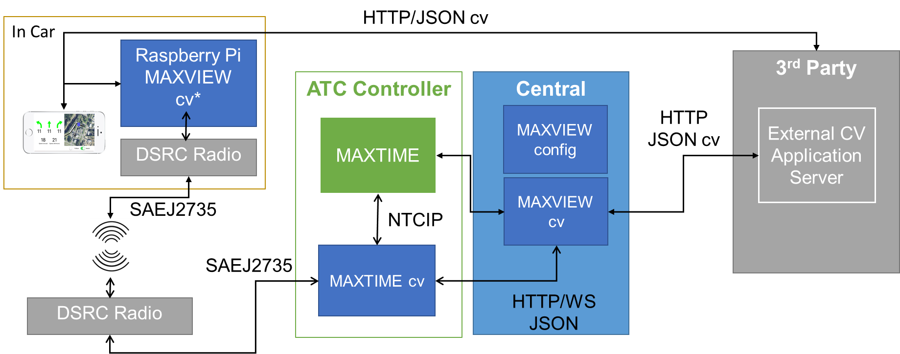
PREPARING THE COACHELLA VALLEY FOR A SMART REGION
CONNECTED VEHICLE (CV) TECHNOLOGIES

Slide 9
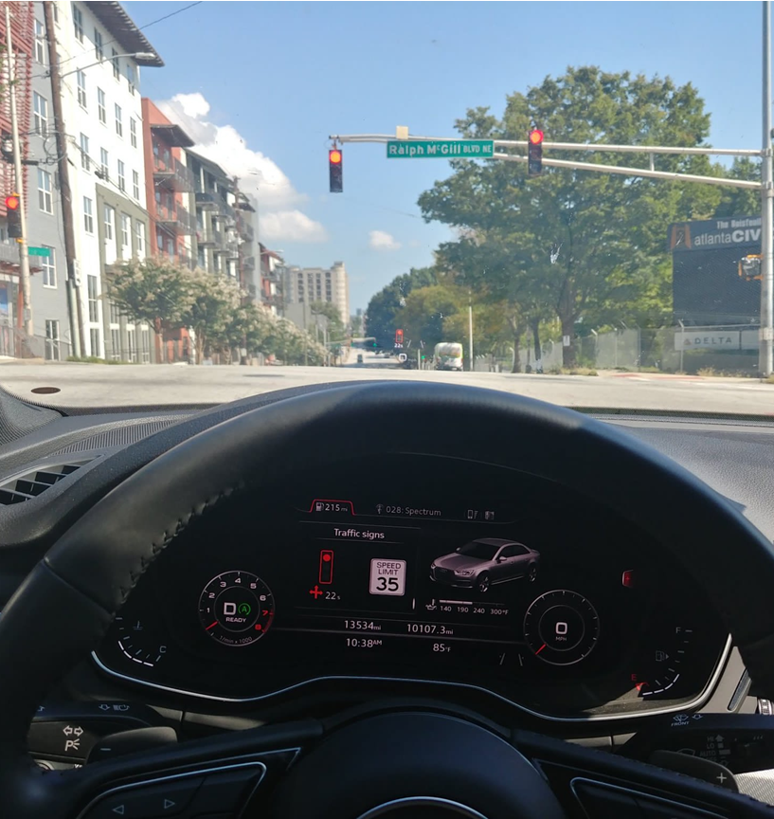
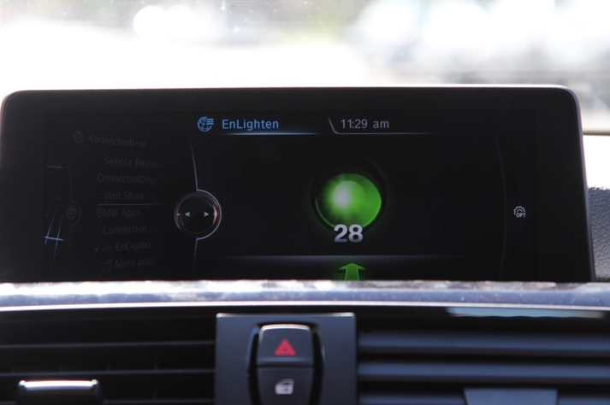
PREPARING THE COACHELLA VALLEY FOR A SMART REGION
SPaT Challenge
Challenge state and local public sector transportation Infrastructure Owners & Operators (IO&Os) to deploy DSRC infrastructure with SPaT broadcasts in at least one coordinated corridor or network (approximately 20 signalized intersections) in each state by January 2020.
Additional V2I Applications that build on SPaT are also encouraged!
CONNECTED / AUTONOMOUS VEHICLE (CAV) TECHNOLOGIES

Slide 10
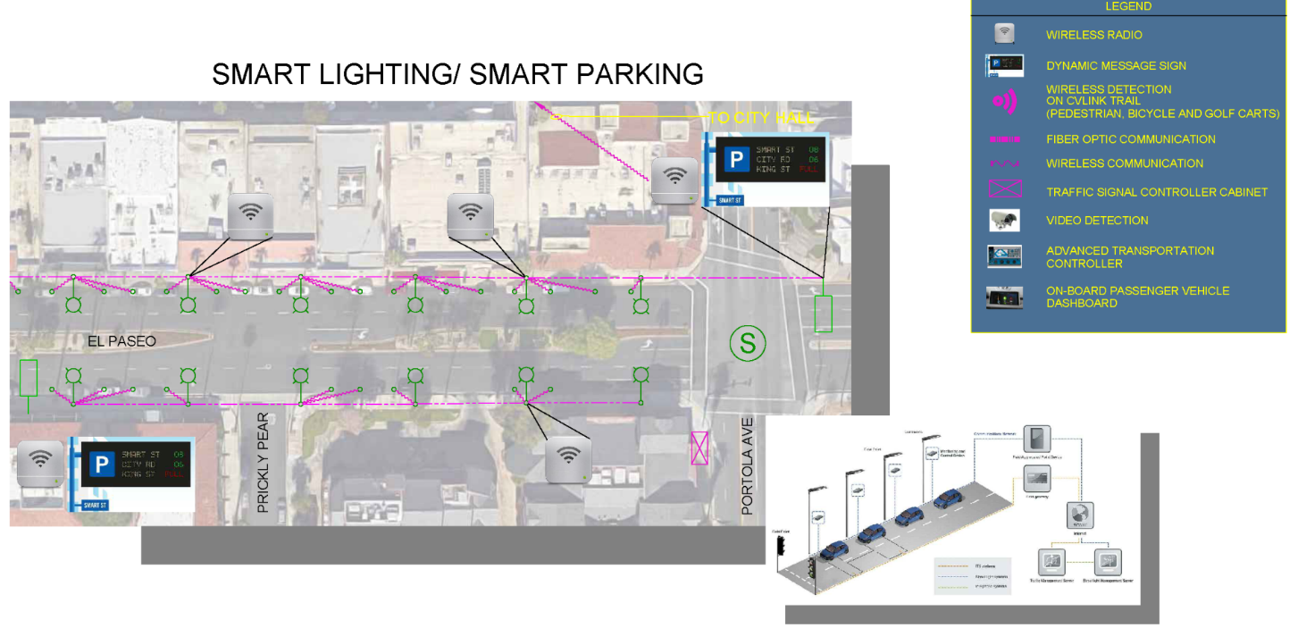
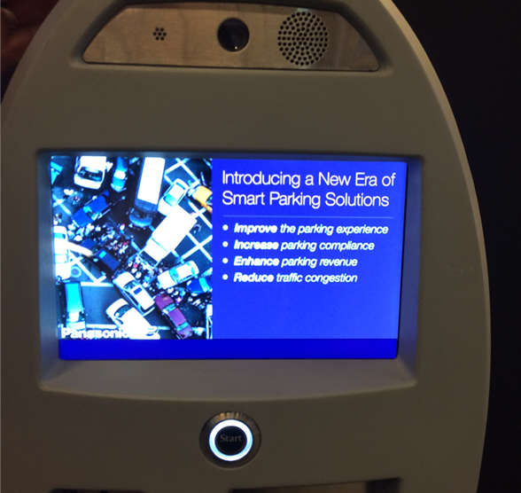
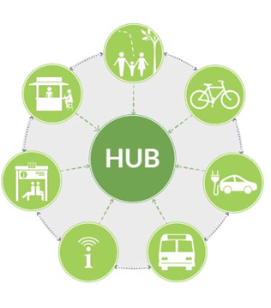
PREPARING THE COACHELLA VALLEY FOR A SMART REGION
Smart Lighting Systems
Smart Parking Systems
Transit Technologies
MaaS
Broadband Communications
READY FOR FUTURE SMART TRANSPORTATION
TECHNOLOGIES

Slide 11
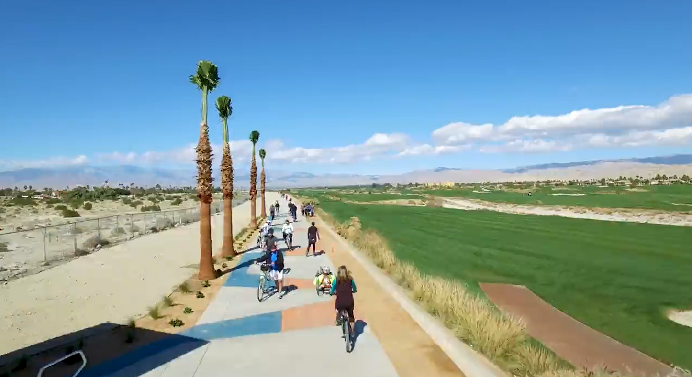
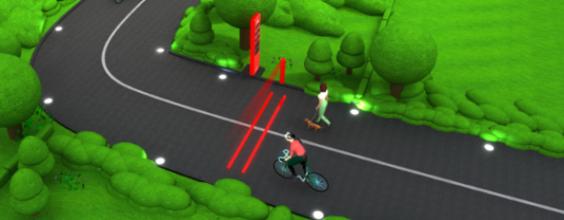
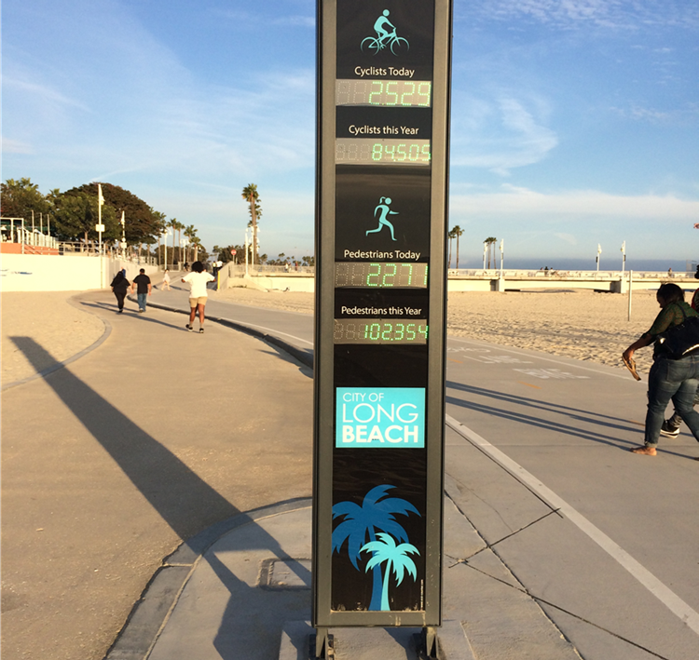
PREPARING THE COACHELLA VALLEY FOR A SMART REGION
CV Link:
50-Mile Corridor
Bicycles, Pedestrians, Low-Speed Electric Vehicles (AV)
Integrate Data/Video
READY FOR FUTURE MULTI-MODAL TRANSPORTATION
TECHNOLOGIES

Slide 12
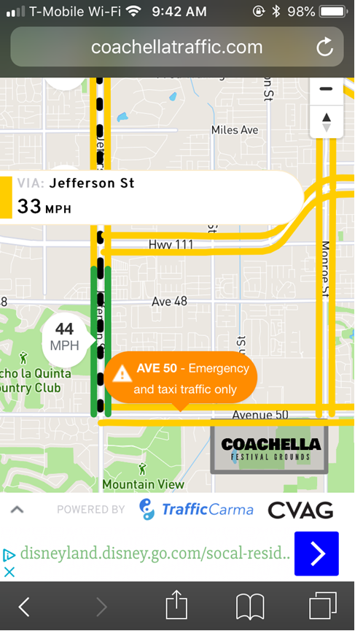
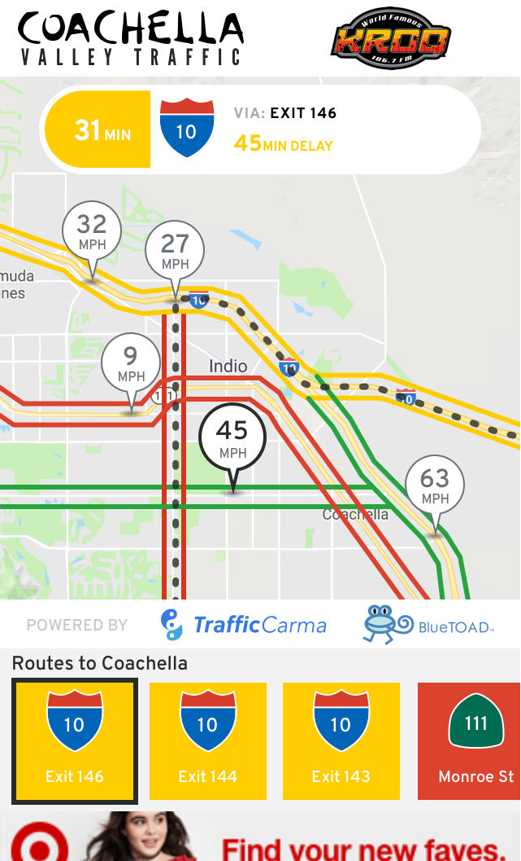
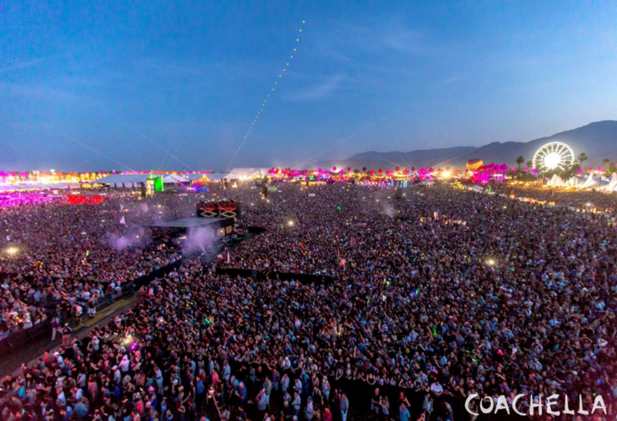
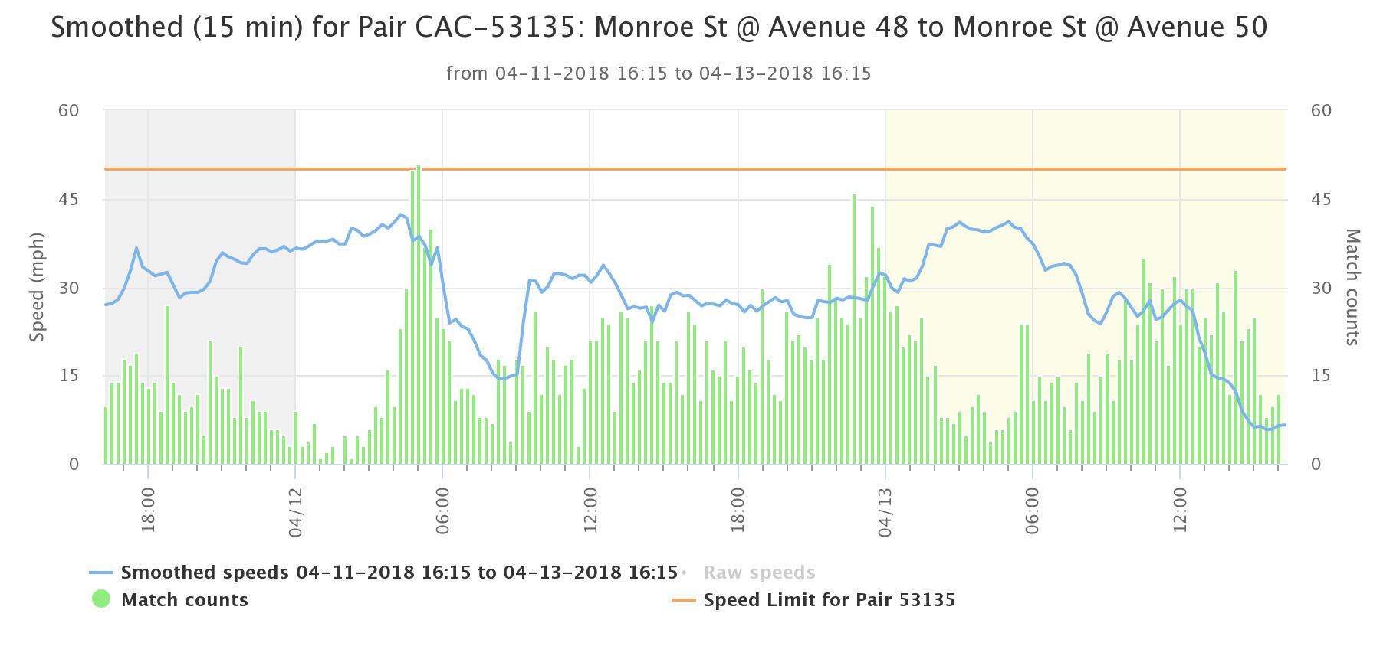
PREPARING THE COACHELLA VALLEY FOR A SMART REGION
2018 Coachella Music Festivals - Jefferson Street, Monroe Street, City of Indio (12 locations) – BlueTOAD Technology
READY FOR ITS AND CAV TECHNOLOGIES
PILOT PROJECTS

Slide 13
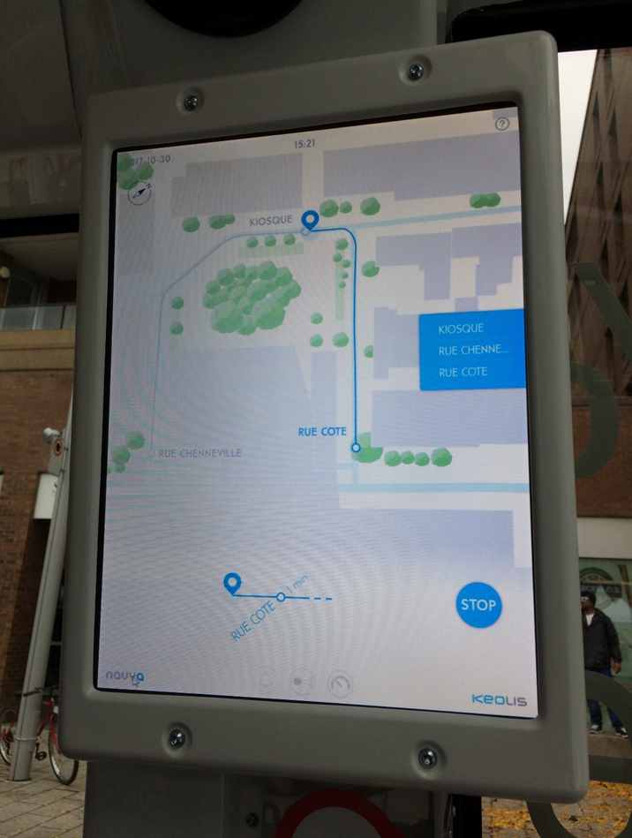
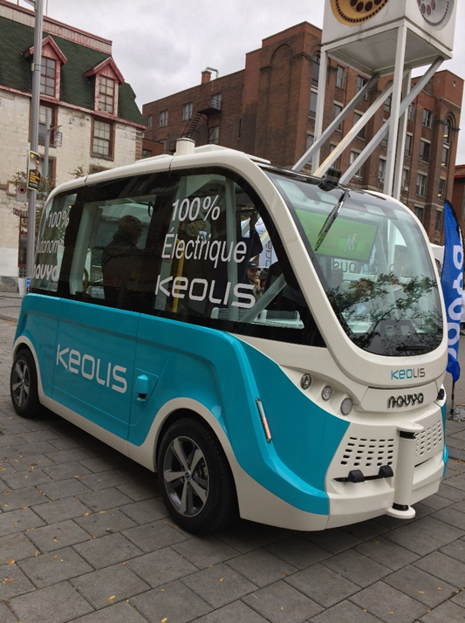
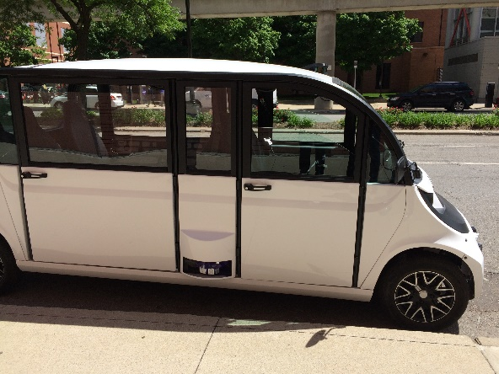
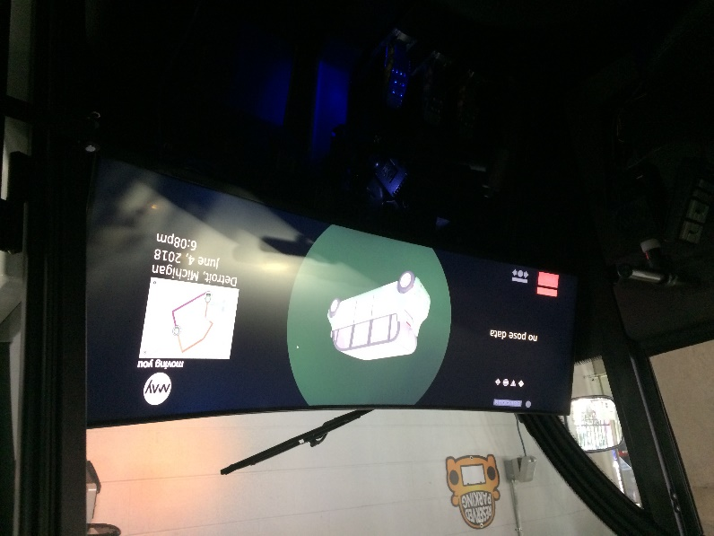
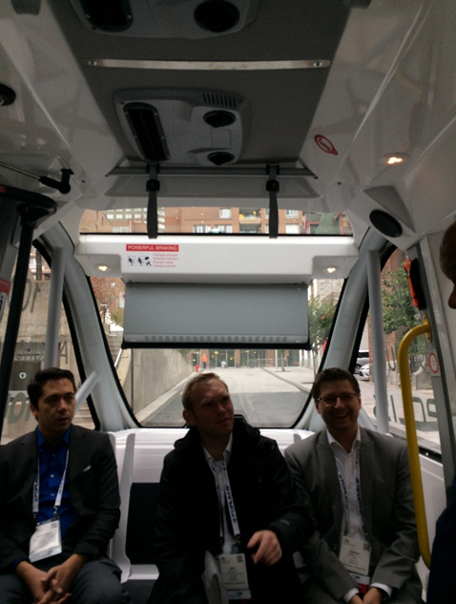
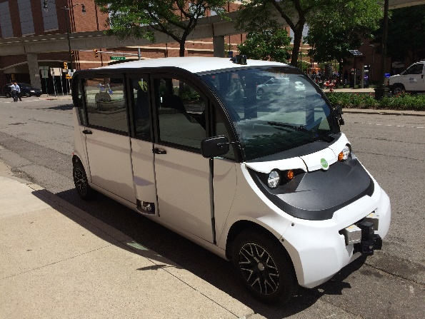
PREPARING THE COACHELLA VALLEY FOR A SMART REGION
Autonomous Shuttles
2019 SPaT Challenge
Cloud Based Technologies, 5G, etc.
Others?
READY FOR ITS AND CAV TECHNOLOGIES
PILOT PROJECTS / deployments

