Slide 1
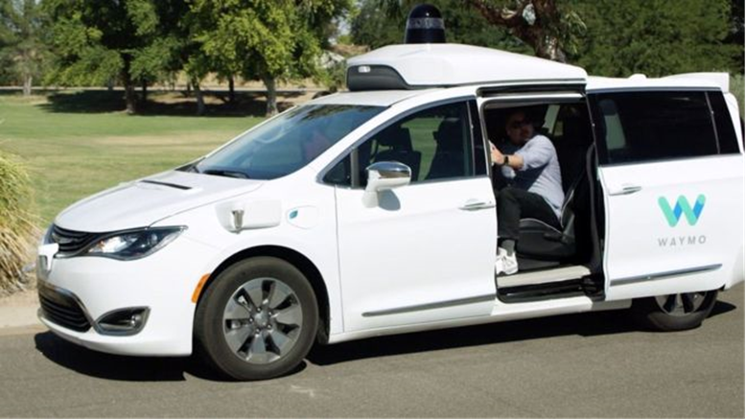
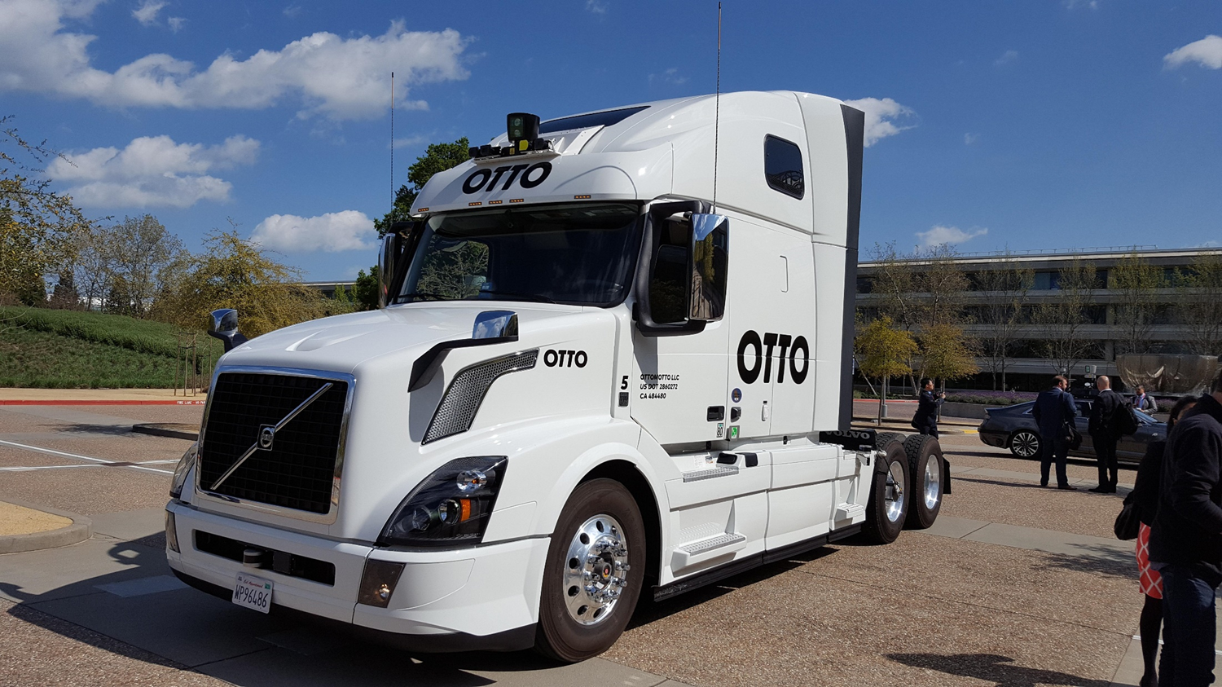
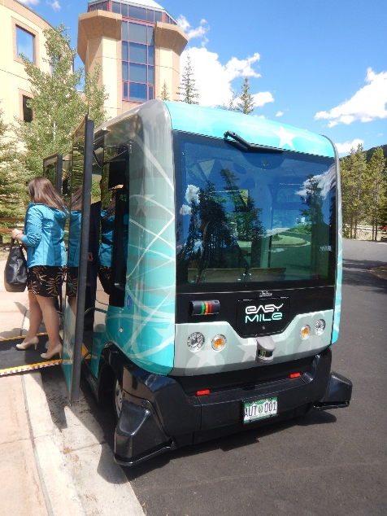
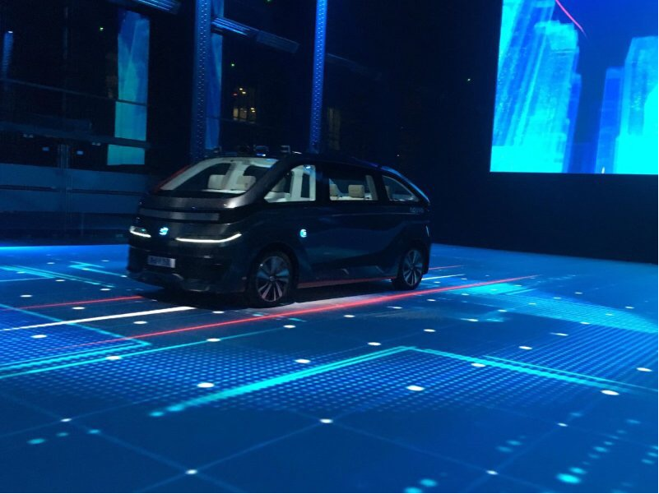
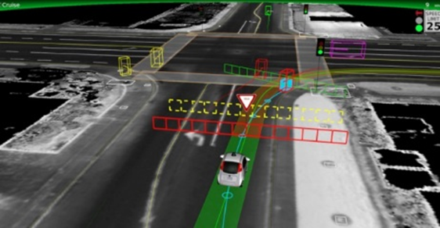
PREPARING THE COACHELLA VALLEY FOR A SMART REGION
Autonomous Shuttles
2019 SPaT Challenge
Cloud Based Technologies, 5G, etc.
Others?
READY FOR ITS AND CAV TECHNOLOGIES
PILOT PROJECTS / deployments

Slide 2
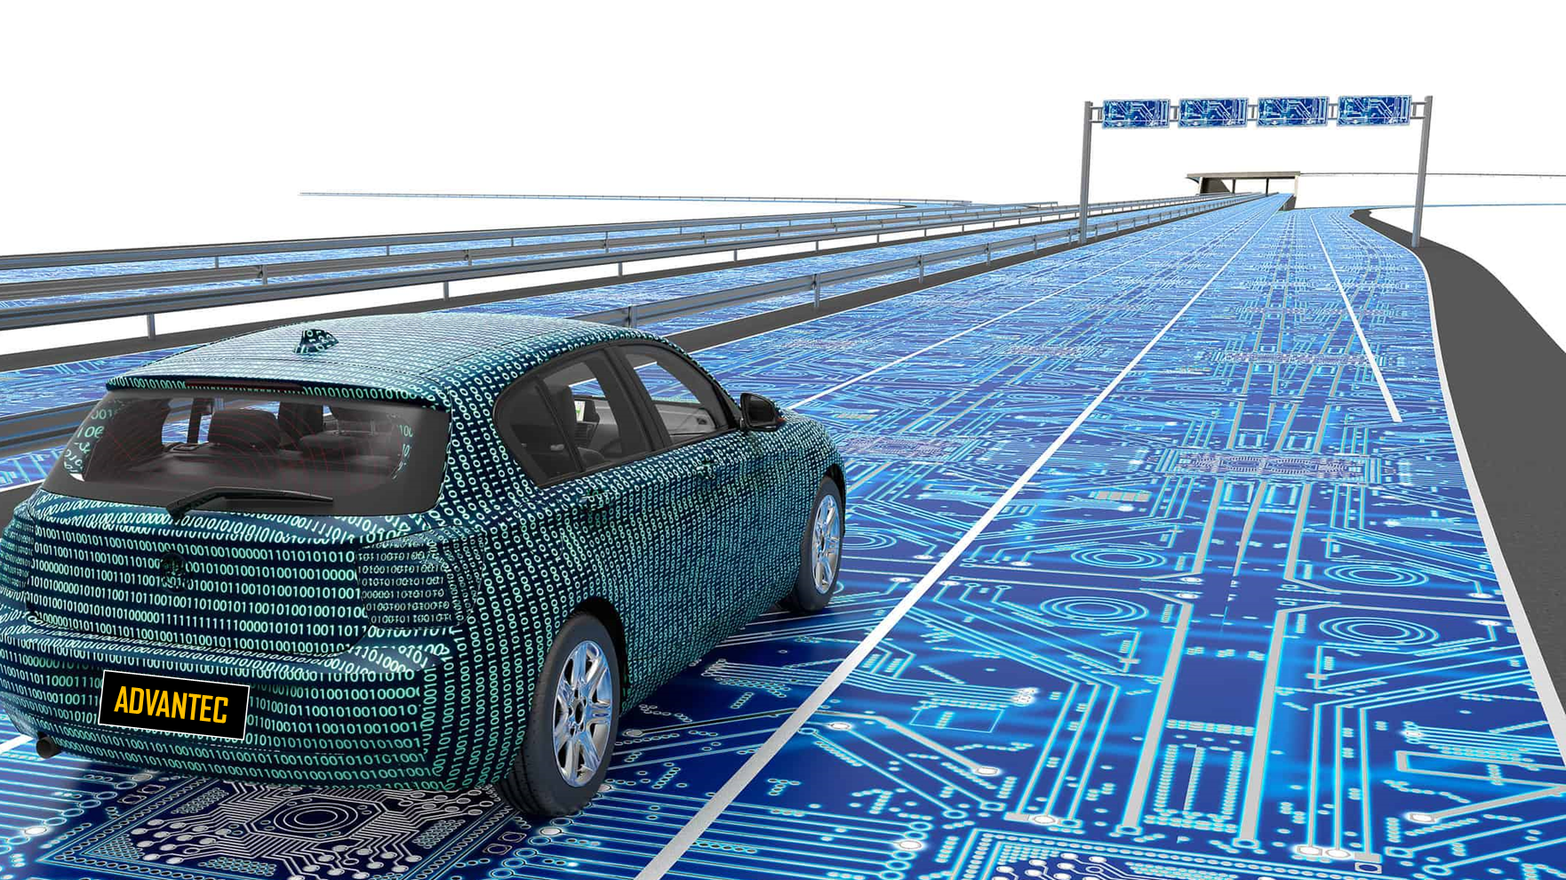
Carlos A. Ortiz, PE, TE, PTOE,
Project Manager, ADVANTEC
949-861-4999 (Office)
949-636-0646 (Cellular)
cortiz@advantec-usa.com
LinkedIN
Twitter: @CAOrtiz2121

Slide 3
PREPARING THE COACHELLA VALLEY FOR A SMART REGION

Slide 4
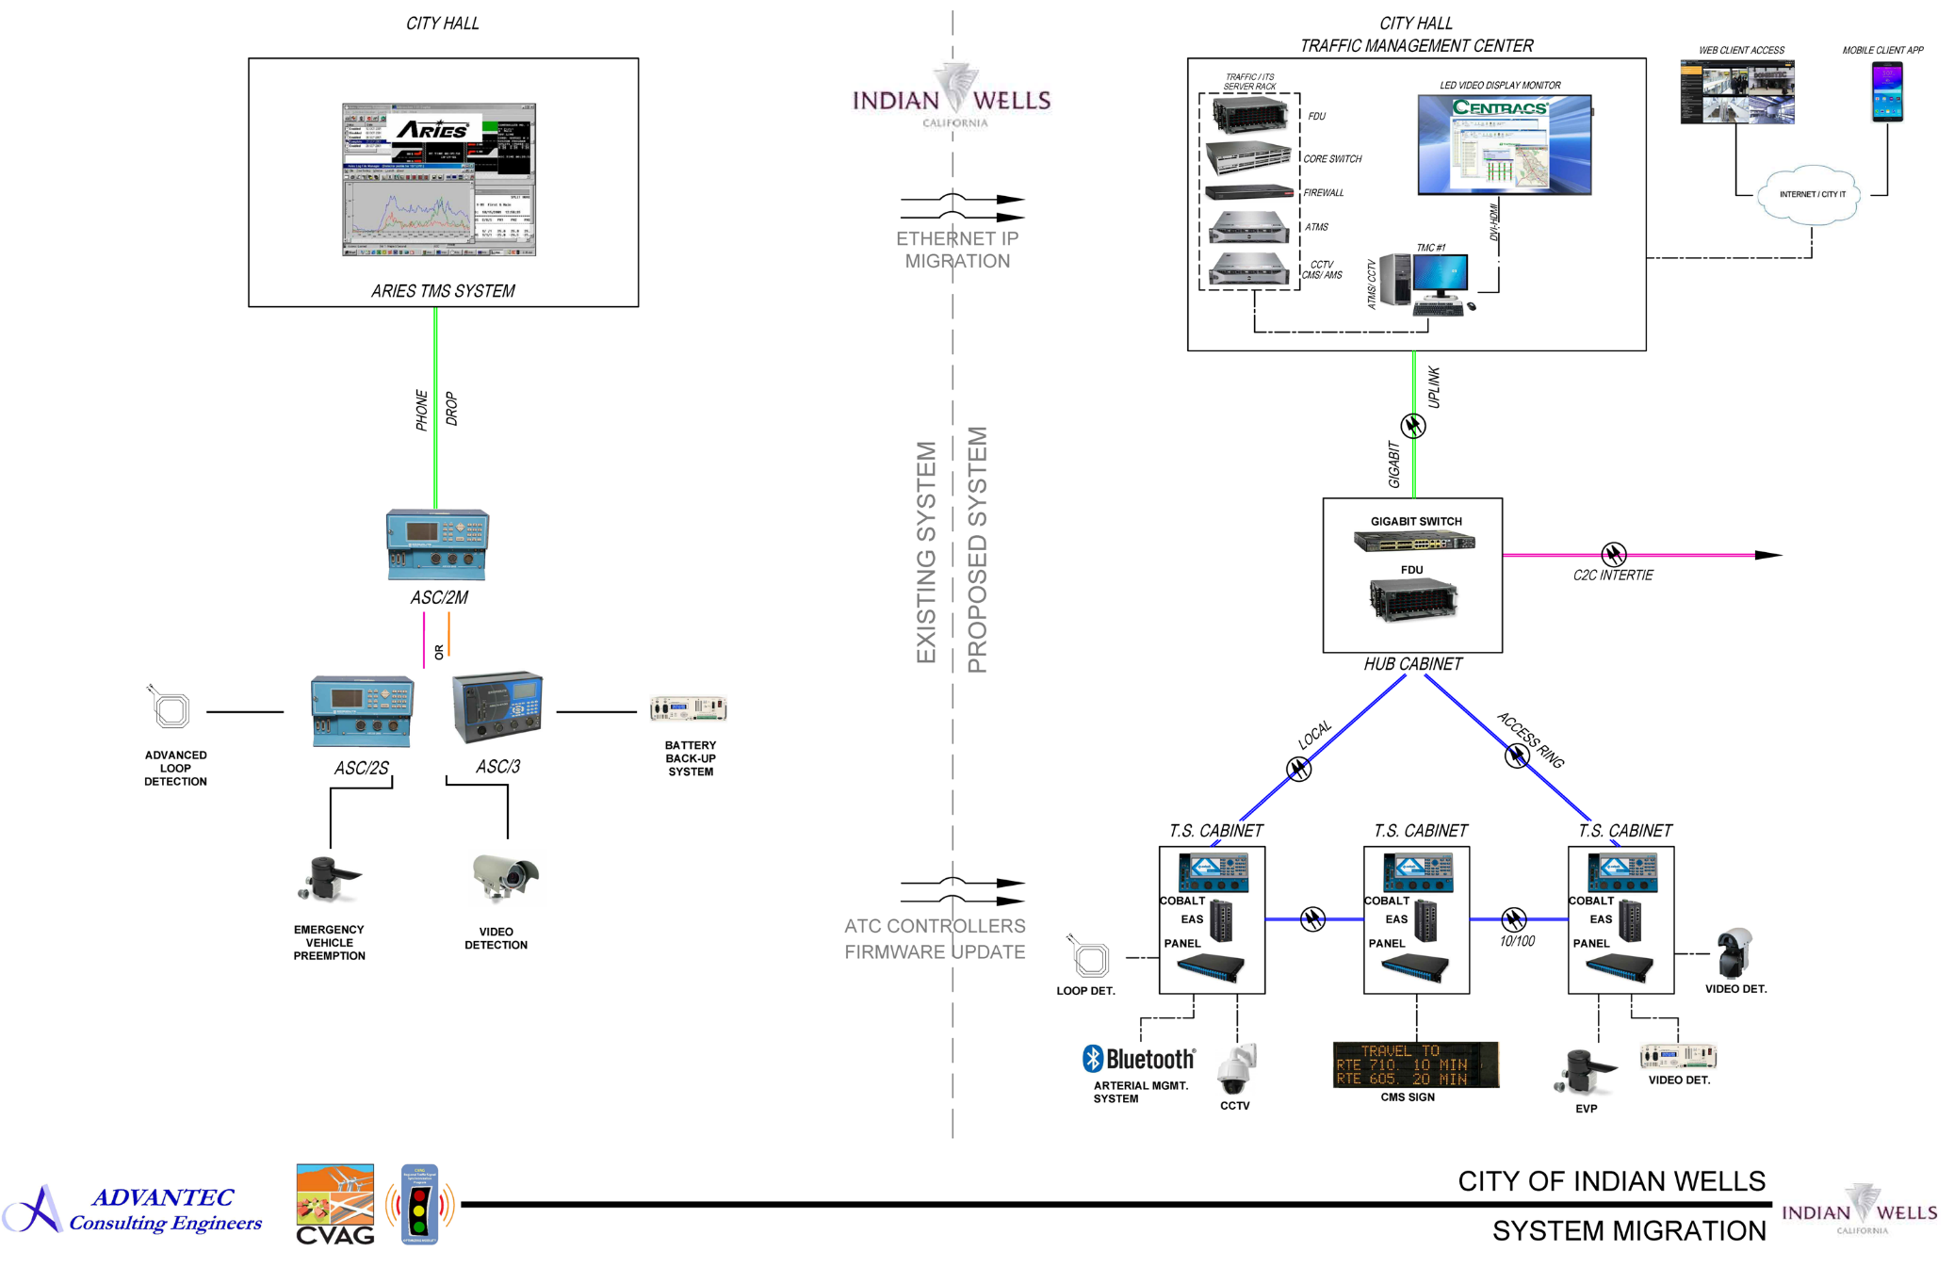
COACHELLA VALLEY TRAFFIC SIGNAL SYNCHRONIZATION PROGRAM – PREPARING THE COACHELLA VALLEY FOR A SMART REGION
STATE-OF-THE-ART LOCAL
TRAFFIC MANAGEMENT CENTERS – CITY OF INDIAN WELLS
(Upgrade)

Slide 5
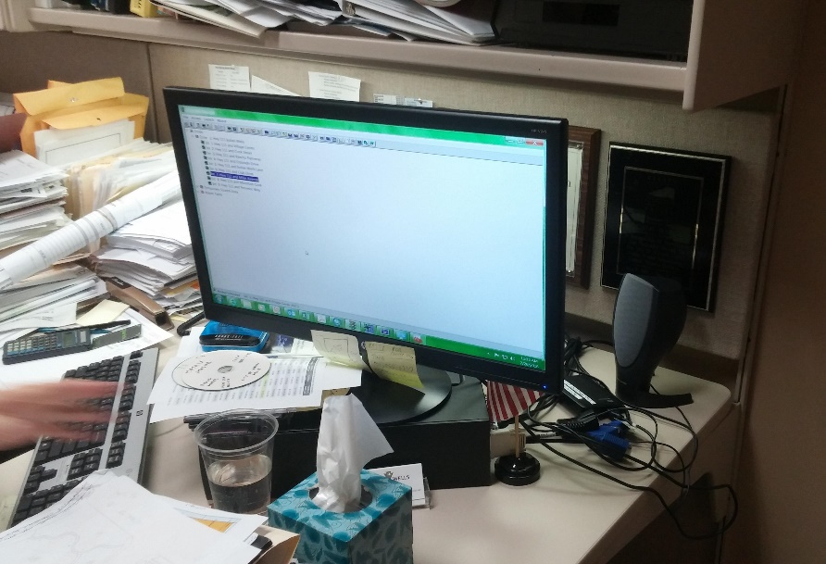
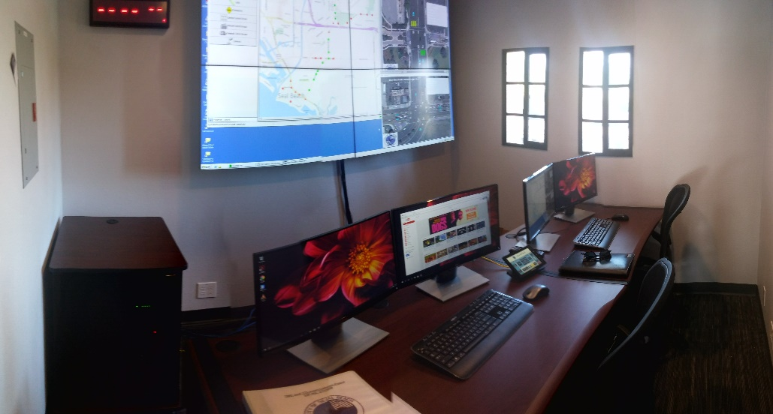
COACHELLA VALLEY TRAFFIC SIGNAL SYNCHRONIZATION PROGRAM – PREPARING THE COACHELLA VALLEY FOR A SMART REGION
STATE-OF-THE-ART LOCAL
TRAFFIC MANAGEMENT CENTERS – CITY OF INDIAN WELLS
(Upgrade)
Existing TMC
Tentative TMC Upgrades

Slide 6
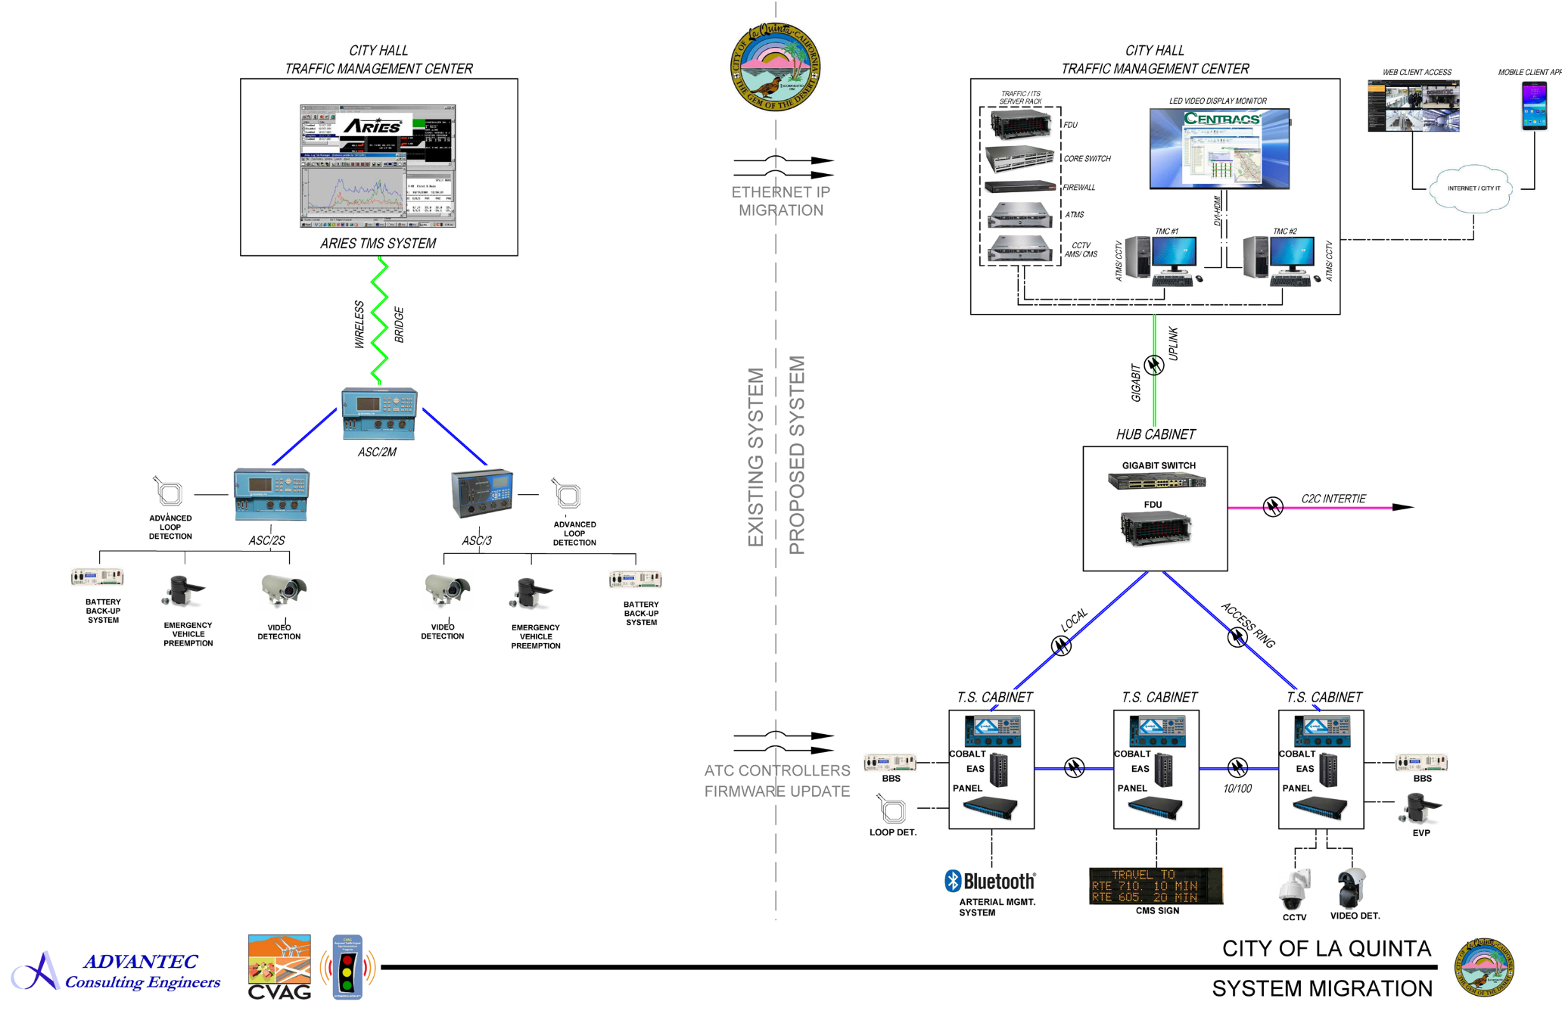
COACHELLA VALLEY TRAFFIC SIGNAL SYNCHRONIZATION PROGRAM – PREPARING THE COACHELLA VALLEY FOR A SMART REGION
STATE-OF-THE-ART LOCAL
TRAFFIC MANAGEMENT CENTERS – CITY OF
LA QUINTA
(Upgrade)

Slide 7
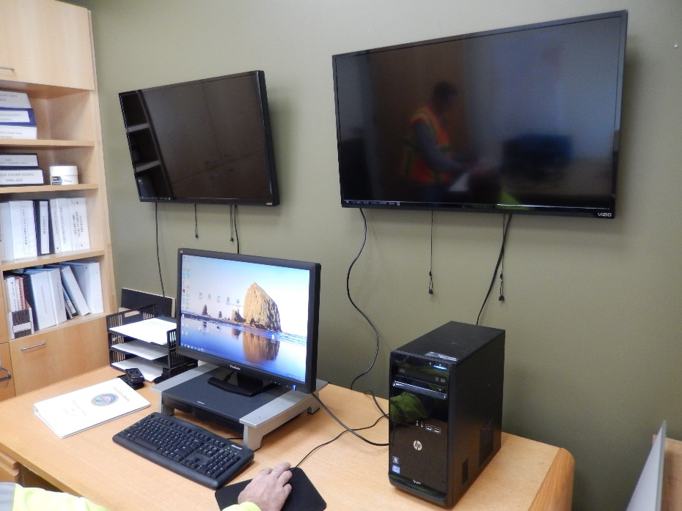
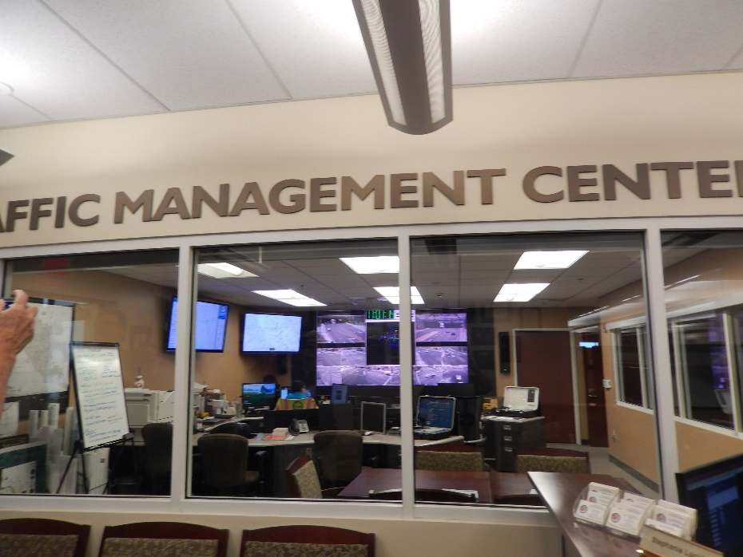
COACHELLA VALLEY TRAFFIC SIGNAL SYNCHRONIZATION PROGRAM – PREPARING THE COACHELLA VALLEY FOR A SMART REGION
STATE-OF-THE-ART LOCAL
TRAFFIC MANAGEMENT CENTERS – CITY OF
LA QUINTA
(Upgrade)
Existing TMC
Tentative TMC Upgrades

Slide 8
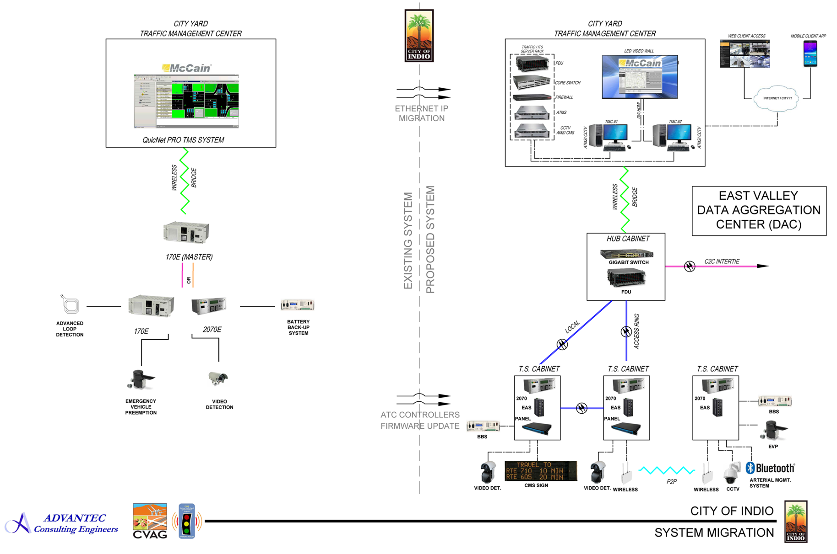
COACHELLA VALLEY TRAFFIC SIGNAL SYNCHRONIZATION PROGRAM – PREPARING THE COACHELLA VALLEY FOR A SMART REGION
STATE-OF-THE-ART LOCAL
TRAFFIC MANAGEMENT CENTERS – CITY OF INDIO
(Upgrade)

Slide 9
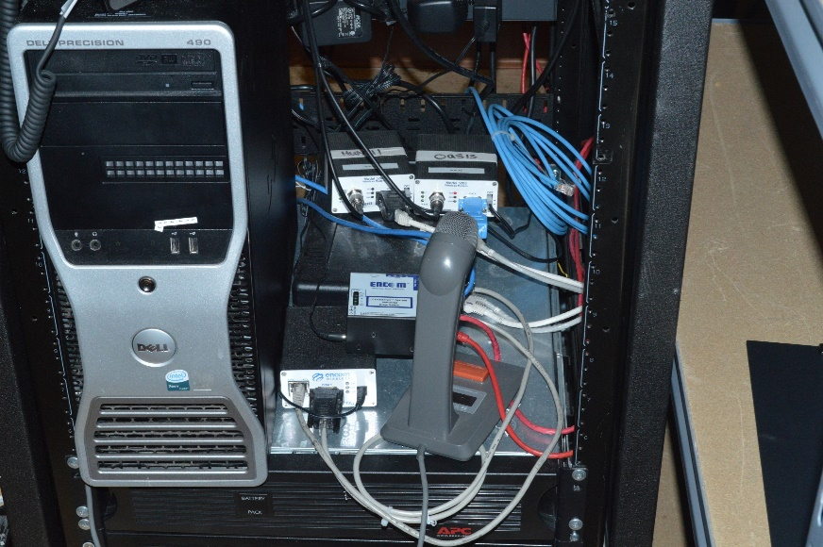
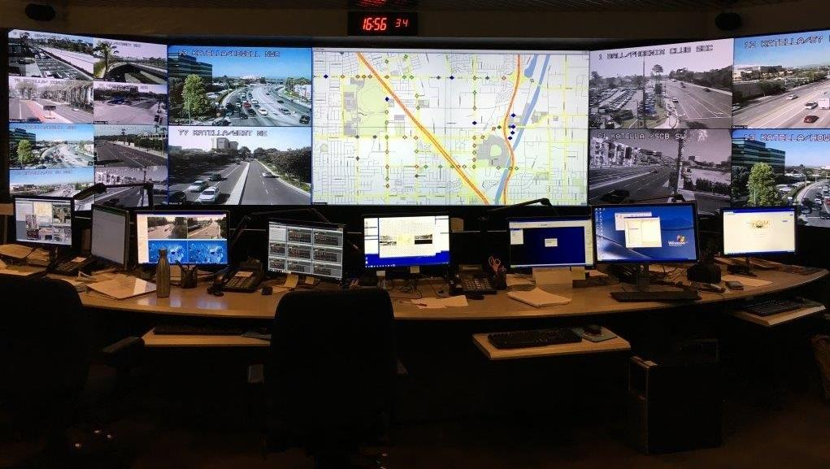
COACHELLA VALLEY TRAFFIC SIGNAL SYNCHRONIZATION PROGRAM – PREPARING THE COACHELLA VALLEY FOR SMART REGION
STATE-OF-THE-ART LOCAL
TRAFFIC MANAGEMENT CENTERS – CITY OF INDIO
(Upgrade)
Existing TMC
Tentative TMC Upgrades

Slide 10
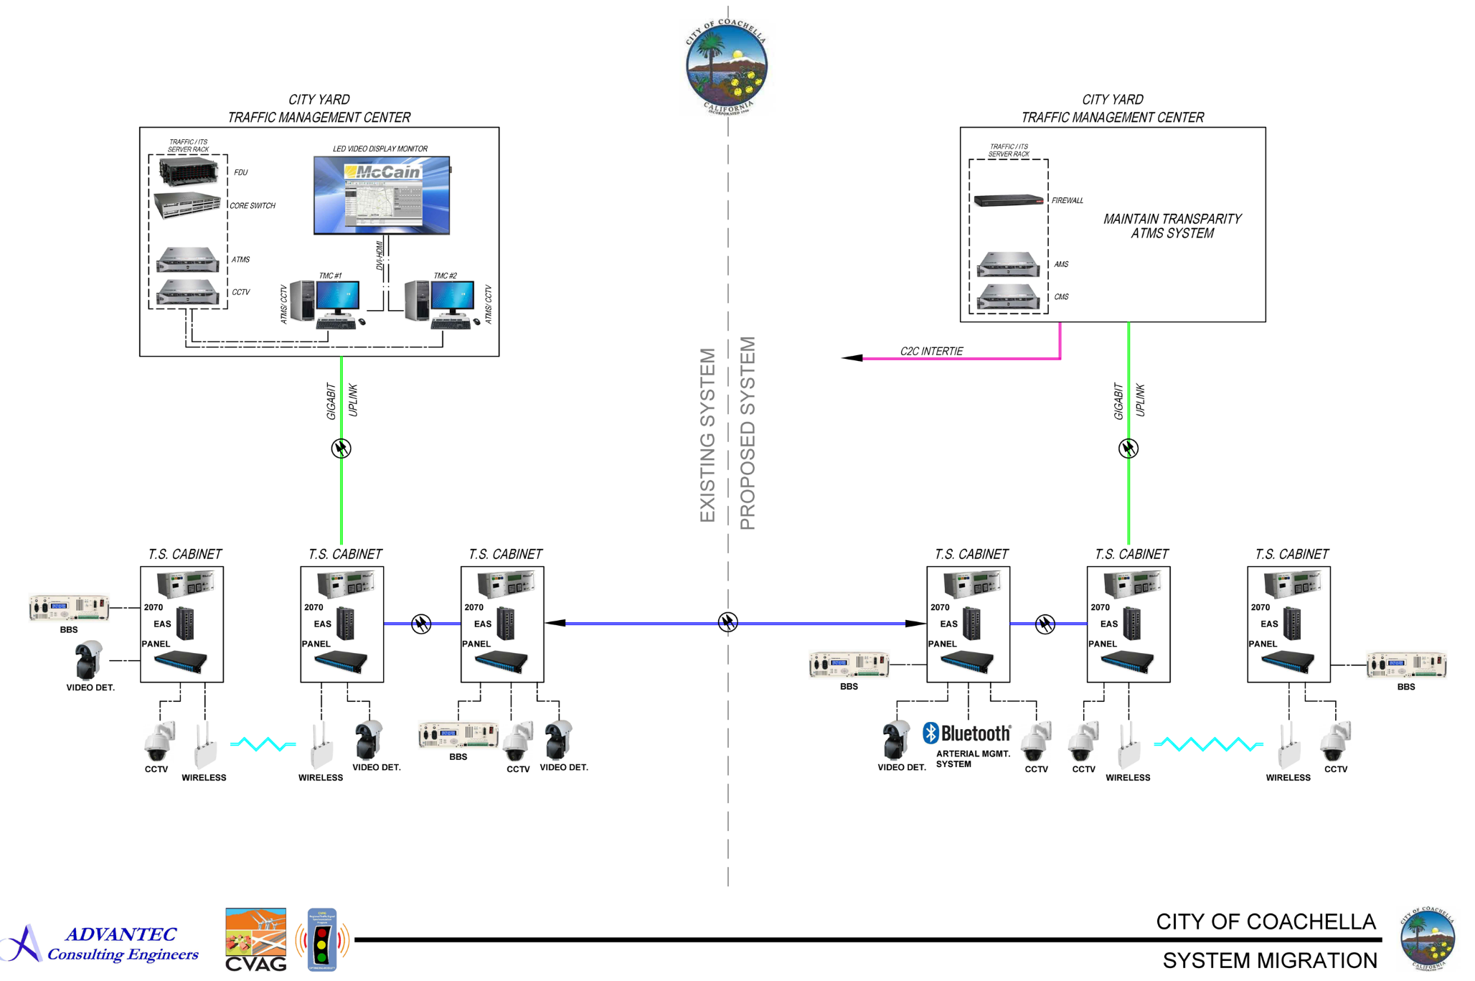
COACHELLA VALLEY TRAFFIC SIGNAL SYNCHRONIZATION PROGRAM – PREPARING THE COACHELLA VALLEY FOR A SMART REGION
STATE-OF-THE-ART LOCAL
TRAFFIC MANAGEMENT CENTERS – CITY OF COACHELLA
(Upgrade)

Slide 11
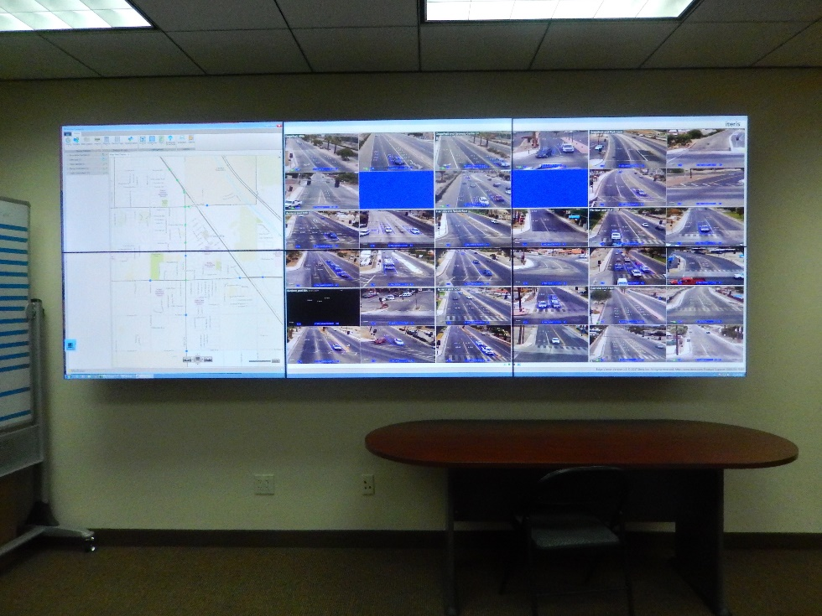
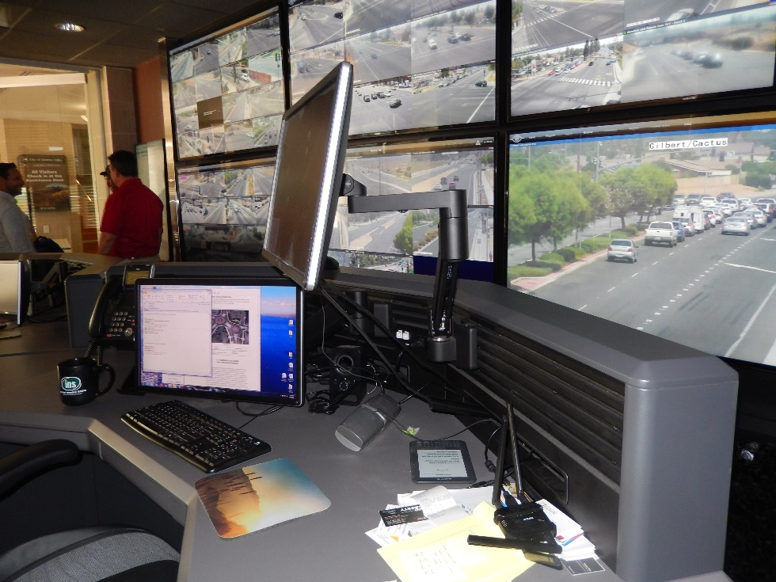
COACHELLA VALLEY TRAFFIC SIGNAL SYNCHRONIZATION PROGRAM – PREPARING THE COACHELLA VALLEY FOR A SMART REGION
STATE-OF-THE-ART LOCAL
TRAFFIC MANAGEMENT CENTERS – CITY OF COACHELLA
(Upgrade)
Existing TMC
Tentative TMC Upgrades

Slide 12
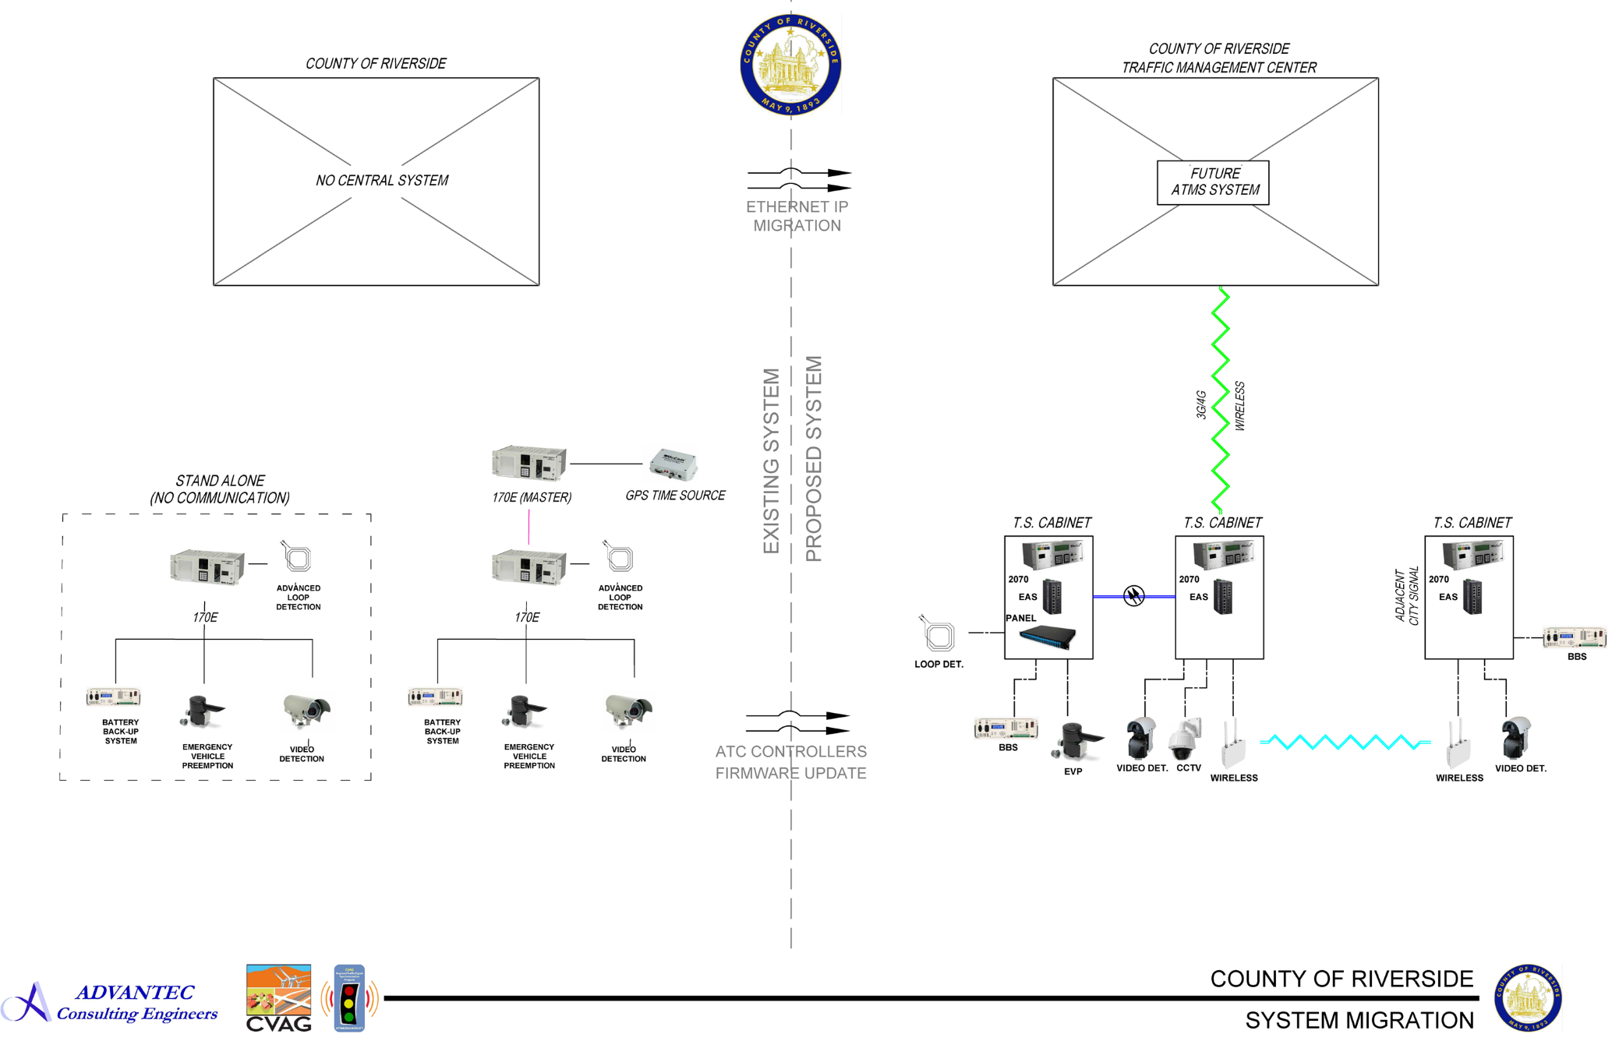
COACHELLA VALLEY TRAFFIC SIGNAL SYNCHRONIZATION PROGRAM – PREPARING THE COACHELLA VALLEY FOR A SMART REGION
STATE-OF-THE-ART LOCAL
TRAFFIC MANAGEMENT CENTERS – COUNTY OF RIVERSIDE

Slide 13
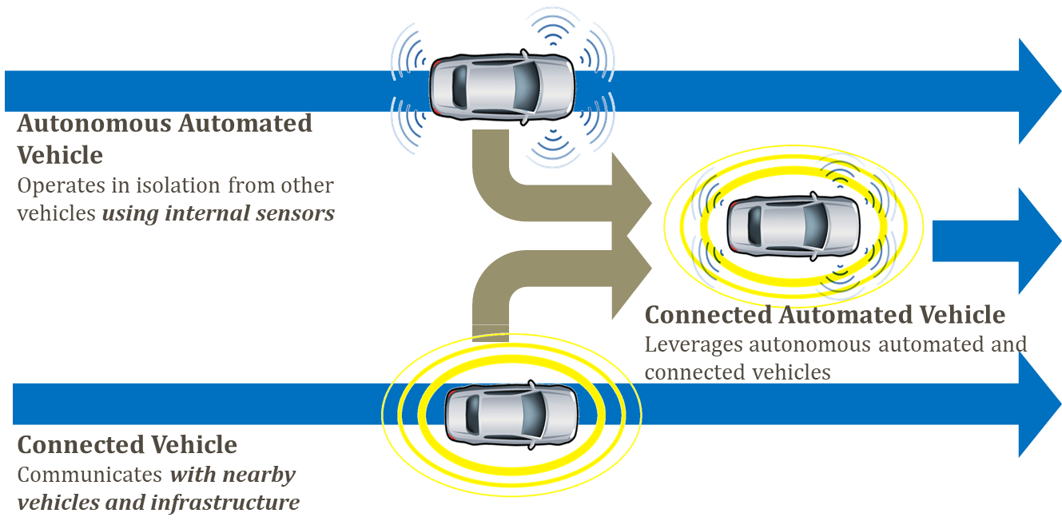
COACHELLA VALLEY TRAFFIC SIGNAL SYNCHRONIZATION PROGRAM – PREPARING THE COACHELLA VALLEY FOR A SMART REGION
CONNECTED / AUTONOMOUS VEHICLE (CAV) TECHNOLOGIES

Slide 14
COACHELLA VALLEY TRAFFIC SIGNAL SYNCHRONIZATION PROGRAM – PREPARING THE COACHELLA VALLEY FOR A SMART REGION
CONNECTED / AUTONOMOUS VEHICLE (CAV) TECHNOLOGIES

