Slide 1
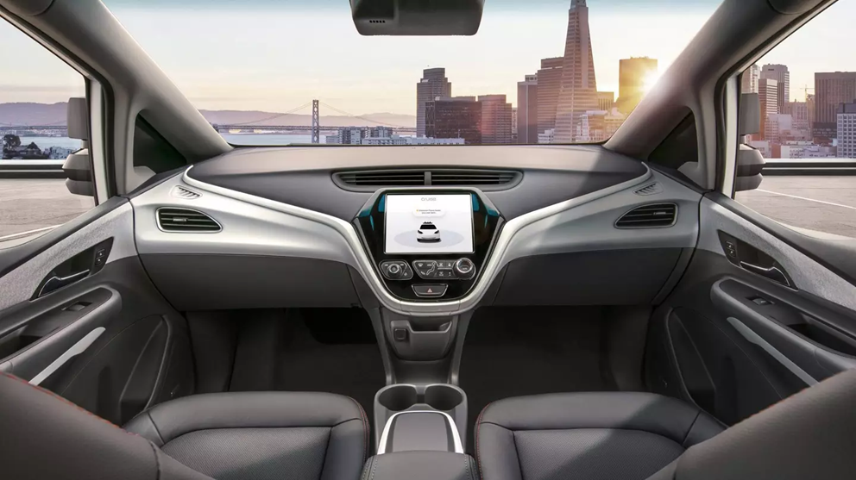
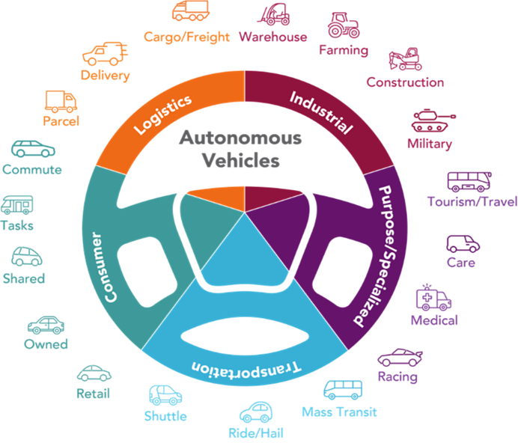
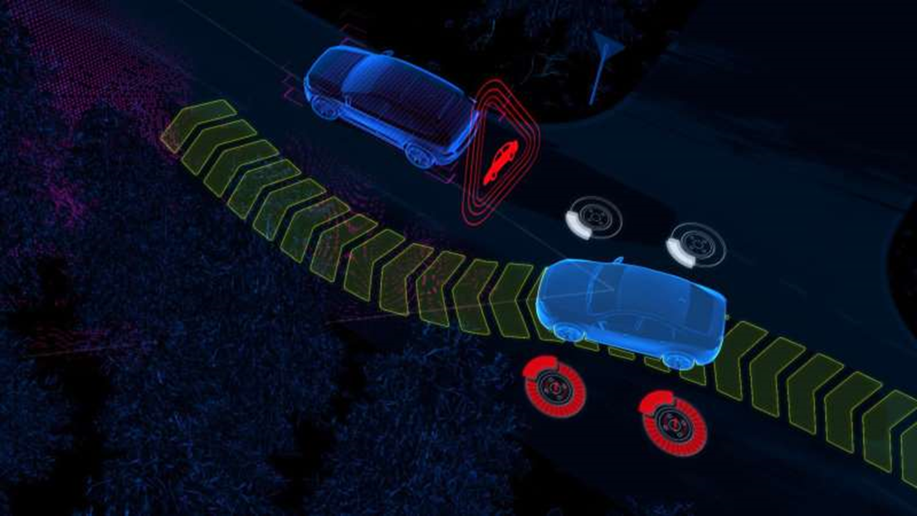
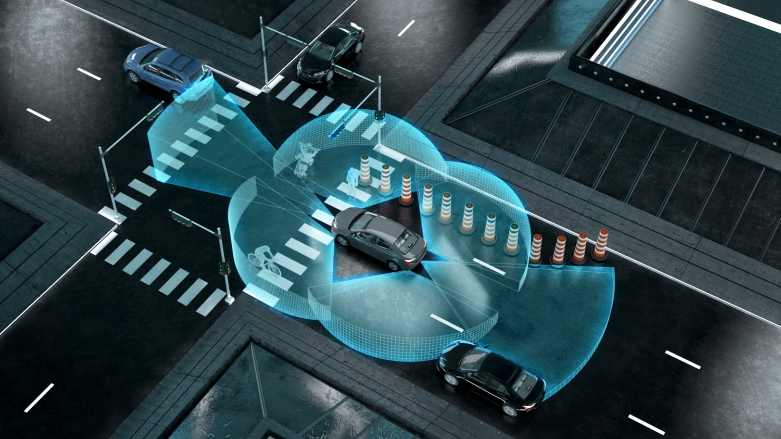
COACHELLA VALLEY TRAFFIC SIGNAL SYNCHRONIZATION PROGRAM – PREPARING THE COACHELLA VALLEY FOR A SMART REGION
CONNECTED / AUTONOMOUS VEHICLE (CAV) TECHNOLOGIES

Slide 2
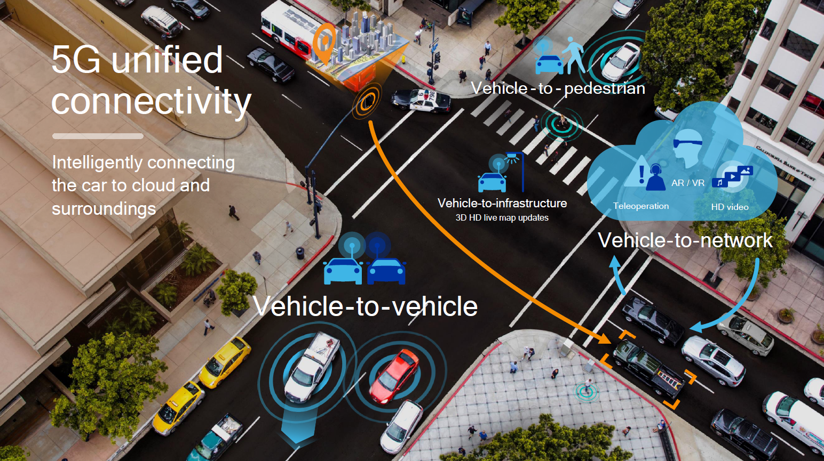
COACHELLA VALLEY TRAFFIC SIGNAL SYNCHRONIZATION PROGRAM – PREPARING THE COACHELLA VALLEY FOR A SMART REGION
CONNECTED / AUTONOMOUS VEHICLE (CAV) TECHNOLOGIES

Slide 3
COACHELLA VALLEY TRAFFIC SIGNAL SYNCHRONIZATION PROGRAM – PREPARING THE COACHELLA VALLEY FOR A SMART REGION
CONNECTED / AUTONOMOUS VEHICLE (CAV) TECHNOLOGIES

Slide 4
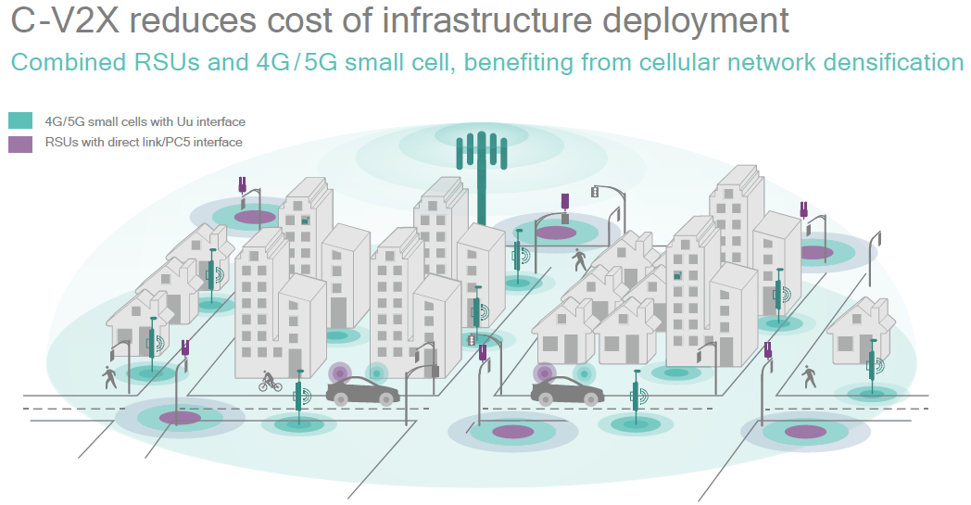
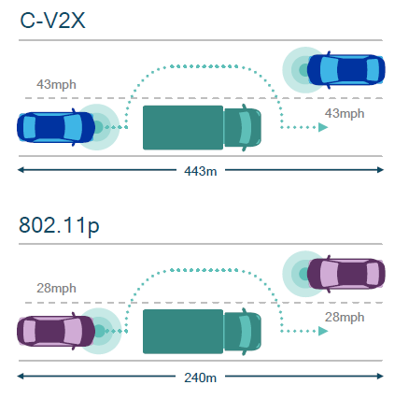
COACHELLA VALLEY TRAFFIC SIGNAL SYNCHRONIZATION PROGRAM – PREPARING THE COACHELLA VALLEY FOR A SMART REGION
CONNECTED / AUTONOMOUS VEHICLE (CAV) TECHNOLOGIES

