Slide 1
PREPARING THE COACHELLA VALLEY FOR A SMART REGION
Presentation By:
Mr. Carlos A. Ortiz, PE, TE, PTOE
Chief Operating Officer and Principal
ADVANTEC Consulting Engineers, Inc.
2018 ITE San Diego Workshop & Vendor Show
October 11, 2018

Slide 2
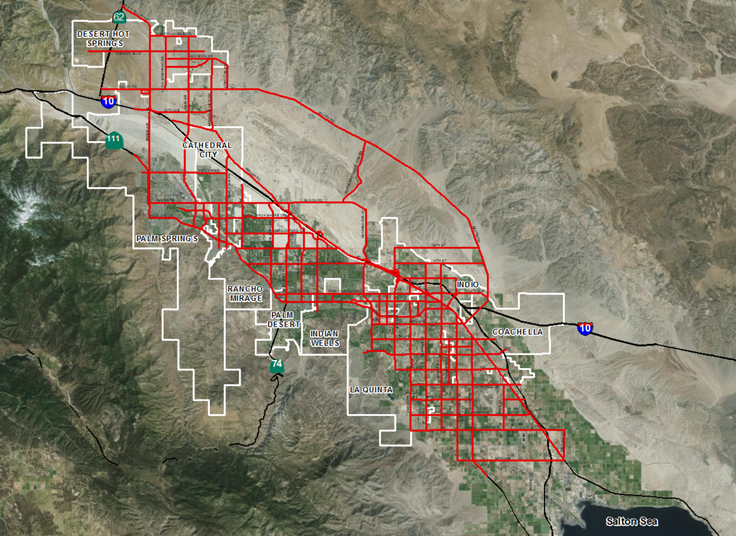
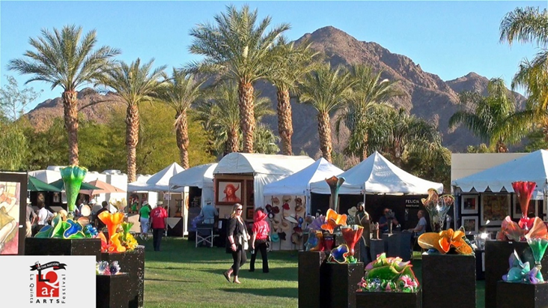
PREPARING THE COACHELLA VALLEY FOR A SMART REGION

Slide 3
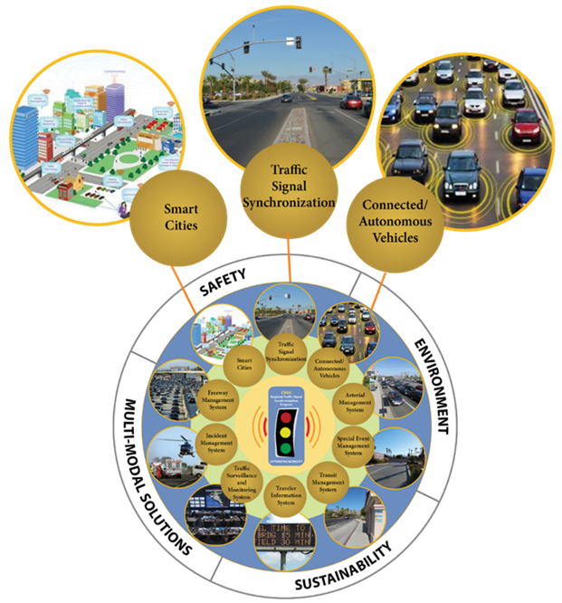
PREPARING THE COACHELLA VALLEY FOR A SMART REGION
SMART CITIES (REGION)
START WITH SMARTER INFRASTRUCTURE

Slide 4
PREPARING THE COACHELLA VALLEY FOR A SMART REGION

Slide 5
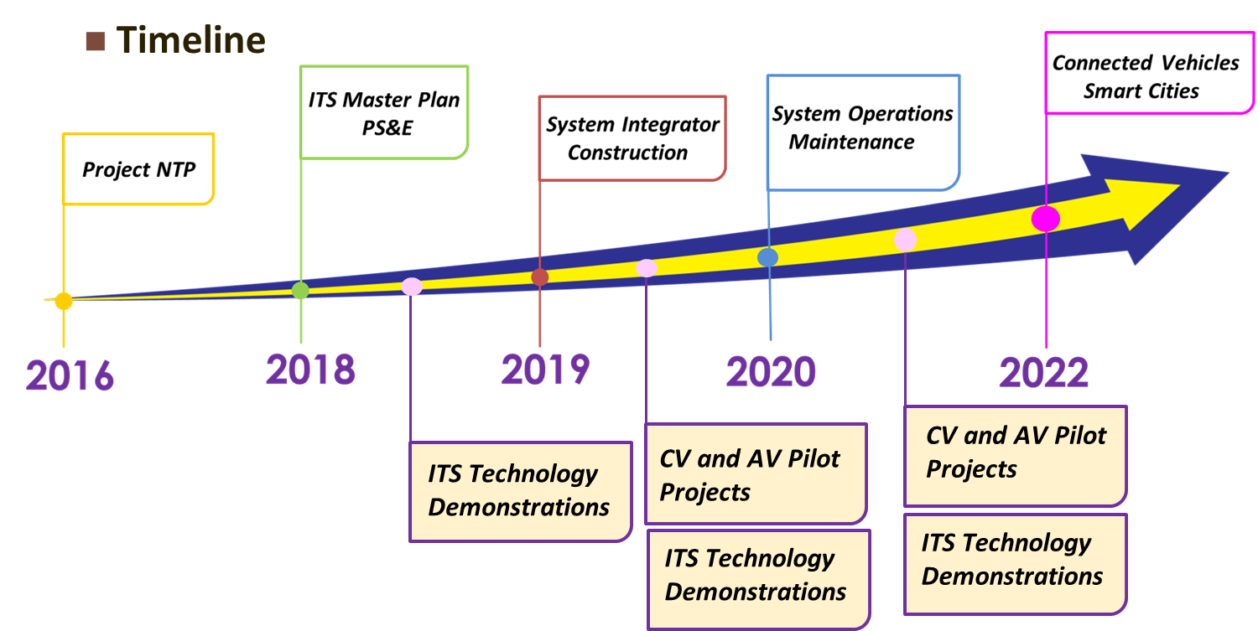
PREPARING THE COACHELLA VALLEY FOR A SMART REGION

Slide 6
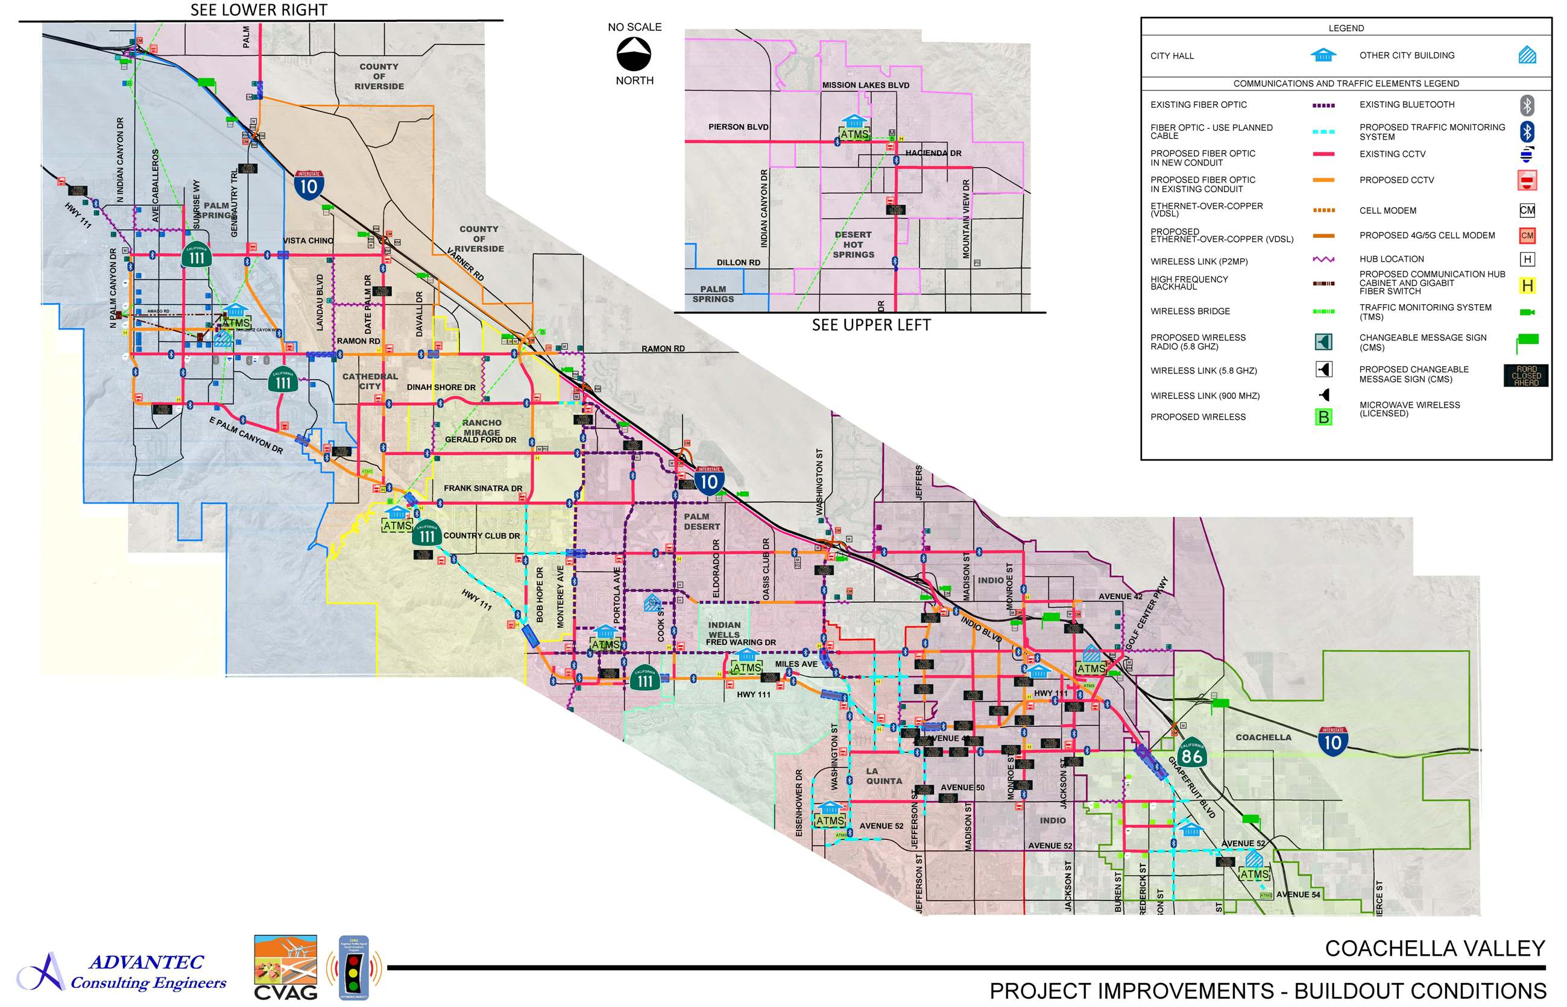
PREPARING THE COACHELLA VALLEY FOR A SMART REGION
Guiding Principles:
Achieve Inter-Agency Synchronization
Real-time Traffic Management
State-of-the-Art, Advanced Technologies
Improve the Environment
Prepare for the Future

Slide 7
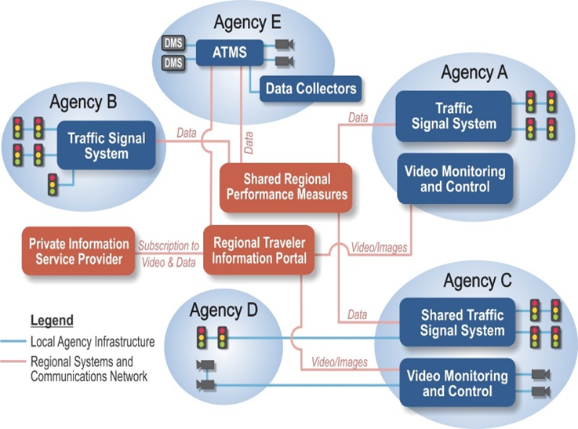
PREPARING THE COACHELLA VALLEY FOR A SMART REGION
APPROVED
REGIONWIDE TSI MASTER PLAN

Slide 8
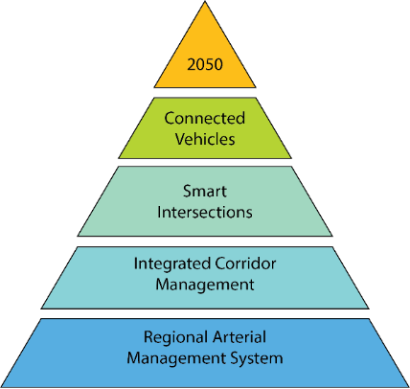
PREPARING THE COACHELLA VALLEY FOR A SMART REGION
APPROVED
REGIONWIDE TSI MASTER PLAN – PROVIDES THE PATH TO A SMART REGION

Slide 9
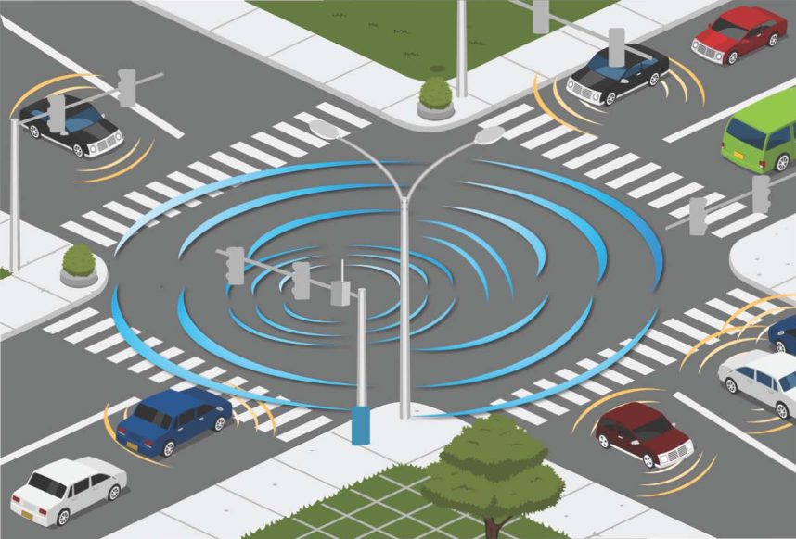
PREPARING THE COACHELLA VALLEY FOR A SMART REGION
APPROVED
REGIONWIDE TSI MASTER PLAN – PROVIDES THE PATH TO A SMART REGION

Slide 10
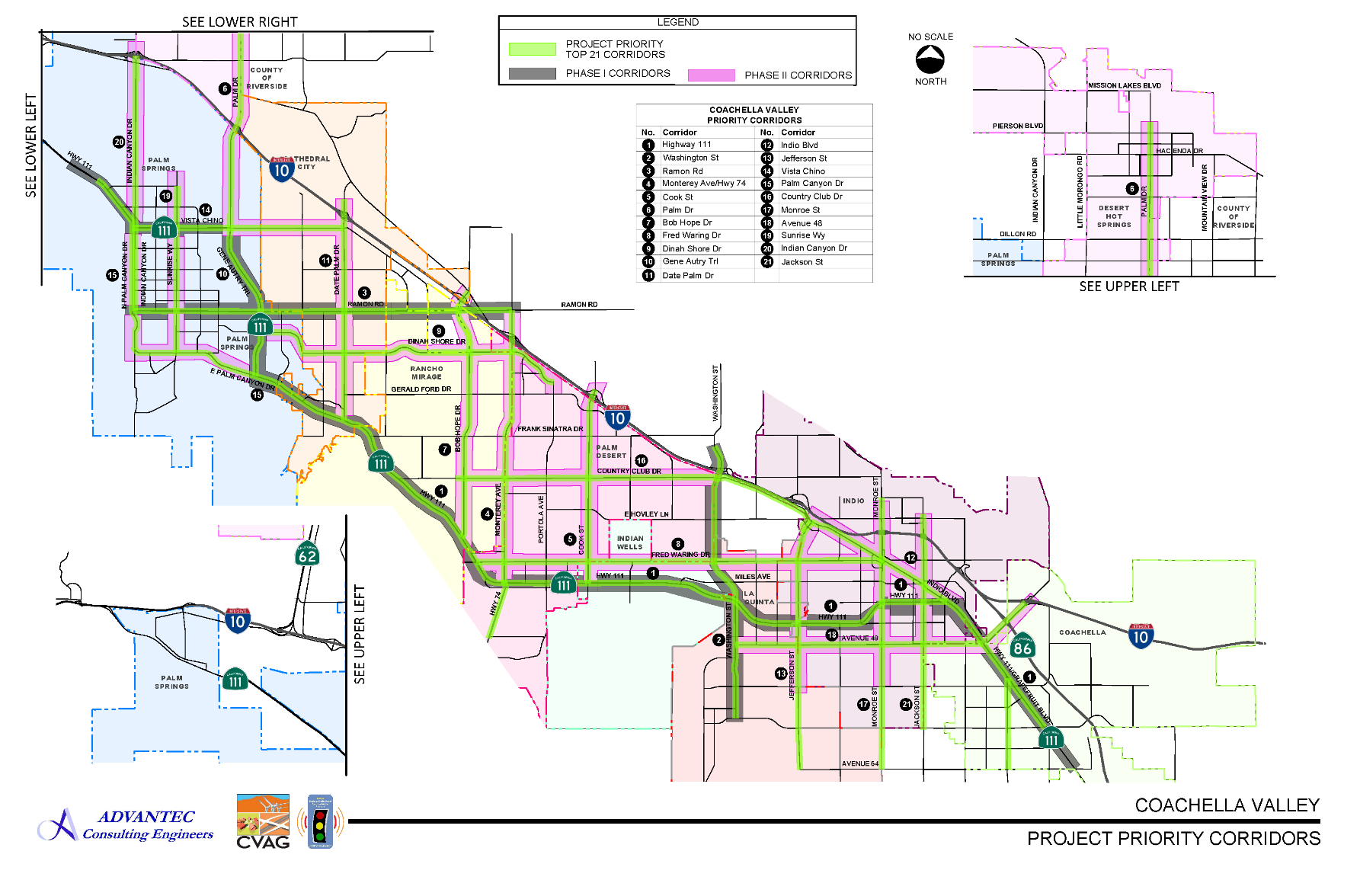
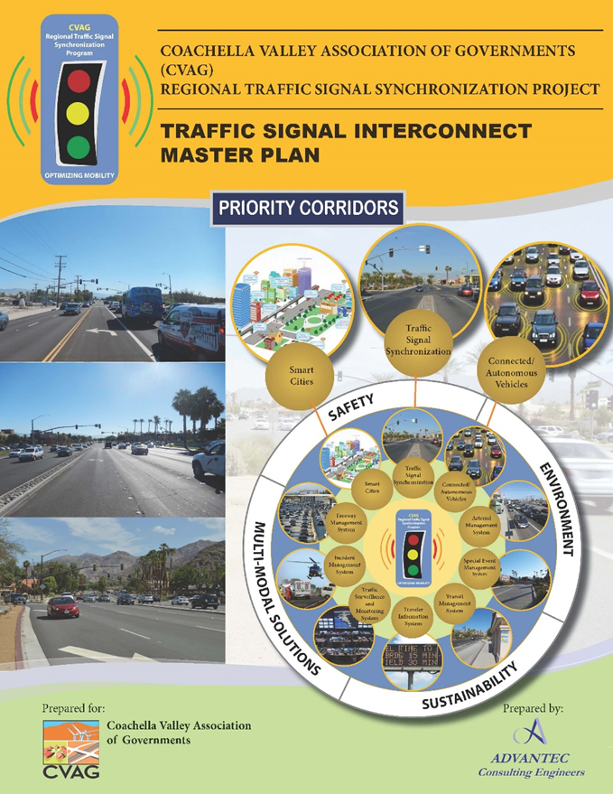
PREPARING THE COACHELLA VALLEY FOR A SMART REGION
APPROVED
21 PRIORITY CORRIDORS

Slide 11
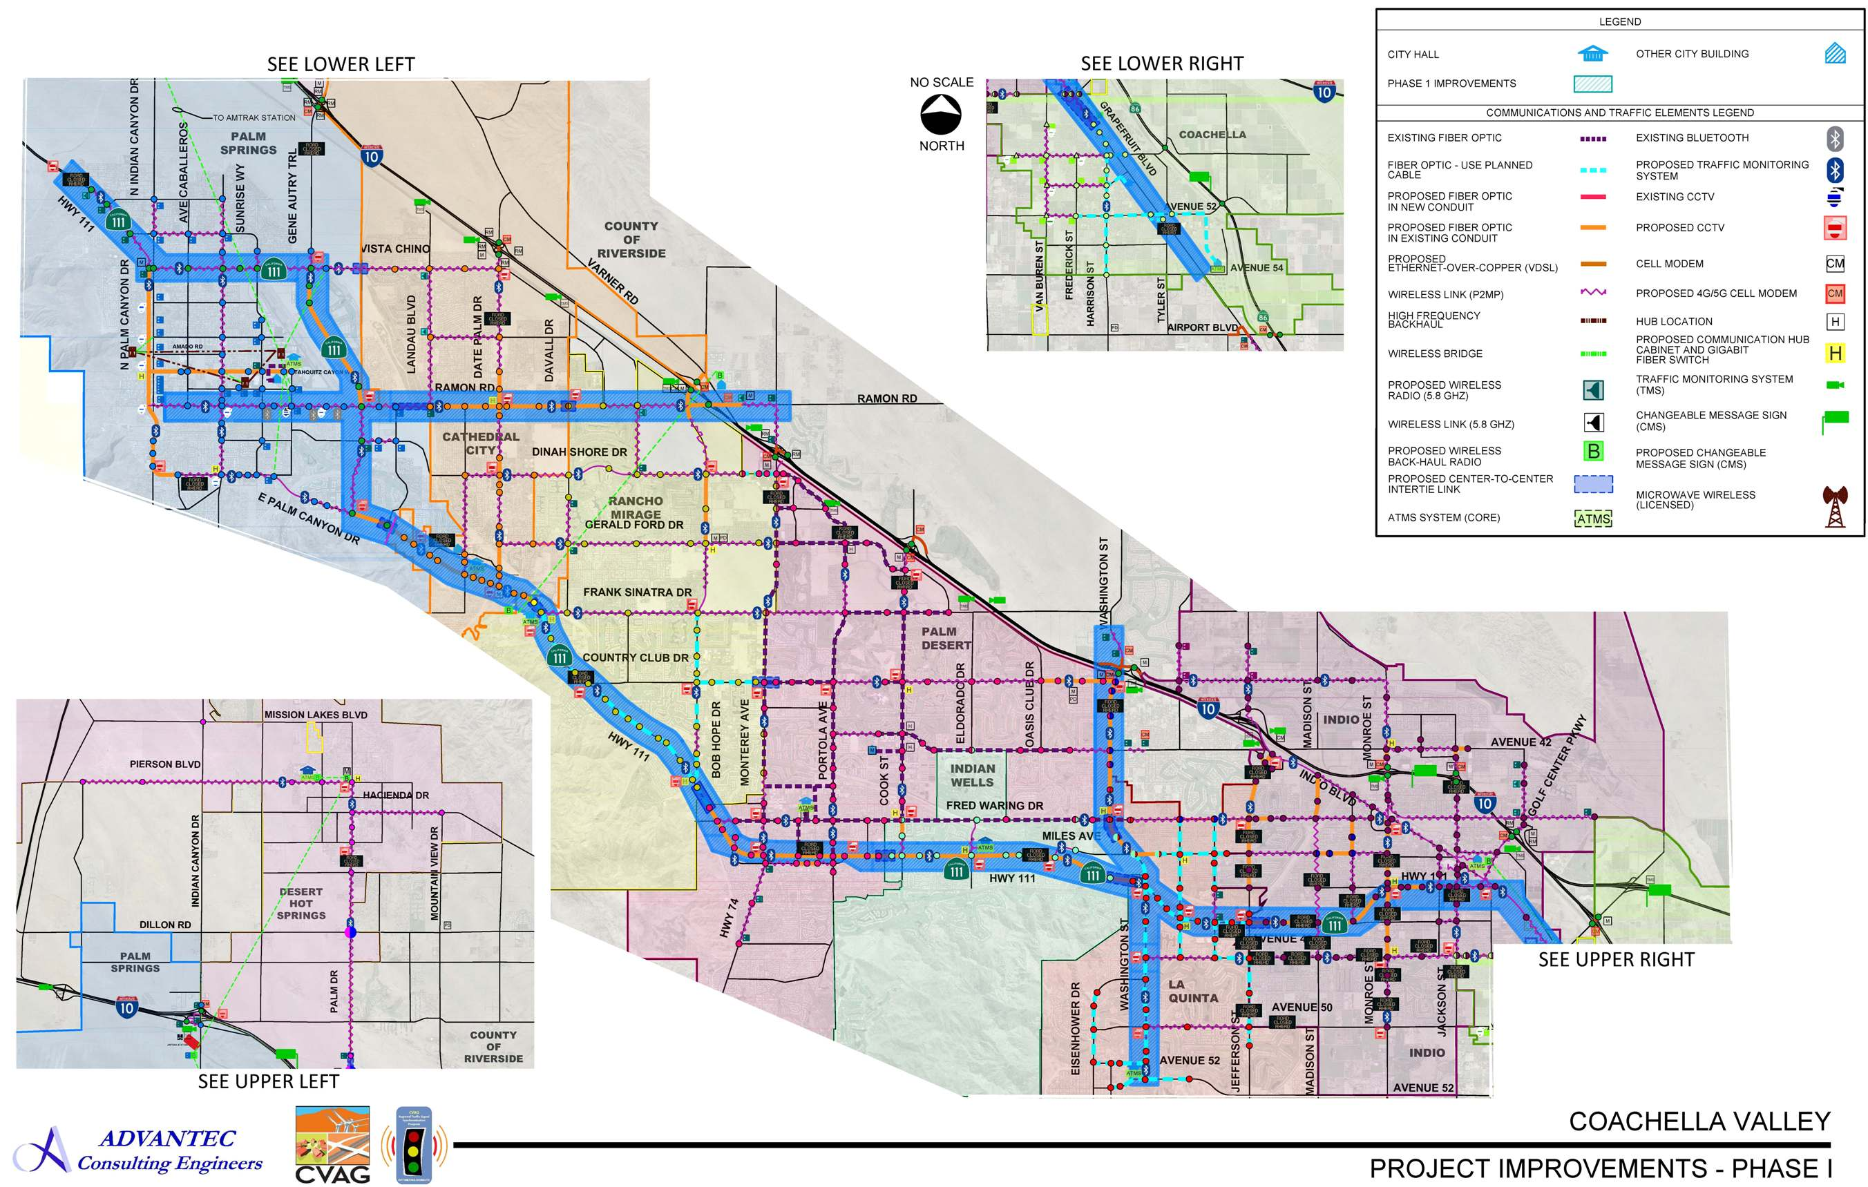
PREPARING THE COACHELLA VALLEY FOR A SMART REGION
APPROVED
PHASE I
PRIORITY CORRIDORS

