Slide 1
A Brave New Multimodal World… and How to Analyze It
Doug Bilse
Sohrab Rashid
Dawn Wilson
Notes:
Several events changed the way Carlsbad needed to evaluate mobility, and we’d like to share what learn learned along this journey.

Slide 2
Where’s my cheese? How SB 743 changes the game
New approach to analyzing impacts under CEQA
Calls for alternatives to Level of Service (LOS) measurements
“…auto delay will no longer be considered a significant impact under CEQA.”
Air quality, noise and safety are still analyzed
Notes:
The biggest change to our entire industry was SB 743 that eliminated traditional intersection LOS analysis and mitigation measures as part of CEQA. What might have been a huge challenge ended up being a good thing.

Slide 3
We need to design and analyze with context…

Slide 4
Multimodal streets must serve our customers…
Notes:
Transportation projects typically focus on serving the primary modes of travel: auto, bus, peds and bikes

Slide 5
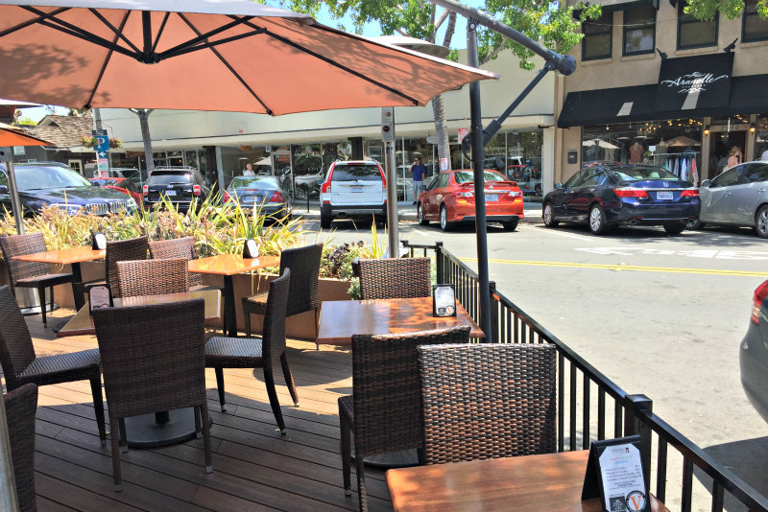
… with features that support businesses…
Notes:
Here’s an example on State Street where we converted parking spaces into an outdoor café.

Slide 6
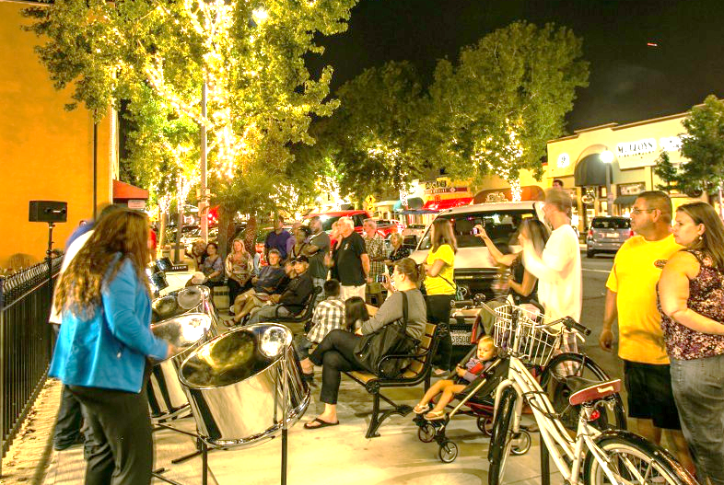
…and staging special events…
Notes:
How many times have streets had to change their primary purpose for a special event like a Farmer’s Market

Slide 7
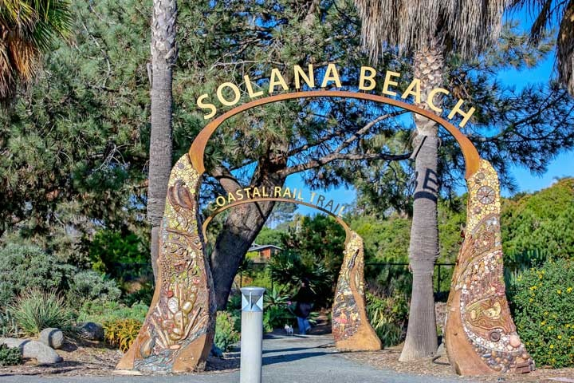
…and creating a sense of place.
Notes:
Sometimes even art is included in a transportation project.

Slide 8
We wanted our analysis to guide us- not constrain us
Notes:
We thought we might be at a fork in the road where we couldn’t meet the LOS standard for all modes on all streets. What could we do?

Slide 9
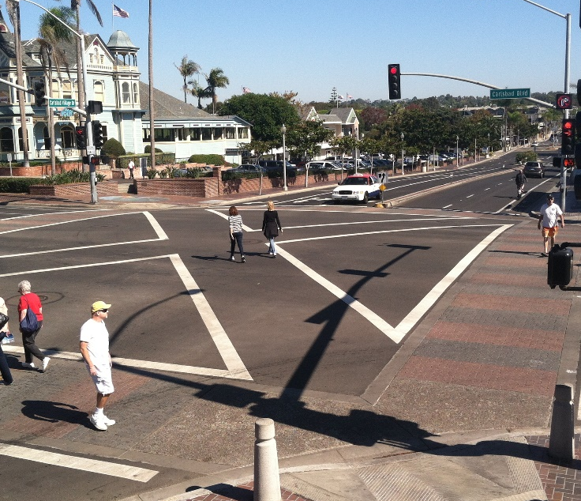
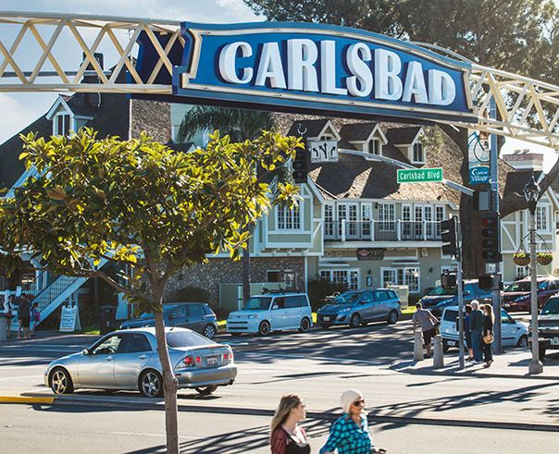
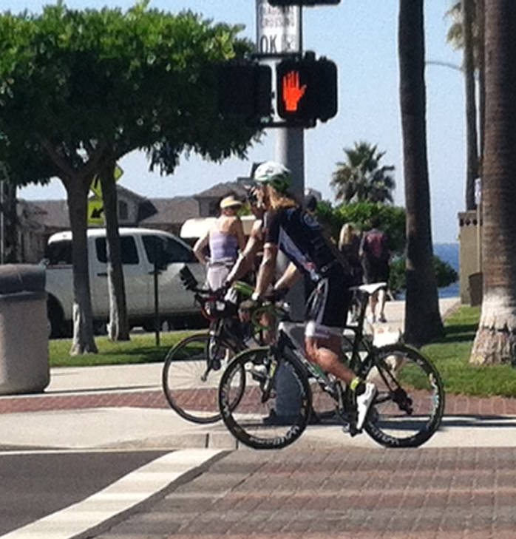
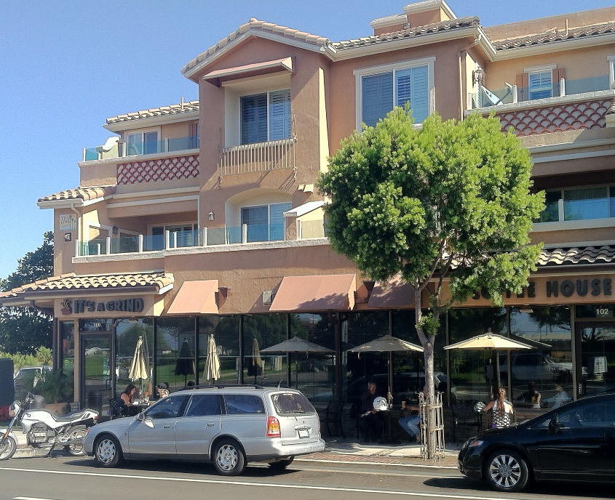
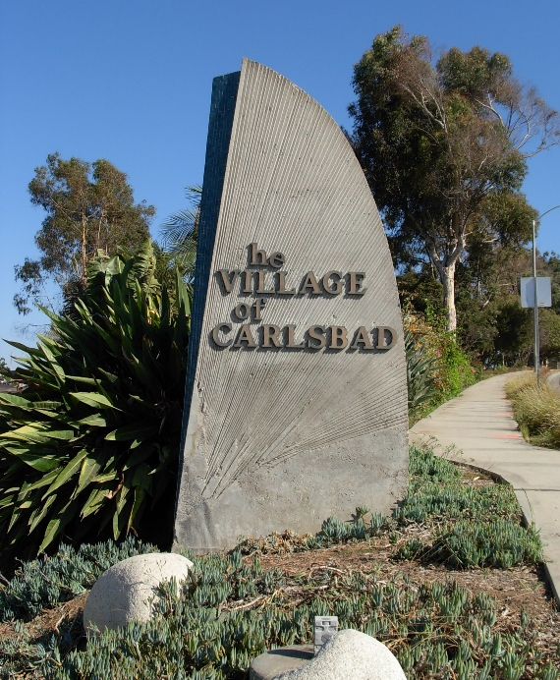
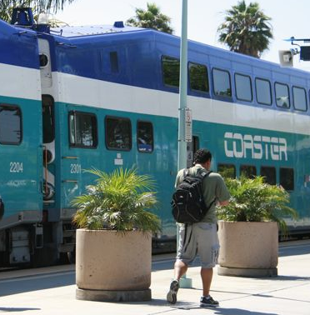
Our Answer was Simple: Design Different Roads to do Different Things

Slide 10
Smart Growth and Mobility Choices: Making the car an option, not a necessity. Dom Nozzi
Notes:
The following slides show how Carlsbad has woven many aspects of mobility and other city priorities in a way that isn’t obstructed by multi-modal analysis- it actually leads our decisions

Slide 11
Paradigm Shift in Transportation

Slide 12
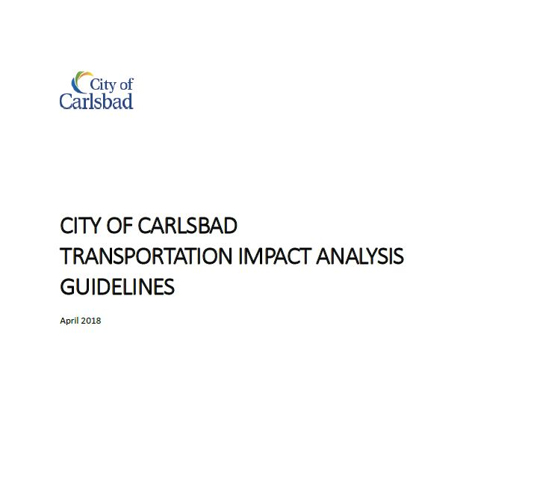
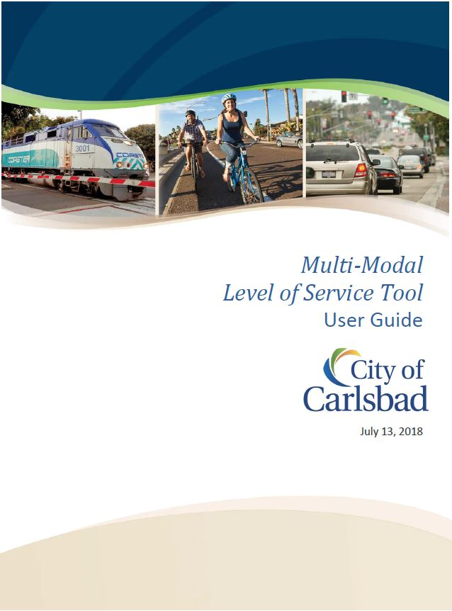
Carlsbad’s Path to the Present:

Slide 13
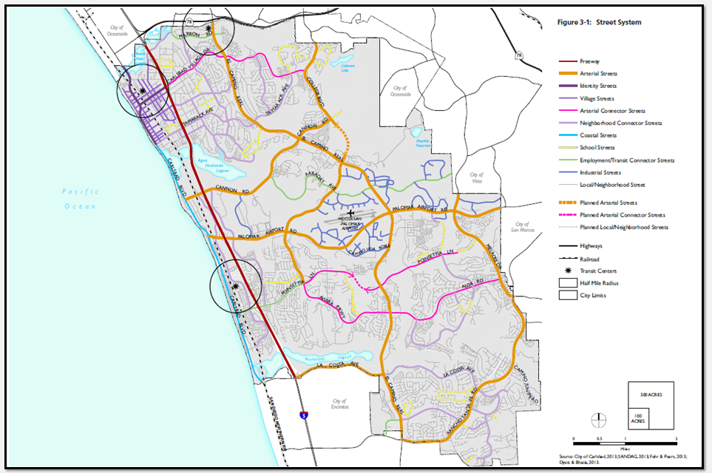
Roadway Typology: Defining Routes by Modes
Notes:
The General Plan defines which modes need to meet LOS standards depending on it’s roadway “typology.” A road in Carlsbad Village should not have to meet auto LOS standards at he expence of better ped and bike facilities. A road like ECR needs to serve autos as it’s primary customer.

Slide 14
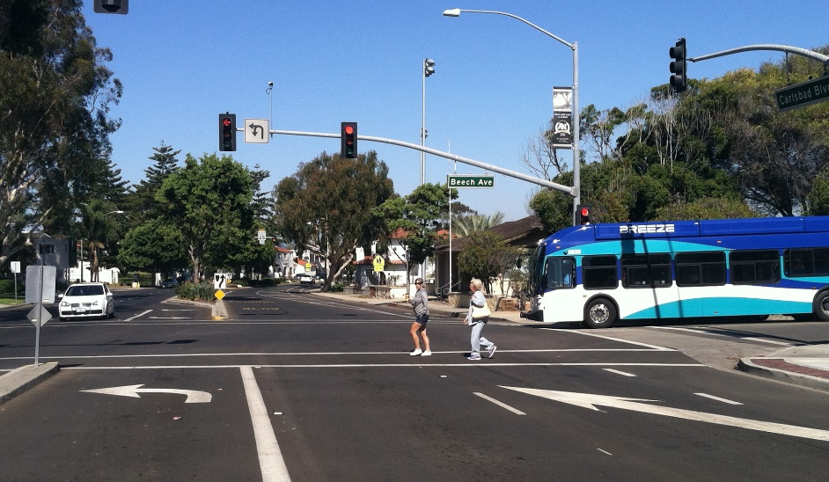
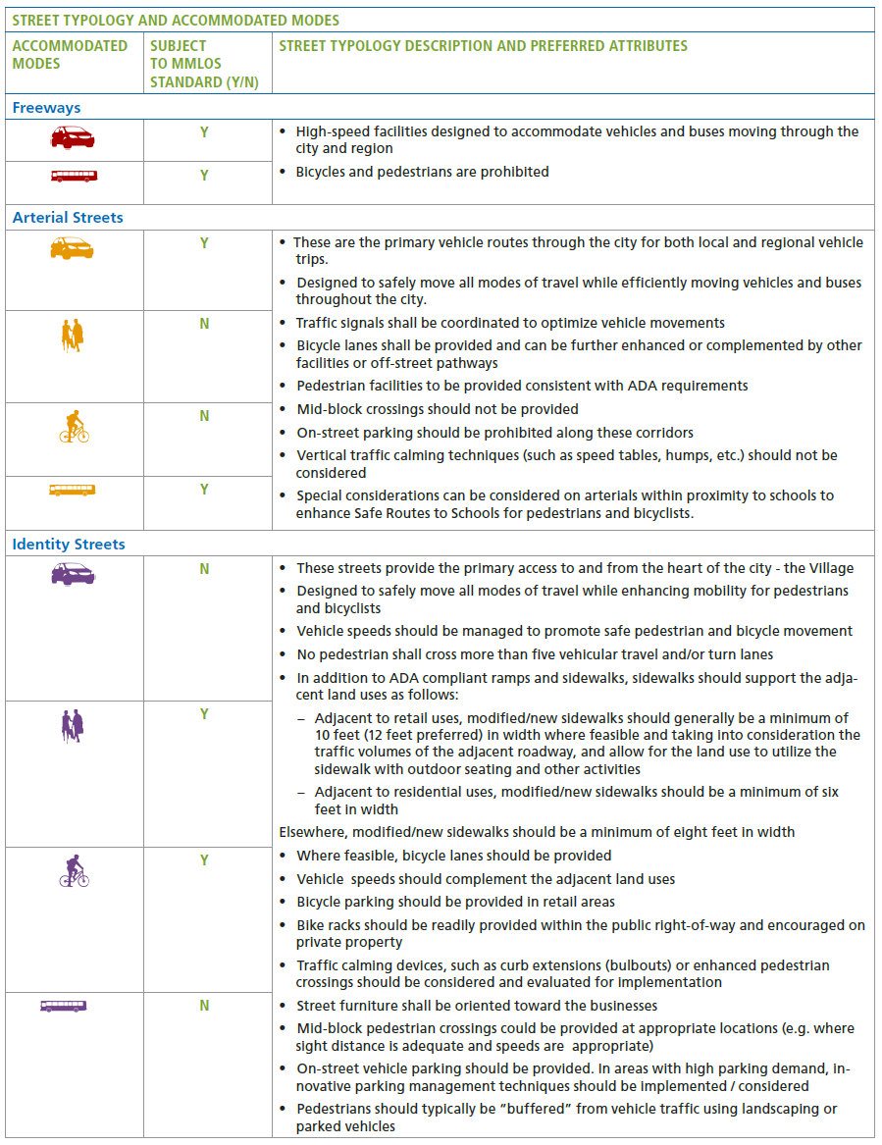
Accommodating Modes: Who Gets Evaluated?
Notes:
This way the context of a street’s surroundings guides what modes get prioritized.

Slide 15
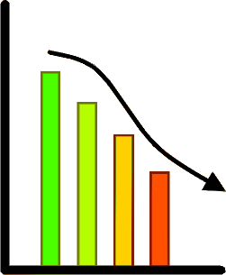
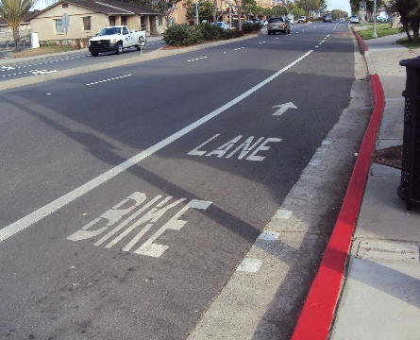
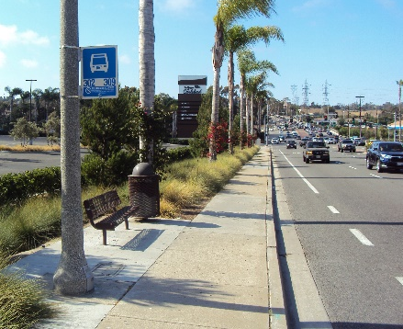
MMLOS: Automobiles need quantity and pedestrians need quality. - Dan Burden
Auto LOS:
Ped/Bike LOS:
Transit LOS:
Notes:
Our approach to MMLOS reflects a need to look at different modes differently. The performance measures driving auto LOS means that we measure how traffic increases as way to show how bad things are getting. For bikes and peds we measure amenities that determine LOS regardless of how many people use that facilitiy- in fact, we actually want MORE people using those facilities.

Slide 16
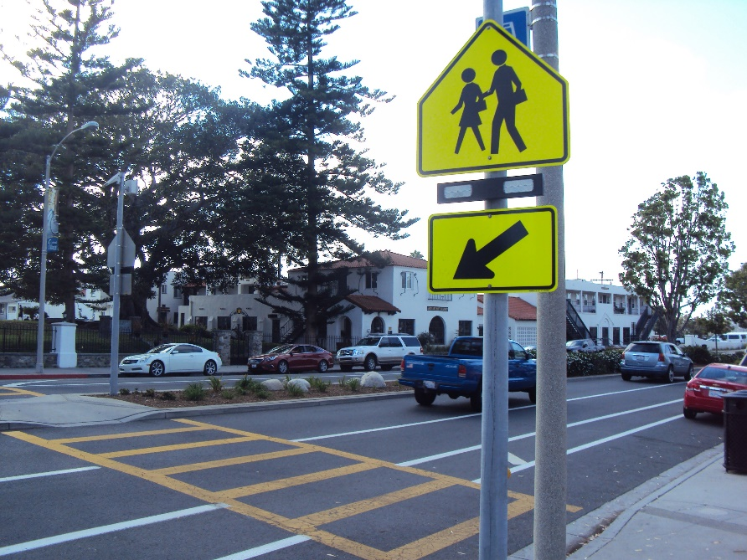
Multimodal Evaluations: Performance vs. Amenities
Performance:
HCM 6th Edition
Amenities
Complete networks
Improved/higher-quality facilities
Identify what makes a facility attractive for a given mode
Define an acceptable standard for each mode
Strive for LOS A by identifying outstanding amenities
Notes:
Ch 16-23 assessing non-auto modes interaction with vehicle traffic
Ch 24 off-street ped and transit facilities
Ch 15 bicycle ops on multi-lane and 2-lane highways
Companion document: Transit Capacity and QOS Manual (2013) evaluates transit facilities
Considers effects of transit presence along urban streets

Slide 17
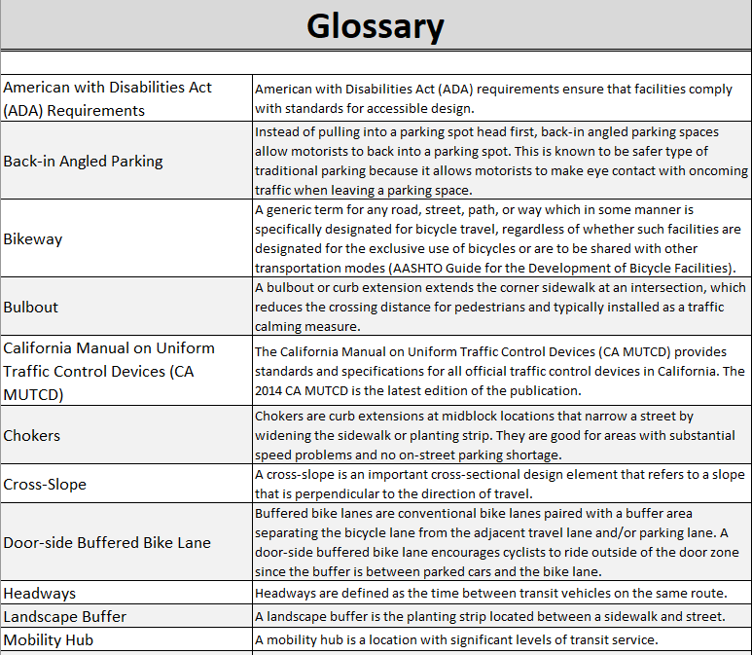
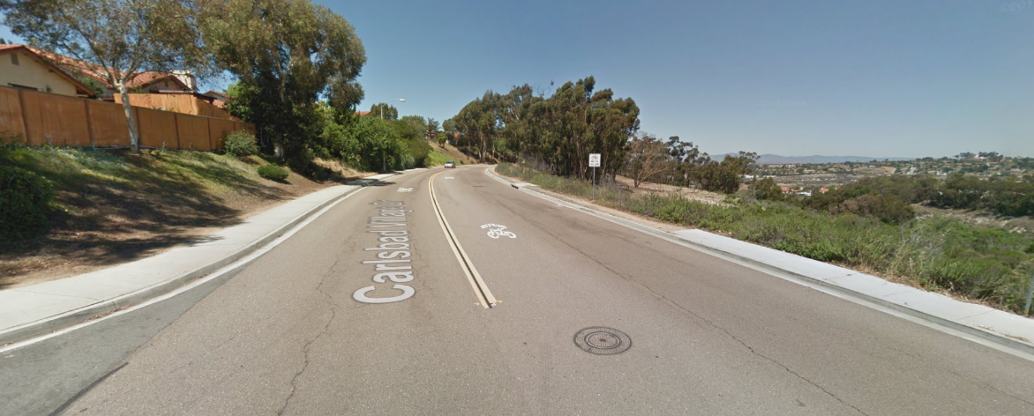
Multimodal Evaluations The Tool
Easy to use and understand
Reduced data collection effort
Simple to update/modify
Accessible for staff and consultants
Notes:
We wanted to develop a MMLOS Tool that was easy to use, simply to gather data, and connected with primary users.

Slide 18
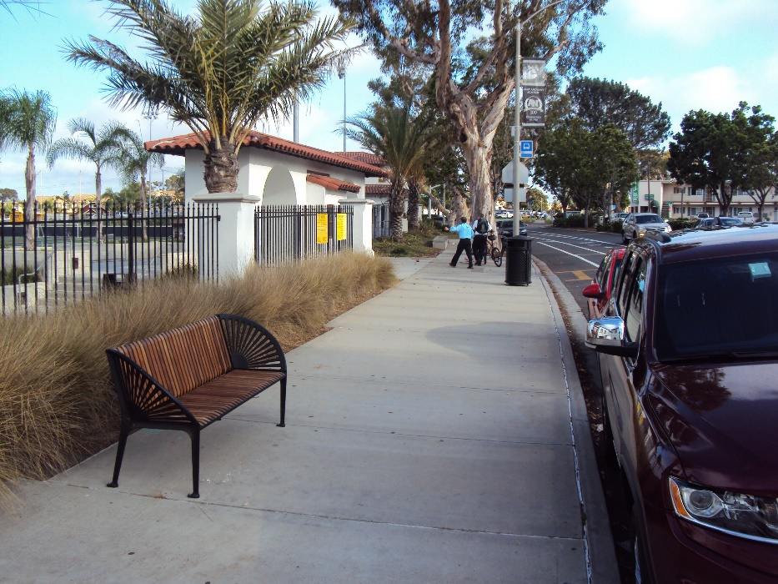
Pedestrian LOS: Any town that doesn’t have sidewalks doesn’t love its children. Margaret Mead

Slide 19
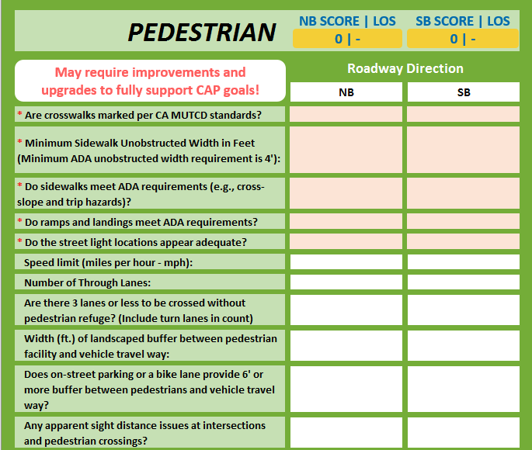
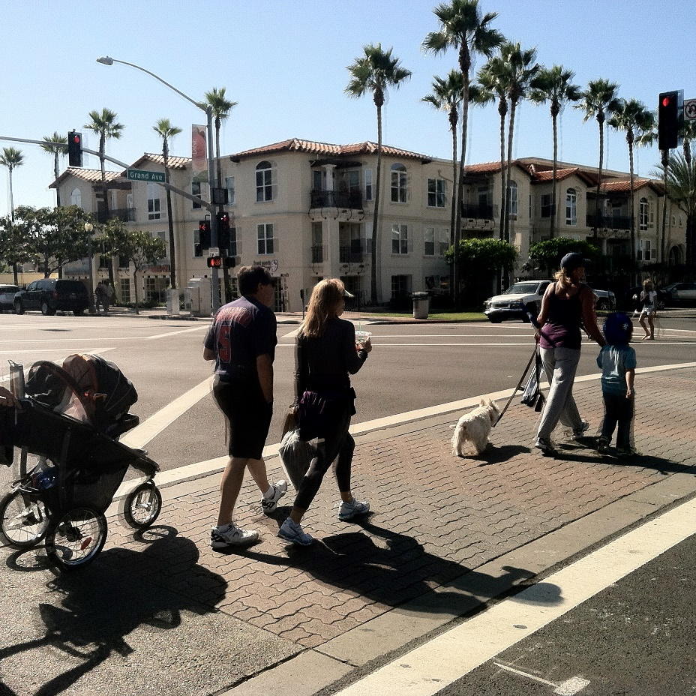
Pedestrian LOS

Slide 20
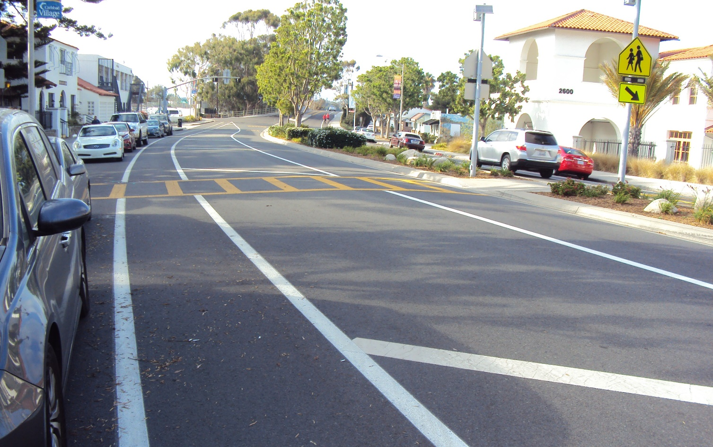
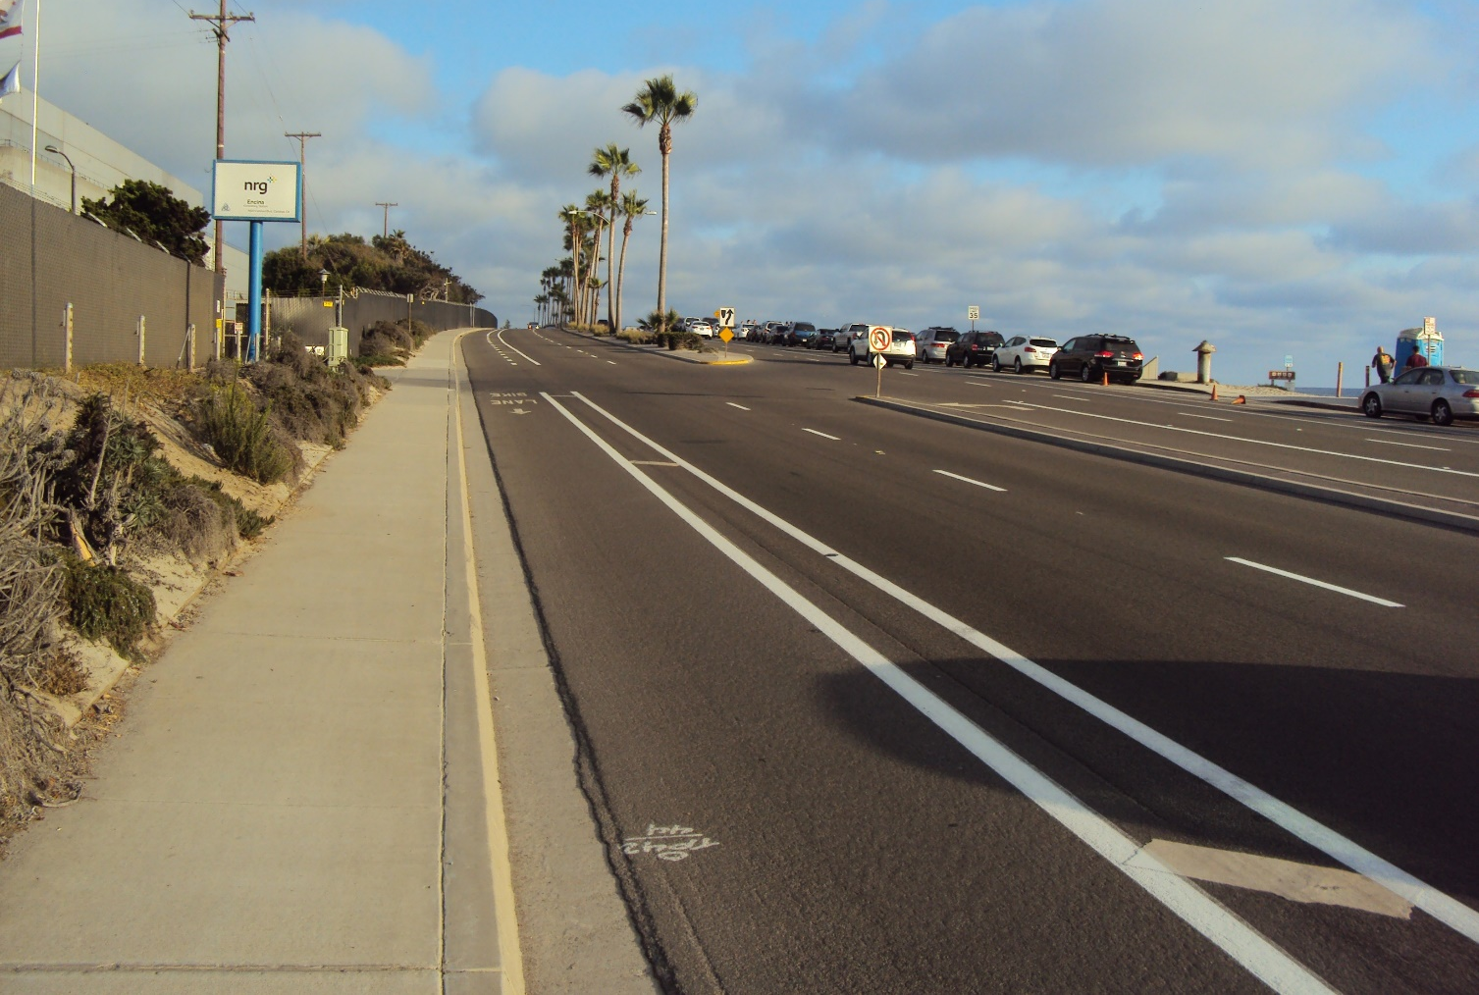
Bicycle LOS: The bicycle is a curious vehicle. Its passenger is its engine. - John Howard

Slide 21
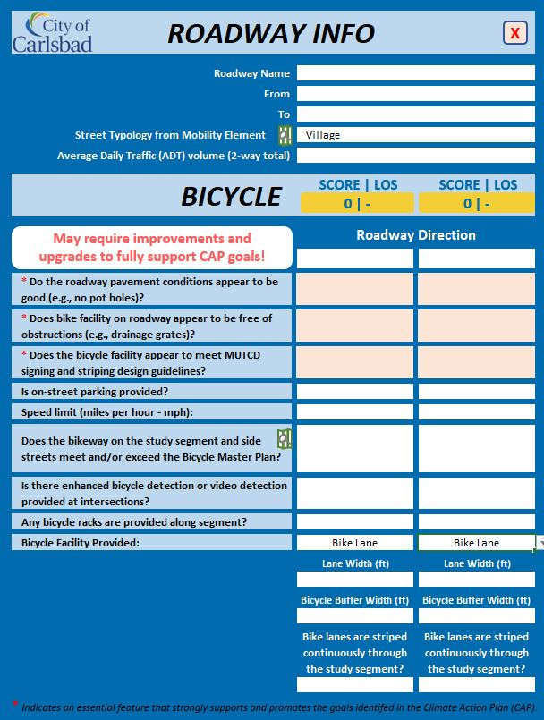
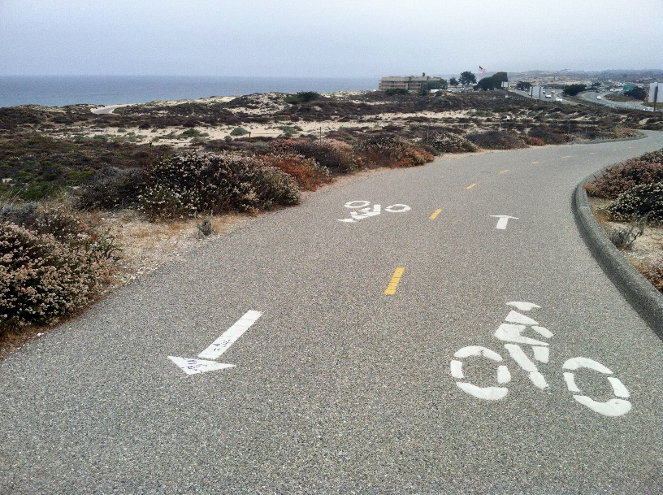
Bicycle LOS

Slide 22
Transit LOS: A developed country isn’t a place where the poor have cars. It’s where the rich use public transit. Gustavo Petro

Slide 23
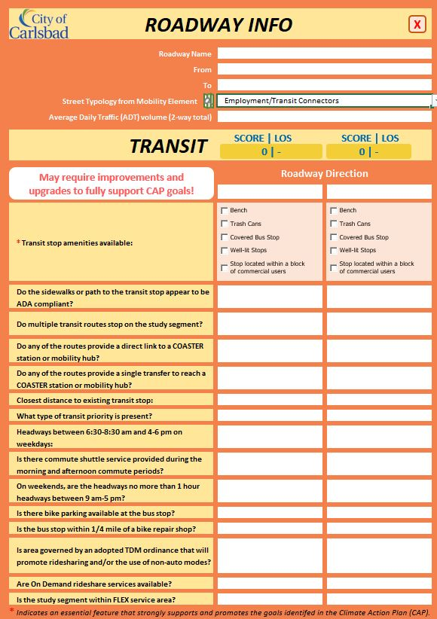
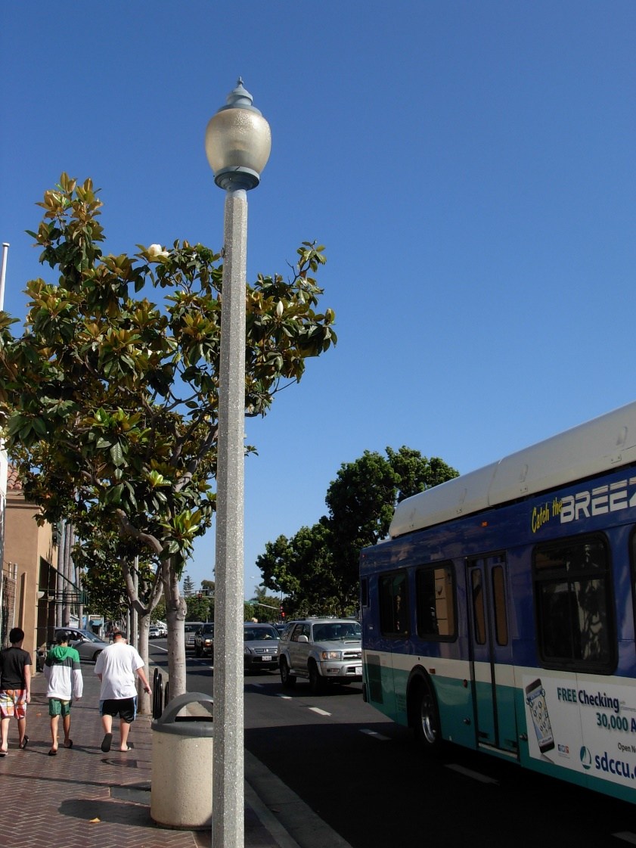
Transit LOS

Slide 24
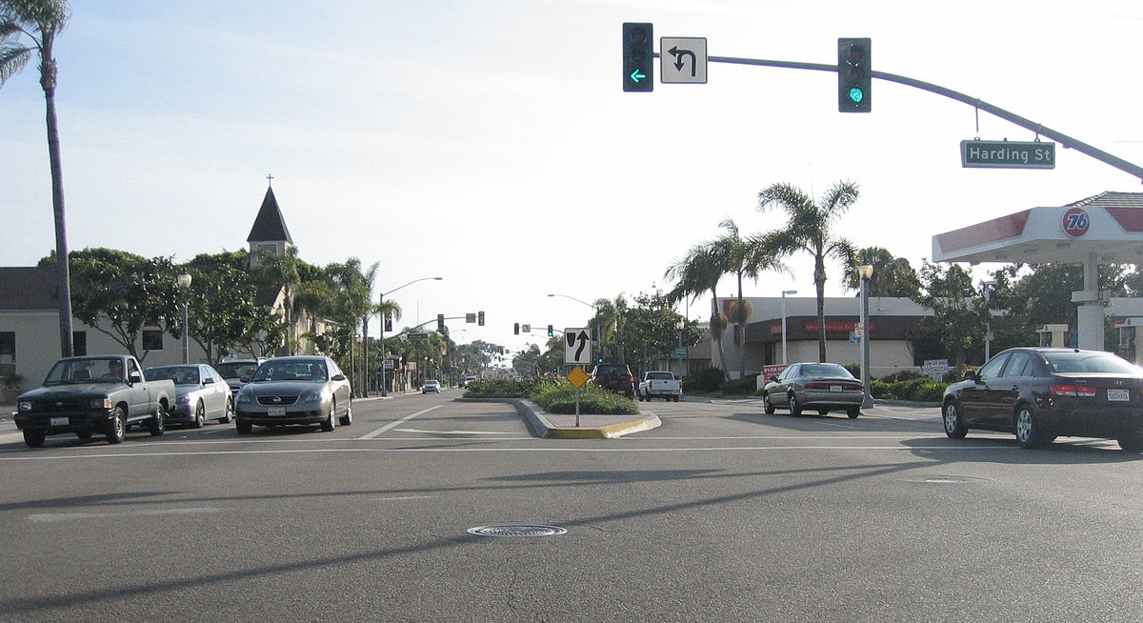
“It is better to be roughly right than precisely wrong.” John Maynard Keynes
Notes:
If there’s anything I’ve learned in traffic engineering, it’s that traffic is highly unpredictable. And yet, we typically take one day of traffic counts – call it average – and then determine intersection operation and geometrics. We know that any given day, traffic volumes can vary in a one hour period. For example – I get into the office every day by 7:30 AM, except on Tuesdays when I drive carpool. Every day but Tuesday, I make a left turn from Aviara Parkway onto Palomar Airport Road to go to work. So if someone took a count on Tuesday, you’d miss me. And some days, I take a completely different route – maybe to see the ocean or maybe to get there faster. Whatever my reason, my presence at the Aviara / Palomar Airport Road intersection is very unpredictable.
So when we starting thinking about traffic conditions in Carlsbad, we realize that “It’s better to be roughly right than precisely wrong”. And that we could streamline the process of evaluating traffic conditions and come to a very similar conclusion to the “old way” of doing things.
I’ll explain.

Slide 25
Carlsbad TIA Guidelines
Streamline the Analysis
Focus on the Operational Needs
Clearly Identify Mitigation
We can no longer expect to build our way out of congestion
Limit the resources used to evaluate roadway capacity
If you make more roads, you will have more traffic.
Allow roads to get LOS exemptions once they have reached their ultimate cross section…
Notes:
There are a few common principles in Carlsbad:
We cannot and do not want to build out way out congestion
If we increase capacity, we are encouraging more vehicle trips
So if we hit the capacity, we’ll just have to live with it
With these general concepts in mind, we worked toward streamlining the process of evaluating impacts. We want to focus on the operational needs and when mitigating – focus on mitigating the impacts associated with the project.

Slide 26
Smaller Projects= Streamlined Reports
Land Use | Forecast Project Generated Auto Trips
 | 200-500 ADT or 20-50 peak hour trips | 500 to 1,000 ADT or 50 to 100 peak hour trips | 1,000 to 2,400 ADT or 100 to 200 peak hour trips | >2,400 ADT or >200 peak hour trips
Conforms to Approved Specific Plan or Master Plan | Level I
Conforms to General Plan or Zoning | Level I | Level III | Level V | Level VII
Does not Conform to General Plan or Zoning | Level II | Level IV | Level VI | Level VIII
Notes:
Rather than try to navigate a complex decision tree for determining the type of TIA needed, the City has created a simple table that will indicate the Level of TIA needed for a project. The level of analysis needed is based on conformance with the General Plan, Specific Plan or Master Plan as well as the vehicle trips generated by the project.
As you can see, small projects, less than 200 trips need not conduct a TIA. Low volume project (200-500 trips) fall into the level 1-2 category. What does that mean you might ask?

Slide 27
Know Your Level – Know Your Study Scenarios
 | MMLOS (ped, bike, transit) | Study Area Map | Trip Generation Table | Trip Distribution & Assignment Figure | Signalized Intersection Analysis | Unsignalized Intersection Analysis | Scenarios to be Evaluated |  |  |  | LFMP Specific TIA
 |  |  |  |  |  |  | Existing Conditions Analysis | Cumulative Conditions Analysis | Horizon Year Analysis | Regional Travel Demand Model Run
Level I | l | l | l
Level II | l | l | l | l | l | l | l |  |  |  | l
Level III | l | l | l | l | l | l | l
Level IV | l | l | l | l | l | l | l | l |  |  | l
Level V | l | l | l | l | l | l | l | l
Level VI | l | l | l | l | l | l | l | l | l |  | l
Level VII | l | l | l | l | l | l | l | l | l | l
Level VIII | l | l | l | l | l | l | l | l | l | l | l
Section Reference: | 7.6 | 3.3 | 5.0 | 6.0 | 7.1 | 7.2 | 4.0 |  |  |  | 3.7
Notes:
Again, in an effort to clearly identify the expectations for each project we created this chart.
So if your project is subject to a Level 1 analysis, a very simple TIA needs to be prepared. Conduct the MMLOS (for segments subject to MMLOS), provide us a map showing the project location, tell us the trips generated. Conclude that auto need not be prepared. Summarize the results.
If you have a Level 2 analysis, you’d do the samething, but you’d need to complete and existing conditions analysis (without & with the project)
For larger projects that will need to modify the General Plan or approved planning document, an update to the Local Facilities Management Plan (LFMP) may be necessary and additional analysis may be needed.

