Slide 1
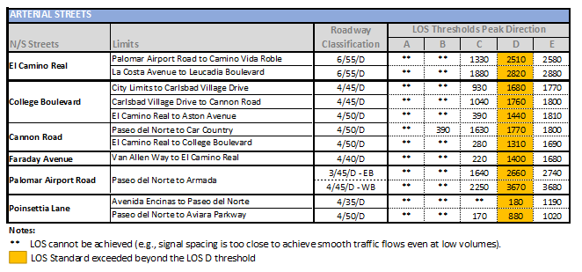
Carlsbad Roadway Capacity (ArtPlan)
Notes:
So you know what scenarios you need to analyze, how did we streamline the process?
Let’s start with arterial analysis. Carlsbad has developed Generalized Service Tables for every roadway subject to auto MMLOS. These tables summarize the maximum peak hour directional capacity for each segment. These capacities were developed using ArtPlan and is consistent with the Highway Capacity Manual. The table provides summarizes the peak direction capacity for El Camino Real.
As I stated previously, the City is not going to build it’s way out of congestion. And as a result, some segments of El Camino Real and Palomar Airport Road have been identified as exempt and are not subject to LOS standards. Therefore, no LOS E thresholds are presented for those segments. Once the operations cross the LOS D threshold, no LOS is reported.
For a TIA, daily traffic volumes would be collected for a segment and the peak hour volumes would be compared to these peak direction thresholds to determine the roadway segment peak period operating conditions. This City has historically used peak hour segment analysis in TIA. However, the “old way” used a fixed per lane capacity for all roadway segments. The “new way” uses segment specific capacities to more accurately reflect the typical capacity on the segment.

Slide 2
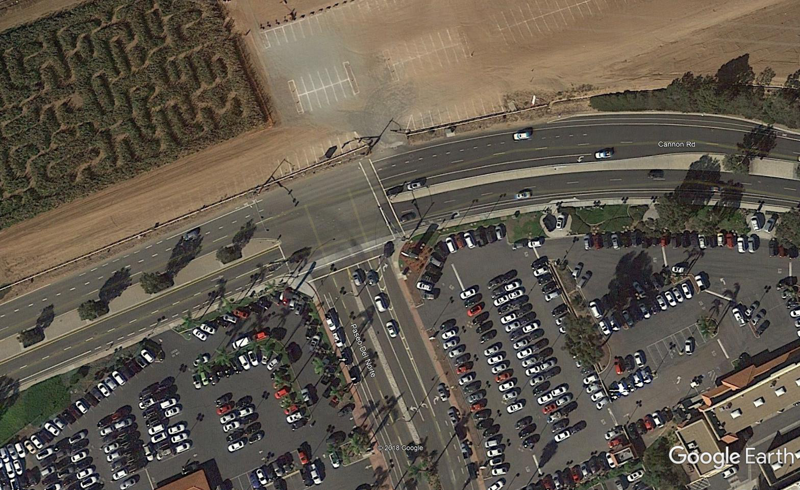
Life after Intersection LOS…
Notes:
I mentioned my unpredictable driving behaviors. When using HCM to analysis intersection impacts, we take a one hour volume on given day, break it down to an adjusted 15 minute volume and then evaluate operating conditions. This is great if the traffic patterns remain consistent on a daily basis. Or if we are trying to conduct signal timing for a corridor.
But we know that HCM analysis, using a complex software program like Synchro, can yield a variety of results. In fact, if two engineers input the same information into Sychro, they may actually get different results. The level of precision for a traffic report has proven to be problematic.
The intersection shown in the image is Paseo Del Norte at Cannon Road. Many of you drove through this intersection on your way to the meeting today. The south leg is Paseo Del Norte. I’ll call you attention to the LOS worksheet on the right. The PM peak LOS is B, which most would say is good. But what I want to draw your attention to is the right turn volume. There are 307 right turning vehicles on the eastbound approach. There is also a good deal of retail and auto dealerships to the south of Cannon Road. So what happens – either drivers try to sneak up the narrow bicycle lane on the right (putting bicyclists at risk) or they get agitated. And when it’s a busy summer day and Legoland to the east is busy – the back up on this approach can extend to the freeway.
But looking only at the delay and LOS doesn’t tell the full picture of the day to day operational issues at this intersection.

Slide 3
Focusing on the Intersection Issues:
Left Turn Queue
Calculate Queue
Compare with Capacity
Left Turn Volume
If Left Turn Volume Exceeds 250 vph, a second left turn is needed
If there is no left turn pocket, more than 150 left turns would require a turn pocket be constructed
Right Turn Volume
If right turn volume exceeds 150 vehicles per hour, a right turn lane is recommended
Determine if Turn Pocket Should be Lengthened
If right turn volume exceeds 300 vph, additional lanes or signal timing modifications may be needed
ONLY EVALUATE LEFT/RIGHT TURNS WHERE PROJECT ADDS TRIPS TO THAT MOVEMENT
Notes:
So, rather than focus on the operations – the City’s TIA guidelines focus on the key operational issues experienced citywide: queues exceeding available capacity and need to add turn lanes.
And again – to streamline the analysis, only the movements that have project trips added are evaluated in the TIA. This resolves the issue of project mitigation measures not coinciding with project impacts. If the queue is exceeded or a turn lane is needed as a result of the project – the project will construct the turn lane or lengthen a pocket. The improvement is a direct benefit to the project and directly addresses the impact identified.
I will note: The City has maintained the HCM level of service analysis for the purpose of CEQA until the TIA guidelines are fully vetted by City Council. So you are not completely off the hook yet. And as you know, CEQA has changed. As the city transitions from LOS to VMT, the analysis described in this presentation today will continue to remain the same. Regardless of the CEQA analysis methodology – all facilities in the City subject to MMLOS will need to be evaluated using the methodology both Sohrab and I have described.

Slide 4
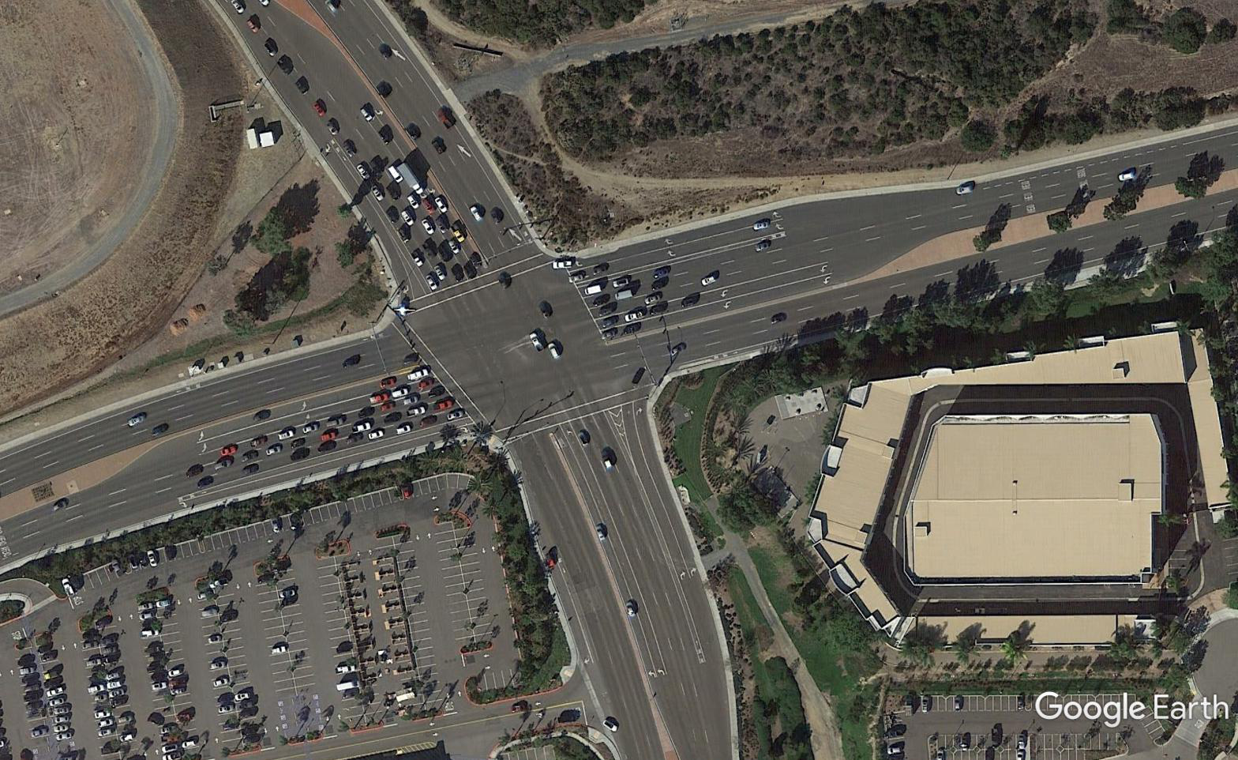
Auto LOS Exemption:
Acquiring the rights of way is not feasible;
or
The proposed improvements would significantly impact the environment in an unacceptable way and mitigation would not contribute to the nine core values of the Carlsbad Community Vision;
or
The proposed improvements would result in unacceptable impacts to other community values or General Plan policies;
or
The proposed improvements would require more than three through travel lanes in each direction.
Notes:
As I mentioned, some segments have been identified as exempt in the City. It’s not easy to get identified this way. The General Plan clearly identifies the criteria that must be met before an exempt status can be considered. The City developed at Community Vision that includes livable, walkable streets. The criteria listed help the City maintain this vision by limiting the number of lanes to 3 in each direction, maintaining and considering community values, and consideration for other impacts to the environment. At this time, only segments of Palomar Airport Road and El Camino Real have received the exempt status.

Slide 5
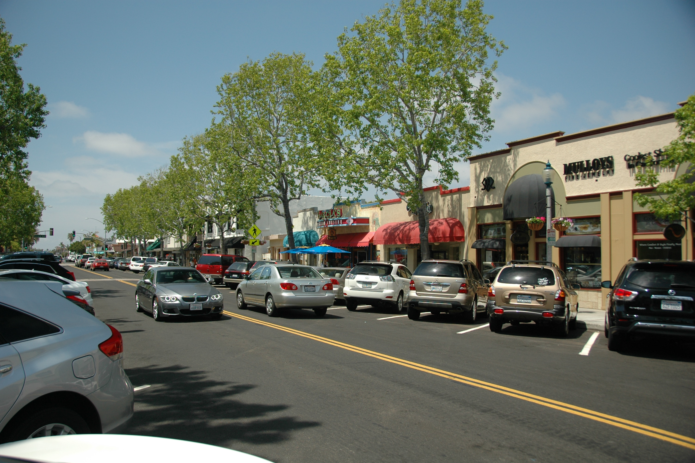
“If you plan cities for cars and traffic, you get cars and traffic. If you plan for people and places, you get people and places.”
Fred Kent

Slide 6
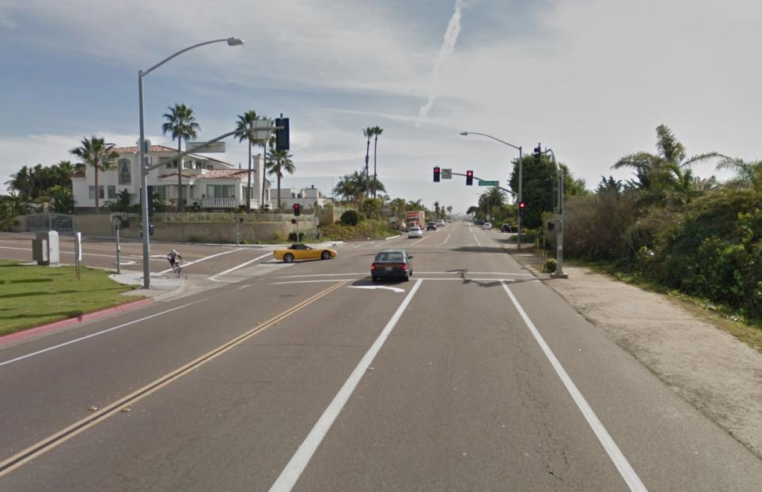
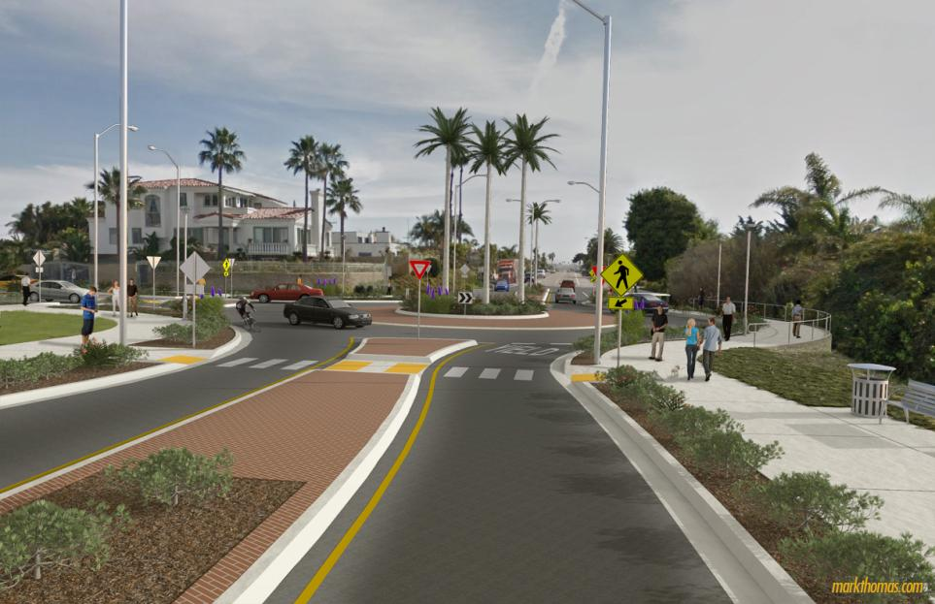
Putting it All Together:
“Cars are happiest when there are no other cars around. People are happiest when there are many other people around.”
Dan Burden

Slide 7
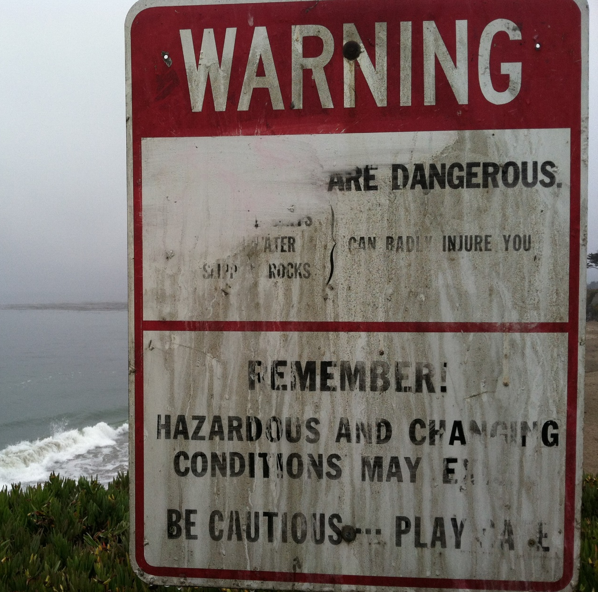
Warning for using Guidelines:
The Pirate’s Code is more what you’d call guidelines, than actual rules.
Captain Jack Sparrow

Slide 8

Go All-In with Multi-Modal Analysis:
Commitment is an act, not a word
Jean-Paul Sarte

Slide 9

Discussion

