Slide 1
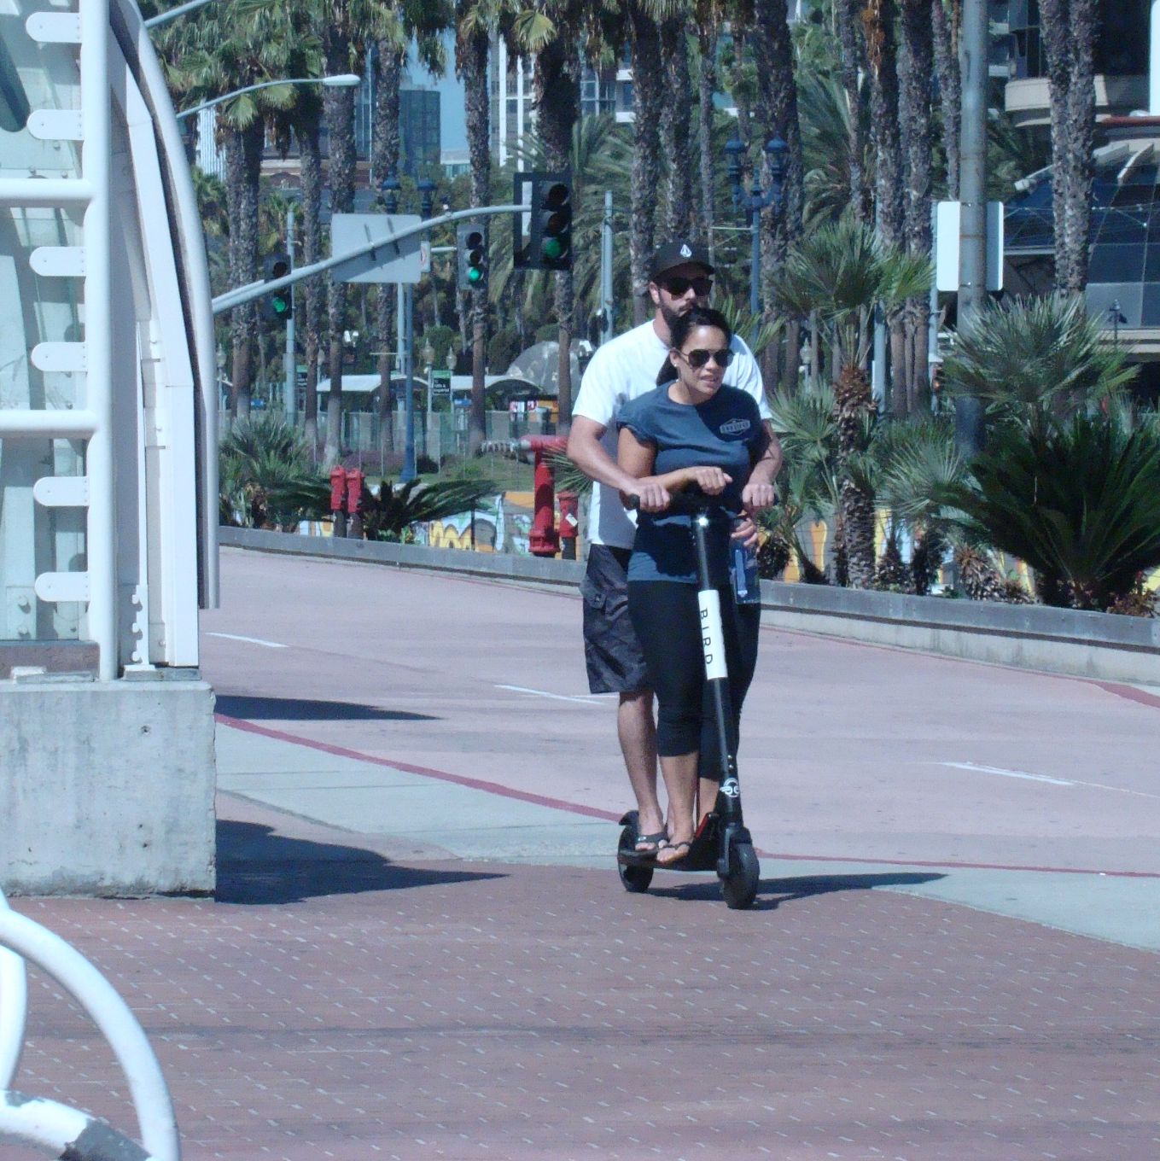
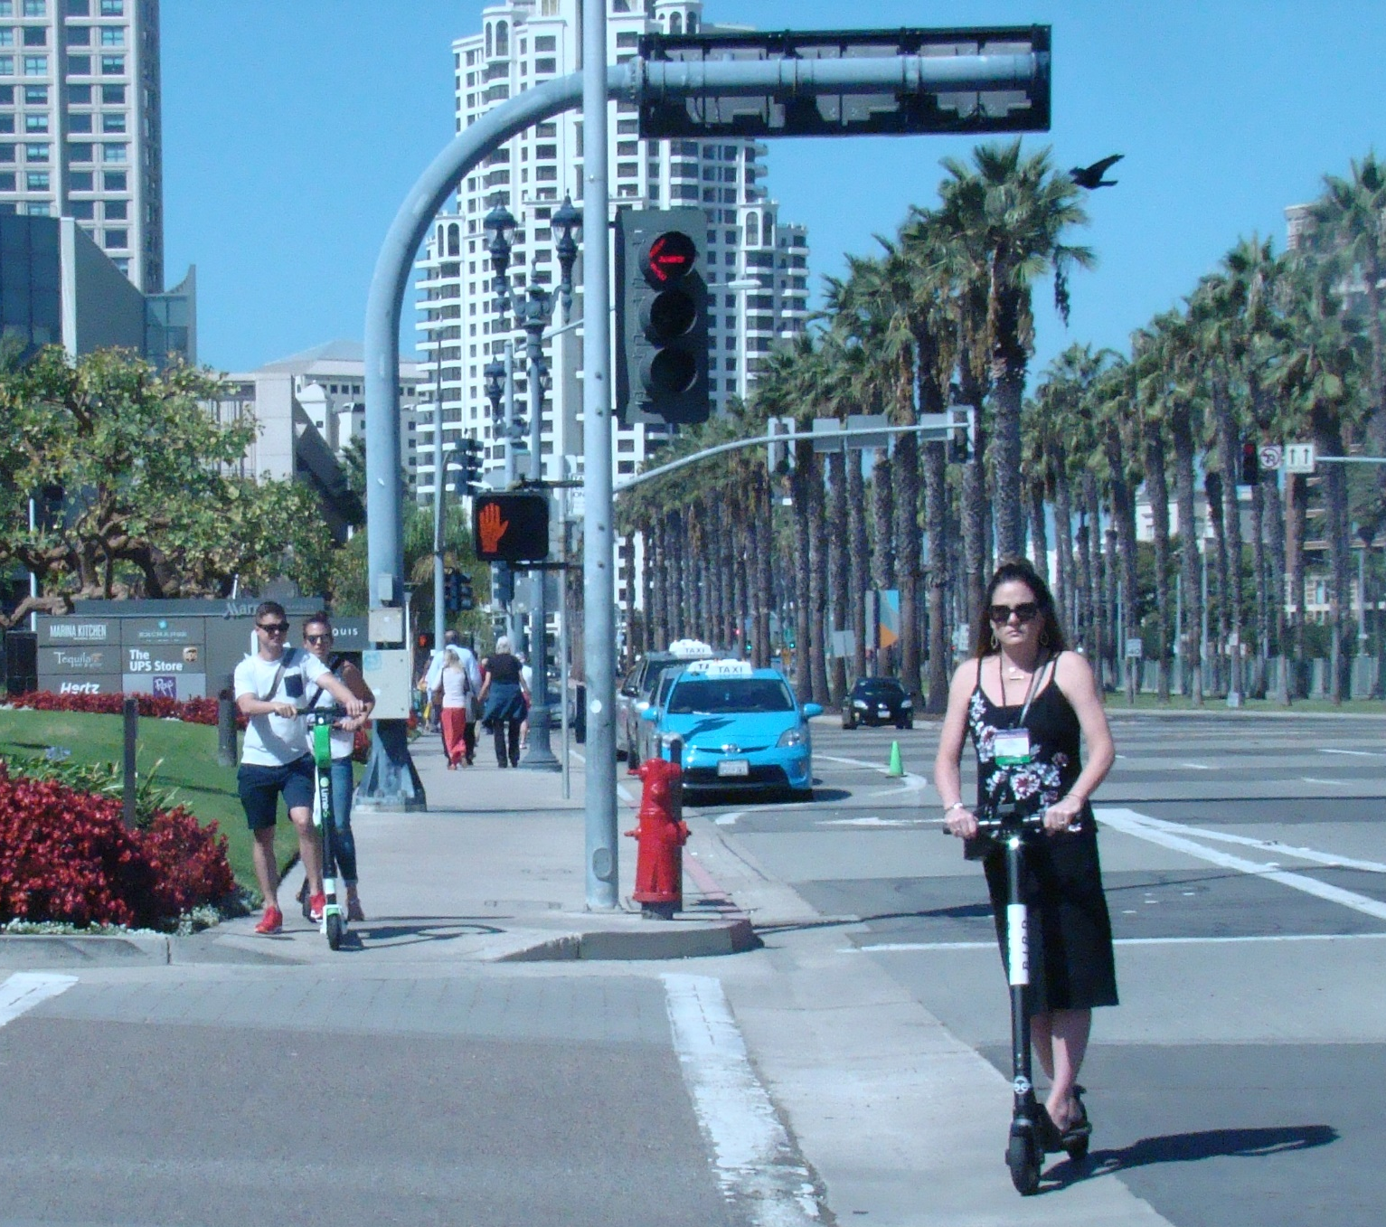
Transportation & Storm Water Department
ITE San Diego Workshop & Vendor Show, October 11, 2018
1

Slide 2
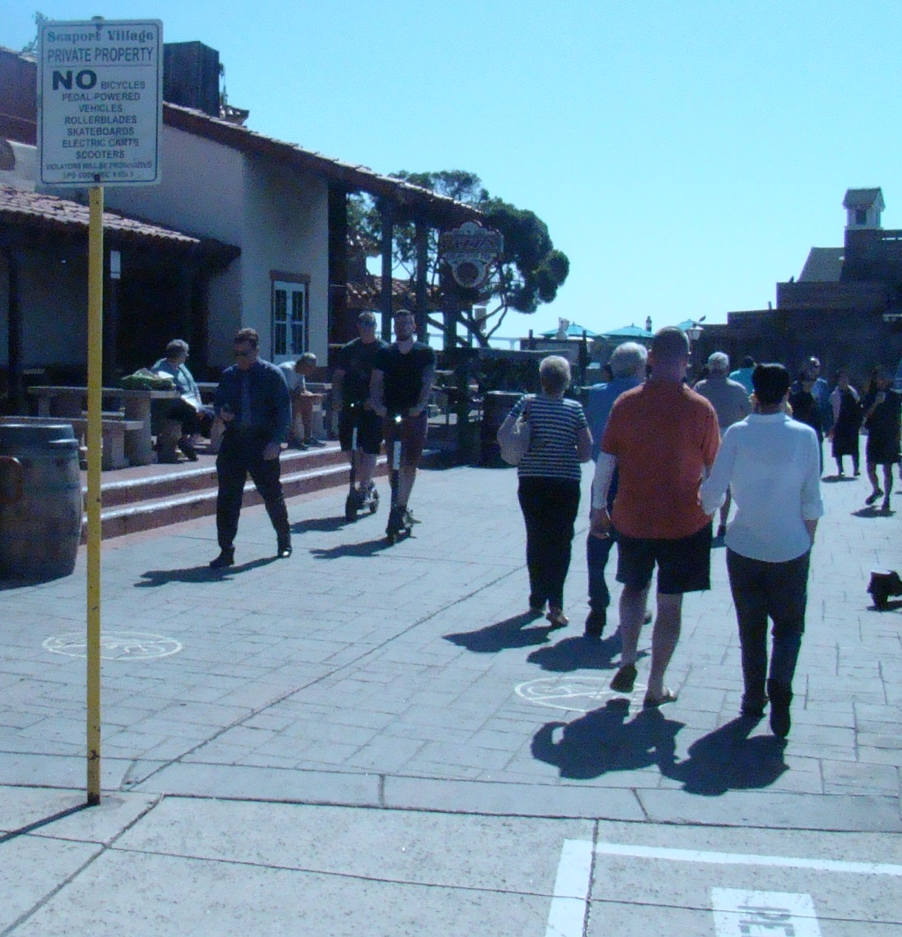
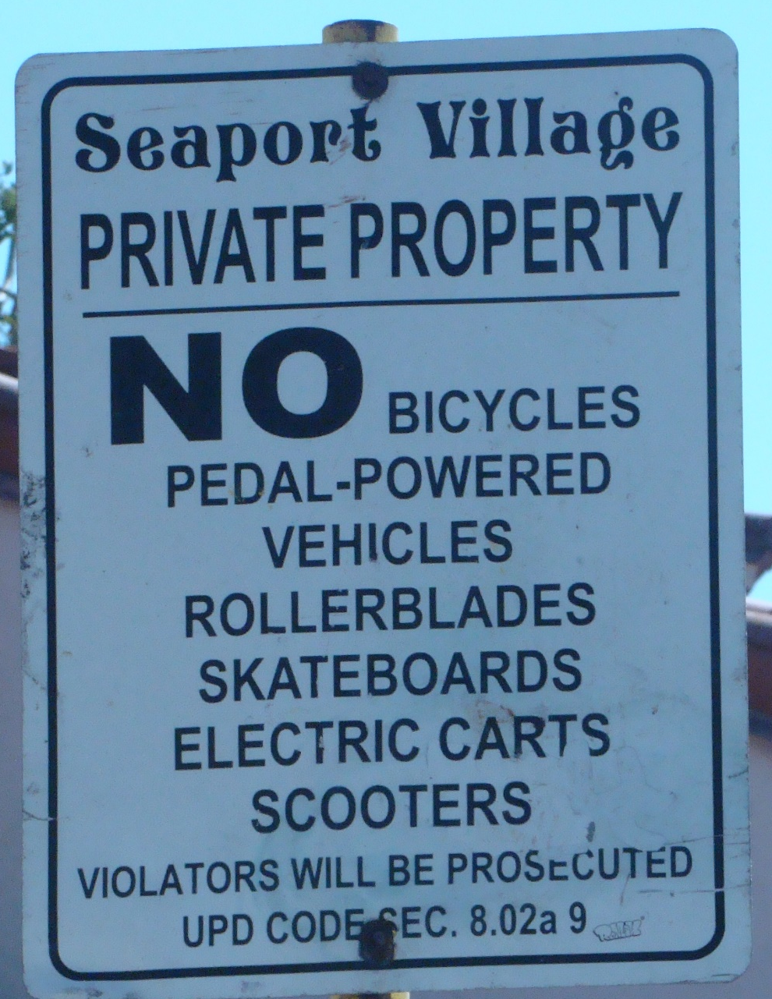
Transportation & Storm Water Department
ITE San Diego Workshop & Vendor Show, October 11, 2018
2

Slide 3
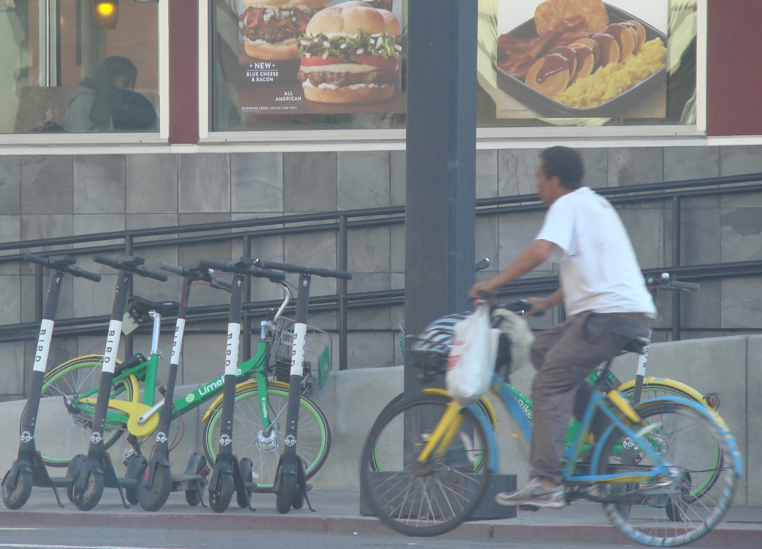
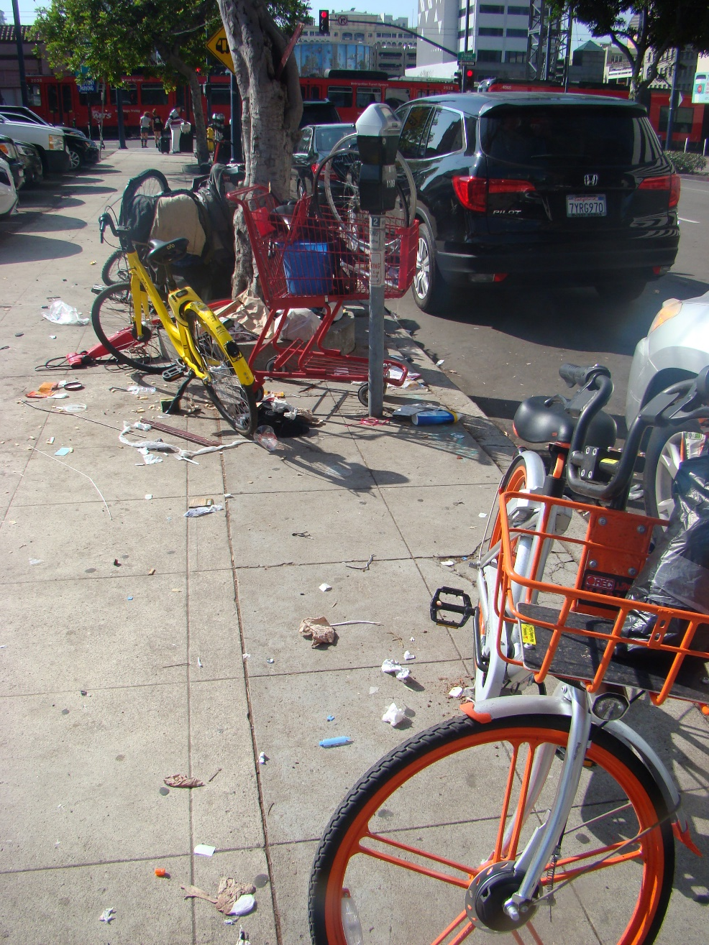
Transportation & Storm Water Department
ITE San Diego Workshop & Vendor Show, October 11, 2018
3

Slide 4

Transportation & Storm Water Department
ITE San Diego Workshop & Vendor Show, October 11, 2018
4

Slide 5

Transportation and Storm Water Department
5

Slide 6
Transportation and Storm Water Department
6

Slide 7
Transportation & Storm Water Department
First 3 Weeks of Operation
500-600 scooters deployed
primarily Downtown
More than 30,000 rides
over 9,000 riders
ITE San Diego Workshop & Vendor Show, October 11, 2018
7

Slide 8
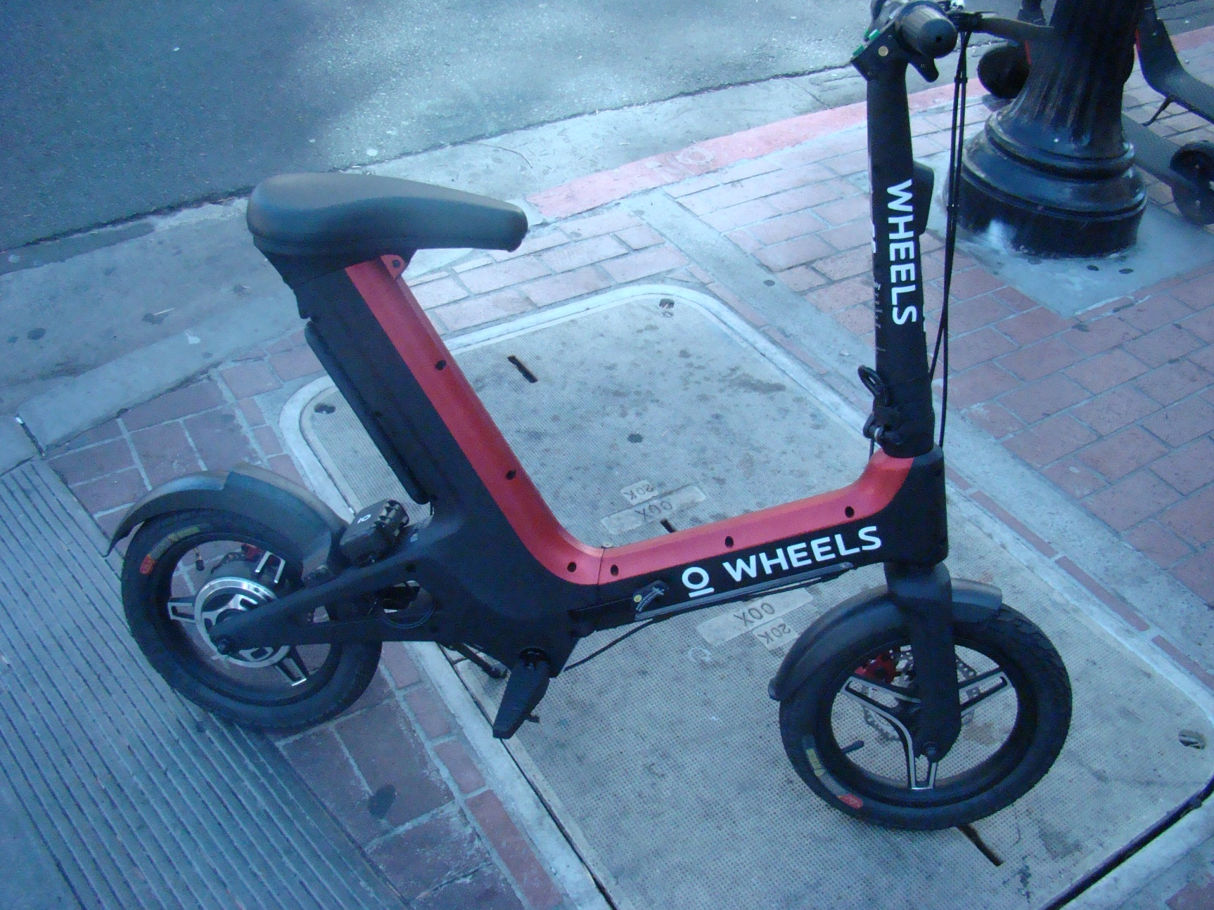
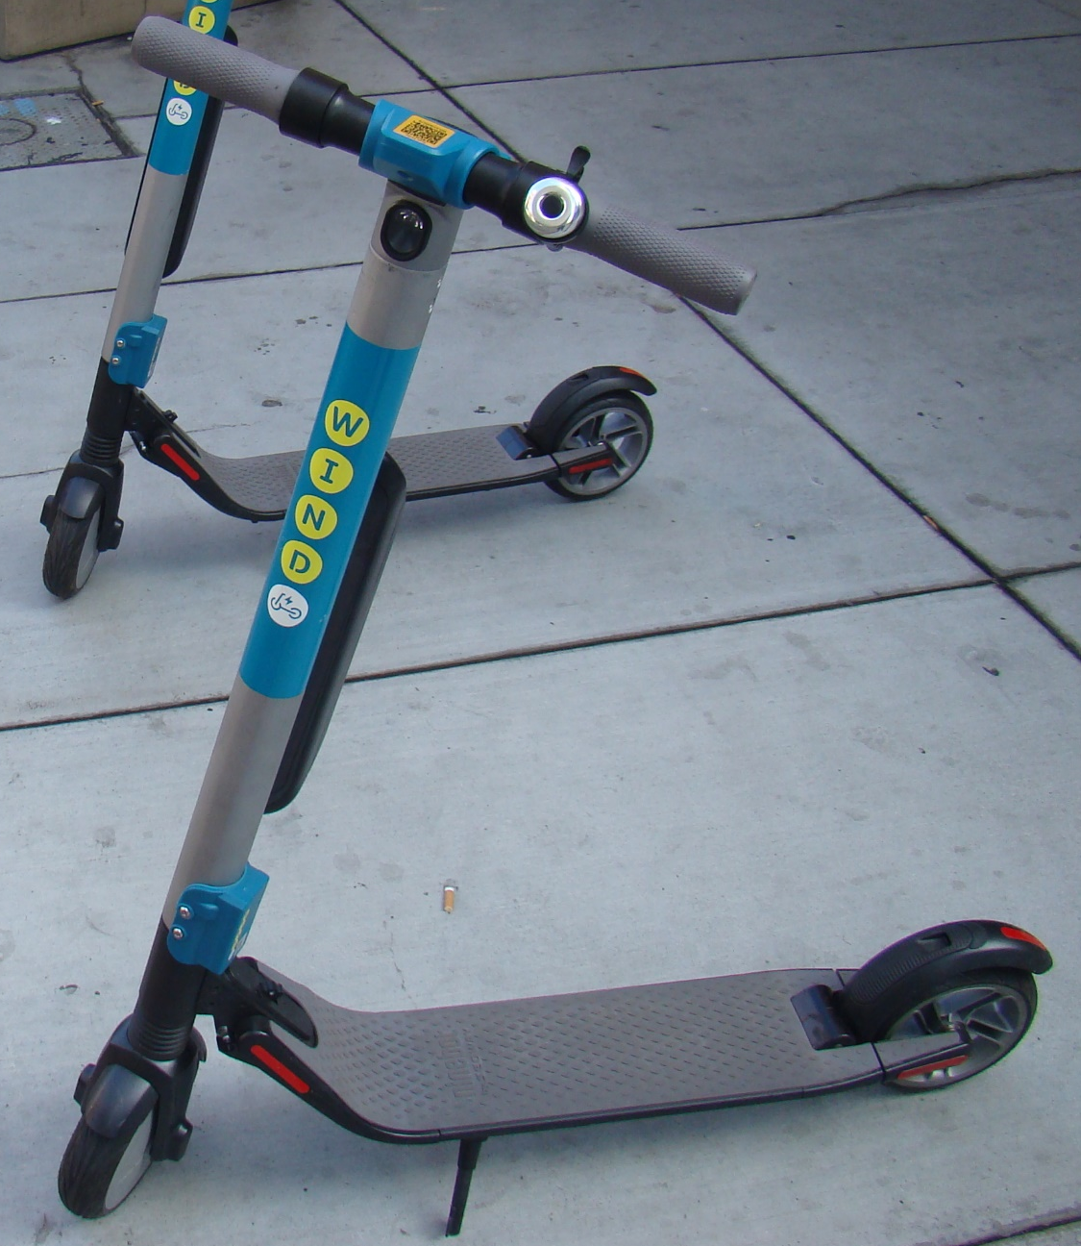
Transportation & Storm Water Department
ITE San Diego Workshop & Vendor Show, October 11, 2018
8

Slide 9
Transportation and Storm Water Department
AB 2989
and
CVC 21235
Allows scooters on higher speed roads
Requires helmets for under 18 users like bicycling
(Use on sidewalks removed from original legislation)
Effective Date
1/1/19
≤25MPH
≤35MPH
9

Slide 10
Transportation and Storm Water Department
COSD Considerations for Dockless Shared Mobility Operators
Regulate usage with code revisions
Permit each device to help identify chain of custody
Require operators to reposition (balance) their fleet as needed
Offer bonus for service areas in underserved markets
Add defined parking areas for orderly staging
Enforce safety and permit violations
Require detailed data on ridership
10

Slide 11
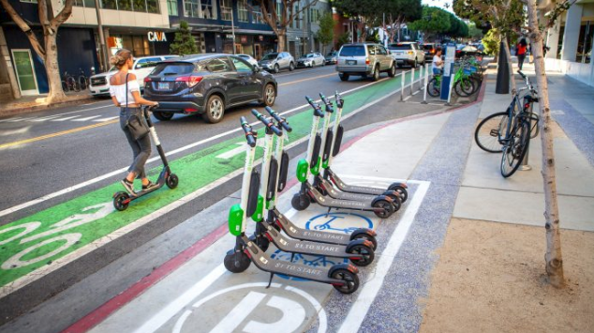
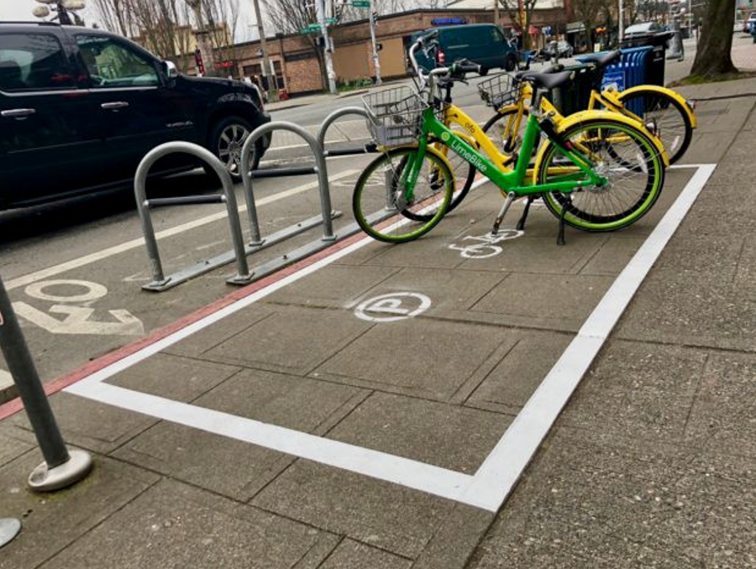
Transportation & Storm Water Department
ITE San Diego Workshop & Vendor Show, October 11, 2018
11

Slide 12

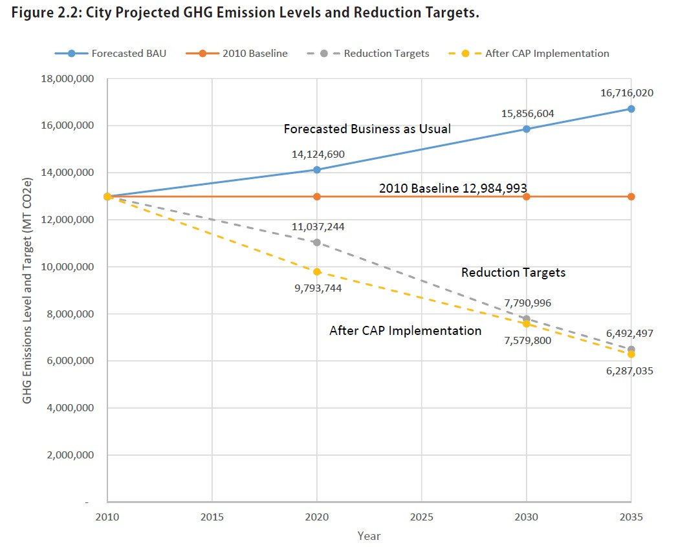
Transportation & Storm Water Department
GHG Reduction Target
15%
40%
50%
12
ITE San Diego Workshop & Vendor Show, October 11, 2018
12
Notes:
The CAP establishes GHG reduction targets of 15% by 2020, 40% by 2030, and 50% by 2035 below the 2010 base year emission level.

