Slide 1

ITE Vendor Show
Dockless Bikes
& Scooters
Ed walton, PE
City engineer
October 11, 2018

Slide 2
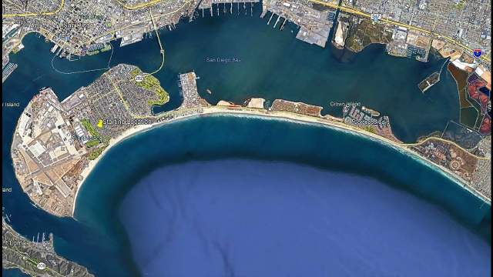
Aerial View of Coronado

Slide 3
Background
LimeBike requested a business operations permit for use of the public rights of way for a dockless bike share program (Coronado Municipal Code)
Other bike share companies made presentations highlighting the merits of dockless bike share programs

Slide 4
Council Decision
City Council tabled discussions on the business operation permit on December 5, 2017
  Concerns for the eleven brick and mortar bicycle rental companies
  Bicycle Sharing was not included in the City’s Active Transportation Plan
  Would not be very beneficial to Coronado residents
Directed staff to develop policies for enforcement

Slide 5
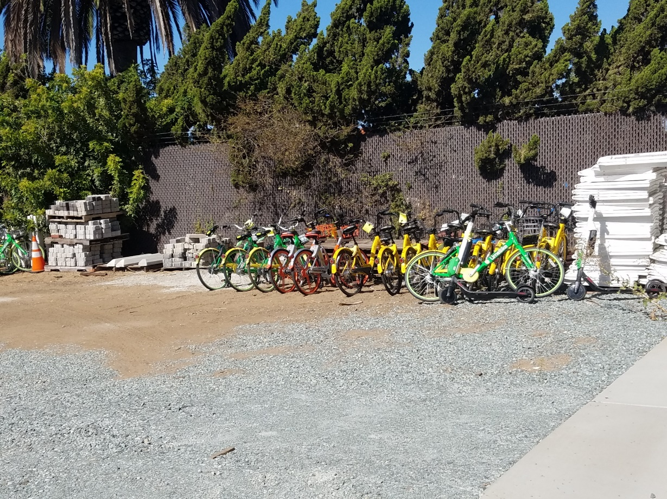
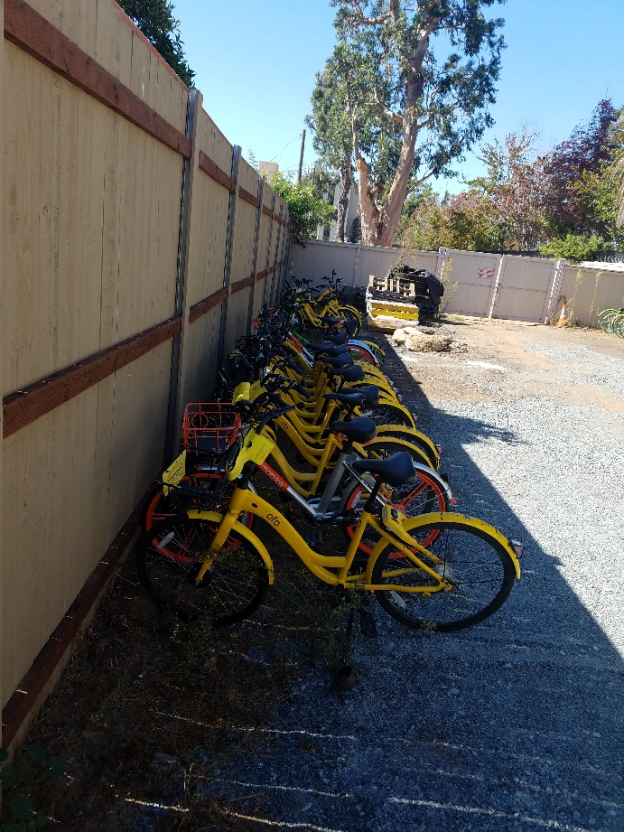
Enforcement

Slide 6
Naval Base Coronado
LimeBike entered agreement with Naval Base Coronado for a bike share program at Naval Air Station North Island
  LimeBikes are intended to stay on base
  Department of Defense requires that bicycle helmets be worn while riding on all bases

Slide 7
Questions?

