Slide 1
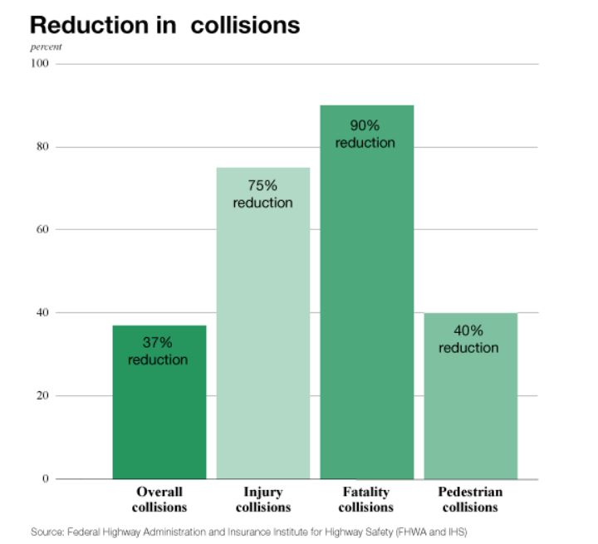
Roundabouts reduced injury collisions by 75 percent and fatal collisions by 90% at intersections where stop signs or signals were previously used.
Notes:
This graph shows some of the drastic reductions in collisions that can be achieved with a roundabout.
Notice that injury collisions were reduced by 75% and fatal collisions were reduced by 90%.
The main two reasons for this drastic reduction are the minimization of conflict points and slower speeds.

Slide 2
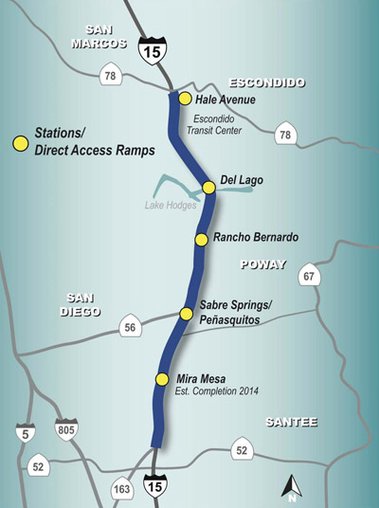

I-15 Express Lanes
Unique facility in the U.S.
“Freeway within a freeway”
20 miles long
10 general purpose lanes
4 reconfigurable lanes
Multiple entry/exit points and Direct Access Ramps
Integrated with new BRT service
Smart Parking

Slide 3
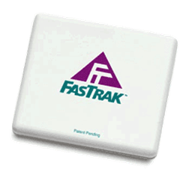
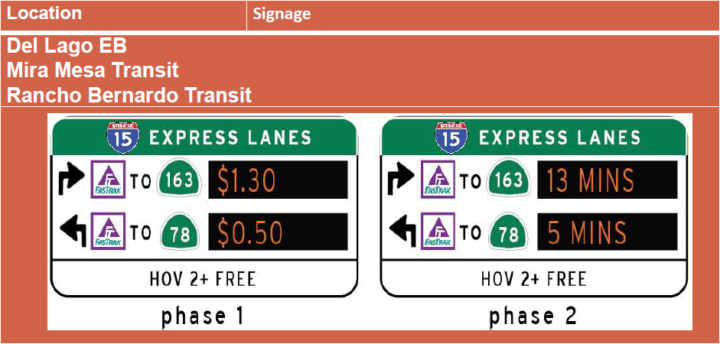

Slide 4
Performance Measures
Quantity of Travel
Number of FasTrak Transponders
Number of FasTrak Users – Active Accuonts
Number of FasTrak Users – During Peak Periods
Average FasTrak User Trip Length – During Peak Periods
FasTrak Cost Recovery
Express Lanes Violation Rates
Peak Period Express Lanes Volumes and VMT
GP Lane Volumes and VMT
Transit Ridership
Corridor Vanpool Use
Quality of Travel
Peak Period Corridor Speeds (GPs and Express Lanes)
Peak Period Person Delay (35 mph and 60 mph)
Peak Period Average Corridor Travel Times
Transit – On-time performance/or Peak Load Factor

Slide 5
Caltrans Organization (portions)
Capital – Maintenance & Operations
Traffic Operations
Information Technology (IT)
Division of Research Innovation and System Information (DRISI)

Slide 6
Organizing Traffic Operations for Tomorrow – Deficiencies & Opportunities
    Culture
        What work/actions are celebrated?
        How do we reinforce aspects/values that we want?
        What are we capable of doing?
        What is our risk tolerance?
        How do we empower our staff to be innovative (ownership and ability to influence)?
        How/where do we create and encourage multidisciplinary teams that collaborate [rather than work in silos]: Traffic Operations – DRISI – IT – Maintenance

Slide 7
Resourcing/Classifications
    How does Traffic Operations receive resources?
    Classifications
        Systems Engineer – bridging Transportation Engineering and Information Technology
        Electrical Engineering Technician – updating minimum qualifications

Slide 8
Asset Management
    [Unique] nature of ITS assets
    Corridor monitoring/dashboards (real-time)
    Data governance
        Who collects it?
        How is it collected?
        Who owns it?
        How/where is it stored?

Slide 9
Final Thoughts
    The State’s transportation system supports a $2.2 trillion California economy (~12% of National GDP, and fifth largest economy in the world). Freight-dependent industries, as an example, provide $740 billion to California’s GDP and 5 million jobs.
    The future will require that Caltrans adapt to better serve its mission, and Transportation Engineers like you will be instrumental in achieving this.
    Caltrans is hiring, and we’d love to have you join the family!

