Slide 1
Ride share impacts on airport Mode share
Ransford S. McCourt, PE, PTOE
DKS Associates
October 2018 ITE San Diego Section

Slide 2
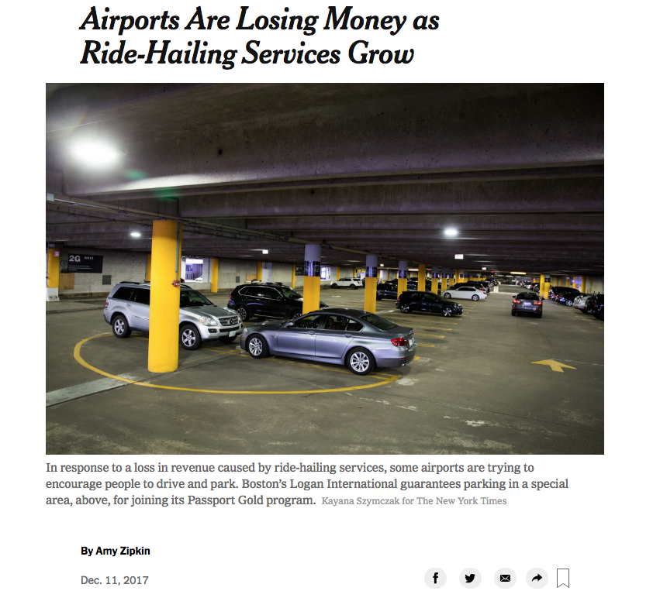
New York Times
December 2017

Slide 3
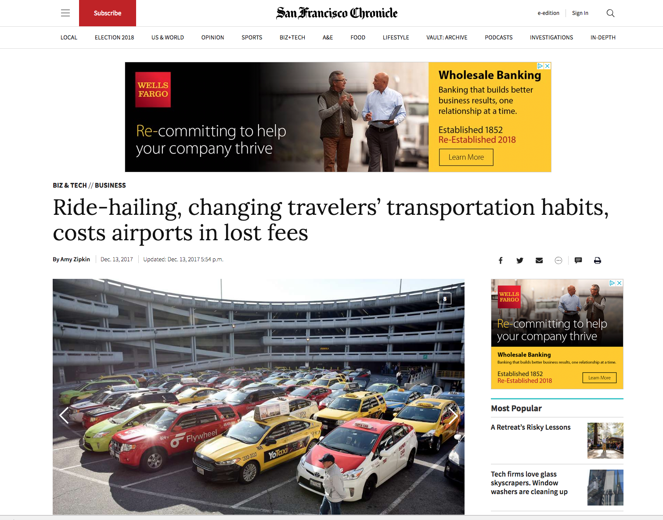
San Francisco
Chronicle
December 2017

Slide 4
Agenda
Research into Mode Share Impacts at Airports
Ridesharing Data Case Studies
Washington, DC (DCA)
Seattle, WA (SEA)
Portland, OR (PDX)
What does it mean in terms of design going forward?

Slide 5
History
2012 - Initiated service
2014 – Nashville 1st airport with TNC agreement
2016 – Permitted at more than 90 airports
Today – Few airports do not have TNC access
Quick disruptor

Slide 6
History
The Why
Provide customer travel options
Reliable
Comfortable
Convenient
Cheaper

Slide 7
ACRP 84 Synthesis 2017
Drop off at same curb area for private vehicles (63%)
Pick up at private or commercial vehicle curb space (85%)
Airports most commonly charge $2-$4 per trip
80% rely on rely on self reported trip data to TNCs
Technology increasing
Medium Airports - $500K to $5M
Large Airports - $1M to $20+
Half the Airports report increased congestion at curb
NOTE: Limited data set, InterVISTA, anecdotal

Slide 8
ACRP 84 Synthesis 2017
Mode Choice changes
Taxi - reduced 5%-30%
Shared Ride (vans) – reduced 18%-30%
Private vehicle – reduced 10-20%
Parking customers – reduced 5%-10%
Rental car transactions – reduced 13%
Limousine – little change

Slide 9
Washington DC – DCA Airport
Metropolitan Washington COG

Slide 10
Washington DC – DCA Airport
Metropolitan Washington COG

Slide 11
Seattle – Seatac airport

Slide 12
Seattle – Seatac airport
Compare last five months of 2015 & 2016
Ground Travel (less private auto) +20%
TNC’s 160% of trip growth
Limos, Charters, Vans, Buses -5%

Slide 13
Portland – PDX Airport

Slide 14
Portland – PDX Airport

Slide 15
Portland – PDX Airport

Slide 16
Portland – PDX Airport

Slide 17
Portland – pdx Airport
Arrival Mode | 2015 | 2018
Private vehicle, and was dropped off at the curb | 40% | 32%
Rental car | 19% | 20%
Private vehicle, and parked in PDX garage/lot | 17% | 16%
TNC: Uber/Lyft | 0% | 13%
Light Rail | 7% | 6%
Taxi | 5% | 3%
Hotel Shuttle | 9% | 6%

Slide 18
Portland – PDX Airport

Slide 19
What does this all mean?
Curb space management is key
Dropping off at the curb and pick up space are the most impacted
Vehicle drops, taxi and shuttles are the next most impacted

Slide 20
Curb management
Curb Space Generation
Creation of curb zones
Shared curb space
Flex curb
Precision in pick-up point
Side of street
Address number for every building

Slide 21
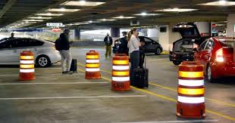

Slide 22
SAN Diego Airport

Slide 23
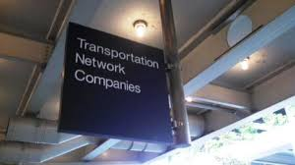
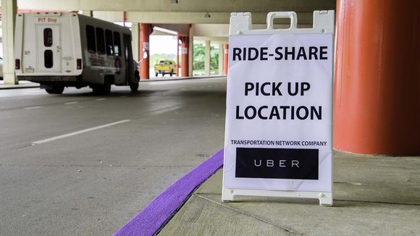
What do you call it?
Signs
TNC
Ride Sharing
Ride Service
Smartphone App Ride
Ride Hailing
Pre-Arranged Rides
Brand Names

Slide 24
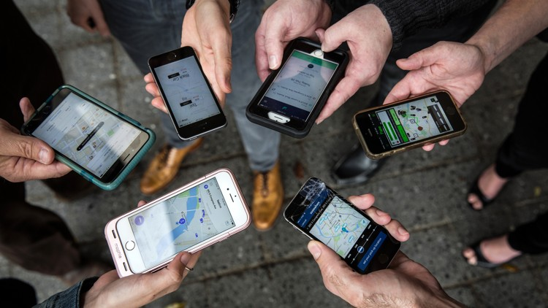
Q’s
Randy McCourt
Principal, DKS Associates
Randy.McCourt@dksassociates.com
(503) 243-3500
Thanks to :
Mike Coleman & Michael Huggins, Port of Portland
Barry Hennelly, Port of Seattle

Slide 25
Think Portland 2021 ITE Joint International/Western ITE Annual Meeting

