Slide 1
Regional Micromobility Coordination
2018 ITE San Diego Workshop
October 11, 2018

Slide 2
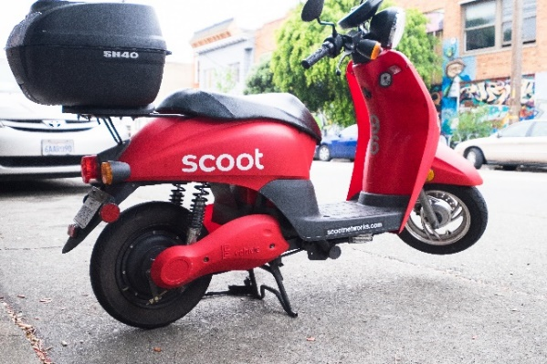
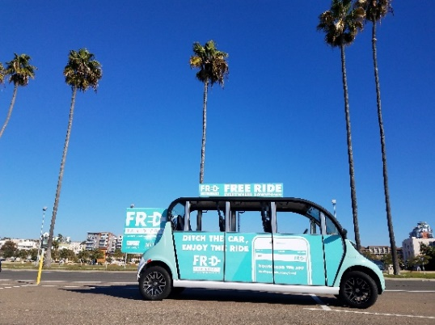
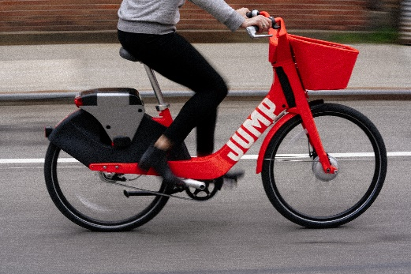
Micromobility Defined
Regional Micromobility coordination
Notes:
Faster than walking but slower than a sedan.
While this series of coordination meetings will focus on bikes and electric scooters, there are other low speed modes that could be included in this category. It’s also important to note that some of these could be personally owned or shared fleets. Space for operating and storing both will become very important.
All of these featured mobility options have some kind of speed cap that falls between 10 and 30 mph.
General motors EN-V - 2-seat urban electric concept car jointly developed by Segway Inc. and General Motors that can be driven normally or operated autonomously. Low speed vehicle – up to 25 mph like a NEV.
I’ll be mentioning NEVs again later in the discussion.

Slide 3
Regional Micromobility Coordination
Shared mobility services play key role in SANDAG Regional Mobility Hub Strategy
Dockless vehicle operations continue to expand in our region
Micromobility data needed for better planning and operations
Regional Micromobility coordination
Notes:
Hub strategy – motorized solutions that help expand the reach of high-frequency transit beyond the first and last mile
Earlier this year, I presented the case for regional bikeshare coordination at various SANDAG working groups, and many jurisdictions concurred it was needed. Now that scooters have been deployed in the City of San Diego and there are additional cities contemplating them, we’ve updated this group to focus on both.
We can leverage this group to share updates on micromobility planning and implementation around the region including providing feedback on experience with various micromobility models and providers.
SANDAG staff will contribute to the effort by compiling bikeshare regulation and policy best
practices. Additionally, our agency’s experience with regional data collection and analysis can help inform local cities’ near and
long-term mobility network planning and development of transportation demand management policies and programs.

Slide 4
Local Micromobility Snapshot
Imperial Beach
National City
City of San Diego
North County Coastal
Chula Vista
Universities
Military
Regional Micro-mobility coordination

Slide 5
Peer Agency Resources
Seattle Free Floating Bikeshare Pilot
San Francisco Micromobility Pilots
Santa Monica Shared Mobility Pilot
National Guidance
NABSA Dockless Bikeshare Regulation Preliminary Guidance
NACTO Guidelines for the Regulation and Management of Shared Active Transportation
Regional micromobility coordination
Notes:
Common to all:
Permit programs and associated fees
Minimum data sharing requirements including user surveys
Fleet size minimums with potential for expansion

Slide 6
Why Micromobility Data Matters
Better understanding of trip patterns and alignment with existing and planned facilities
Equitable deployment of dockless vehicles across neighborhoods
Fleet caps versus market-driven approach
Vendor response rates to safety concerns
Improved insight on travel behavior and user satisfaction
Regional Micromobility coordination
Notes:
Handful of ways the data can help us.

Slide 7
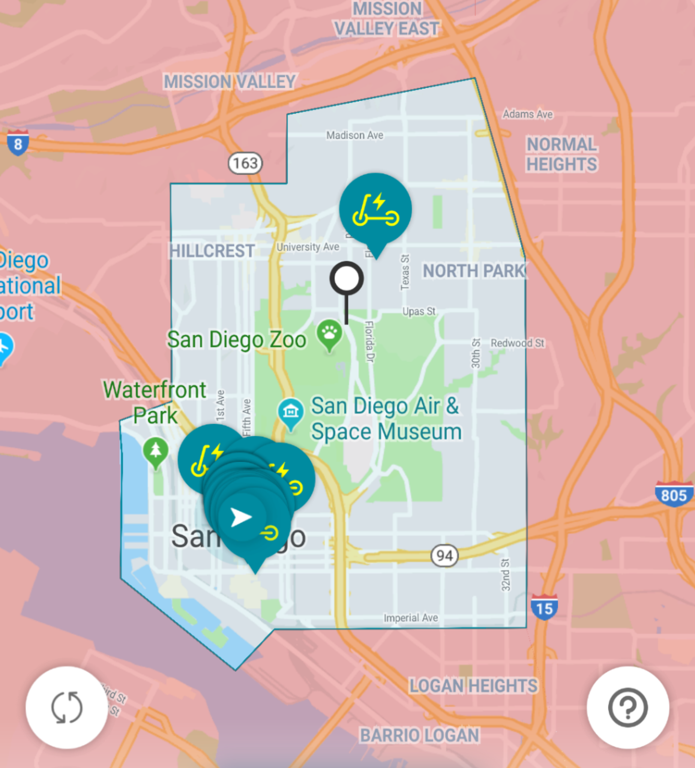
Regional Micromobility Coordination Topics
Data sharing
Regulations including fees, fleet caps
Micromobility parking
Education/Outreach
Safety and liability
Equity
Regional Micromobility coordination
Notes:
Handful of ways the data can help us.

Slide 8
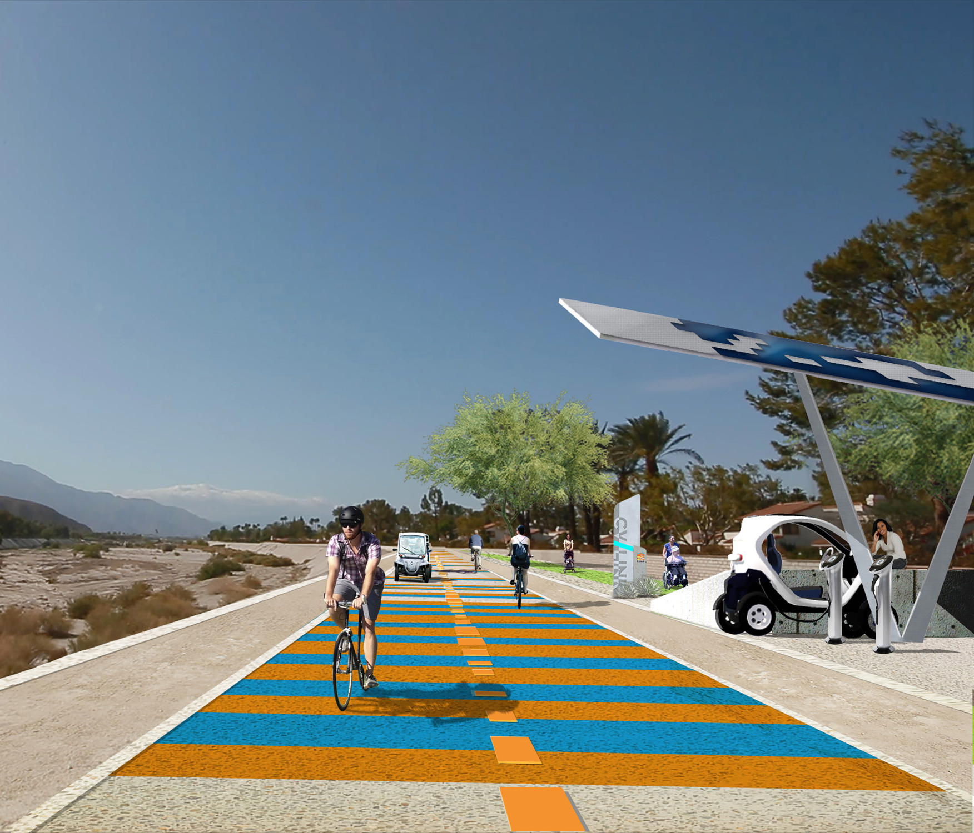
Multi-Modal Integration Opportunity
SB 1151 – Neighborhood electric vehicle (NEV) plans
Image Courtesy of Coachella Valley Association of Governments
Regional Micromobility coordination

Slide 9
Learn More
sandag.org/micromobility
Marisa Mangan, Regional Planner
marisa.mangan@sandag.org
Regional micromobility coordination

