Slide 1
San Diego Regional Proving Ground &
Chula Vista’s Smart Transportation Future
INSTITUTE OF TRANSPORTATION ENGINEERS – SAN DIEGO
June 14, 2018
Notes:
Good afternoon everyone.
My name is Eddie Flores. I’m the City Traffic Engineer for the City of Chula Vista. This afternoon I’m going to be talking about the San Diego Regional Vehicle Proving Ground from the City’s perspective.
In November 2016, the U.S. Department of Transportation announced that it was seeking proposals for the designation of Automated Vehicle Proving Grounds. SANDAG partnered with Caltrans District 11 and the City of Chula to submit an application to USDOT that proposed three distinct proving ground facilities within the region. A couple of months later, in January 2017, we received notification that we had been selected among 60 applicants as one of ten Autonomous Vehicle Proving Grounds across the nation.

Slide 2
Designated Proving Grounds
American Center for Mobility
City of Pittsburgh
Wisconsin AVPG
GoMentum - CCTA
Iowa City Development Group
US Army Aberdeen Test Center
North Carolina Turnpike Authority
SANDAG, Caltrans, and City of Chula Vista
Texas AV Proving Ground Partnership
Central Florida Automated Vehicle Partners
Notes:
The 10 designated proving grounds, shown in this slide form the Community of Practice. They represent a variety of testing environments from wide ranging weather, closed test tracks, simulated environments, a military base, and public streets and roads.
The only proving grounds on the west coast are in the state of California – GoMentum station which is a closed test track facility managed by the Contra Costa Transportation Authority in the Bay Area and our San Diego proving grounds.

Slide 3
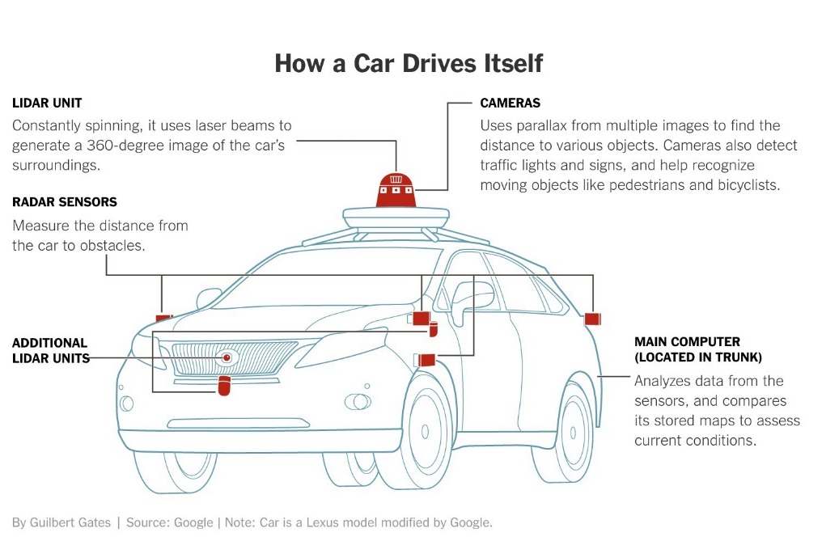
US DOT Objectives for Proving Grounds
Accelerate safe deployment of AV technologies
Public safety, improved mobility, disadvantaged populations
Share best practices for safe testing and deployment
Research and data sharing
Public outreach and education
Notes:
USDOT’s objective for the proving grounds is to accelerate technologies that advance public safety, improve personal and commercial mobility, and open new doors to disadvantaged people and communities. The 10 designated proving grounds are expected to collectively form a “Community of Practice” around safe testing and deployment and to openly share best practices enabling the participants and the public to learn at a faster rate and accelerate the pace of deployment.

Slide 4
San Diego Regional Proving Ground Attributes
Local, regional, state, and federal government
History of collaboration and innovative pilot projects
Real-world test environments
Technology and defense hub
3,270 technology companies
100+ cybersecurity companies
Largest concentration of U.S. military in the world
World-class academic research institutes
UC San Diego: Contextual Robotics Institute and Design Lab
SDSU: Safety through Disruption (SafeD) University Transportation Center
Notes:
A unique attribute of the San Diego regional proving ground is that our facilities offer real world testing on public streets and roads. Also, the San Diego region is considered a global high-tech hub with companies specialized in cybersecurity, software development, information technology, wireless communications, and defense.
The region is also home to two universities with advanced work in the robotics and transportation engineering fields.
** Stats are from San Diego Economic Development Corporation (EDC)

Slide 5
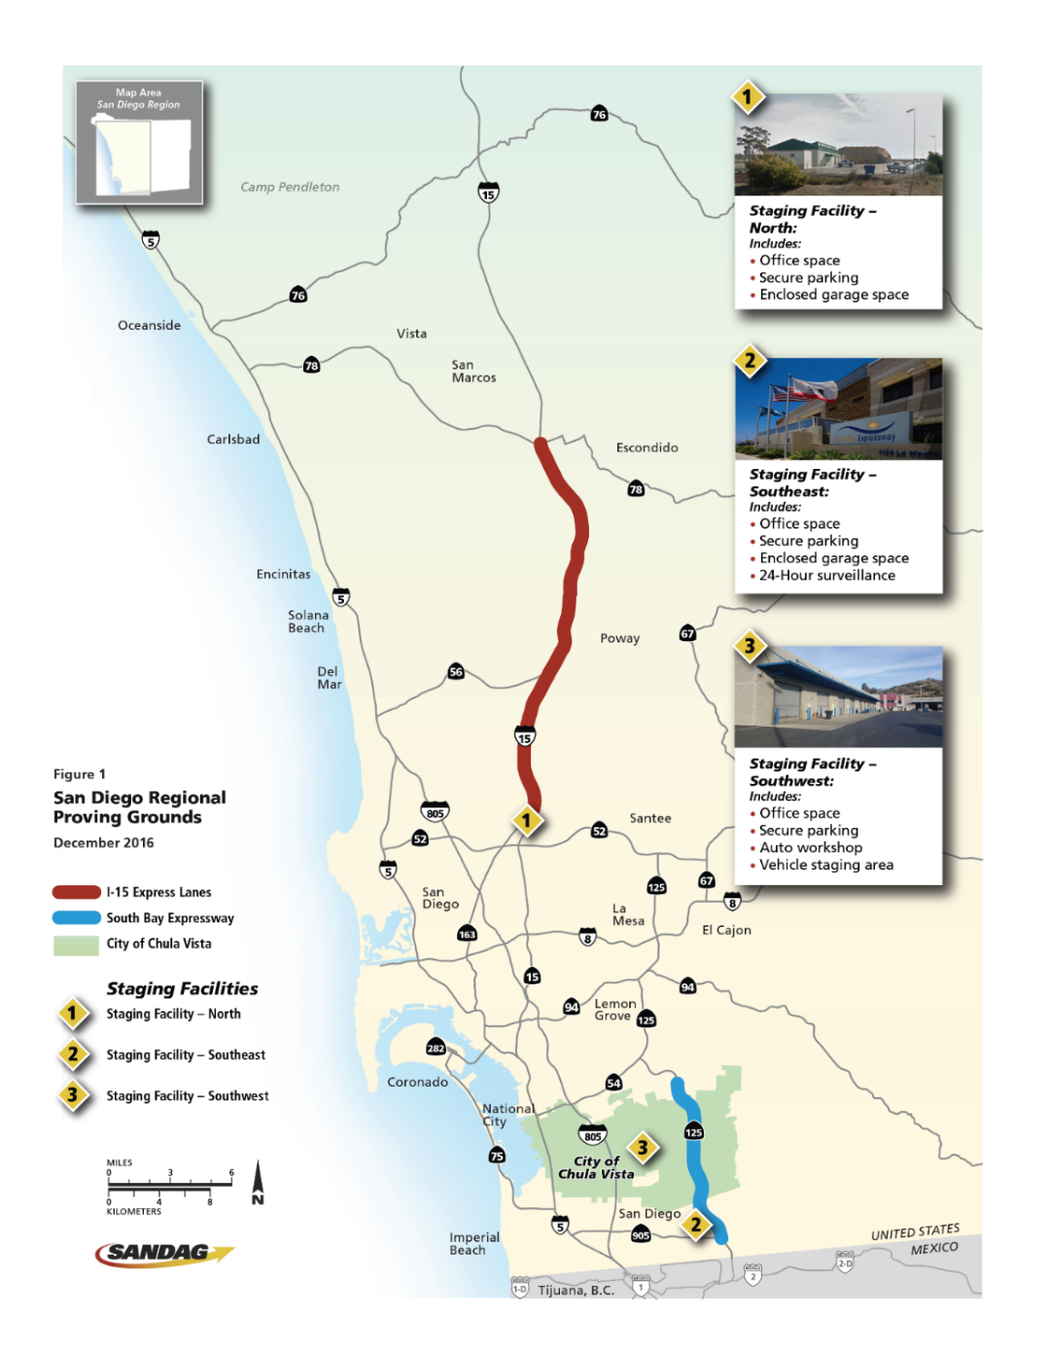
Purpose: San Diego Regional Proving Ground
Facilitate testing and validation of connected and autonomous vehicle technologies while ensuring public safety and security
Inform public policy and long-range planning that guides deployment in support of the region’s goals for mobility, sustainability, and economic prosperity
Notes:
The map on this slide highlights the 3 facilities that make up the San Diego Regional AV proving ground:
City of Chula Vista
Southern portion of SR-125
I-15 Express Lanes
The purpose of the San Diego Regional AVPG is to not only facilitate testing and validation of AV technologies but to inform public policy and long-range planning that guides deployment in support of the region’s goals for mobility, sustainability, equity, and economic prosperity.

Slide 6
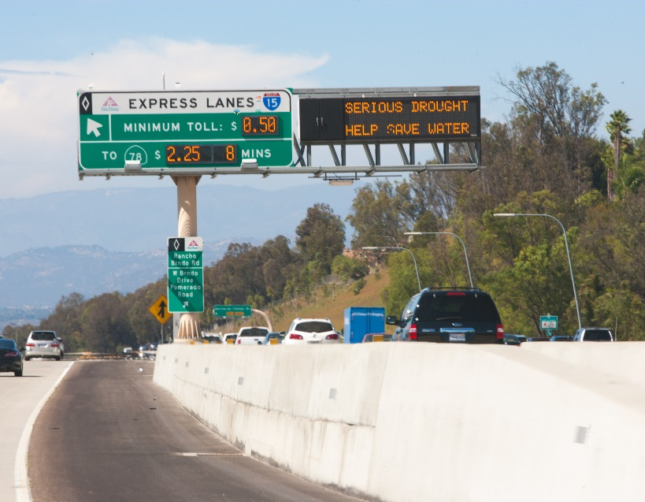
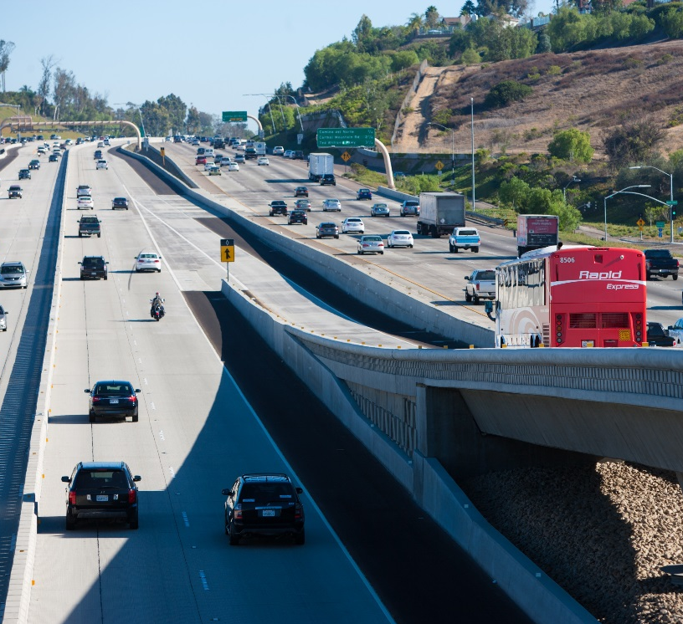
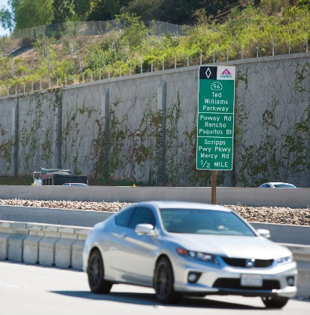
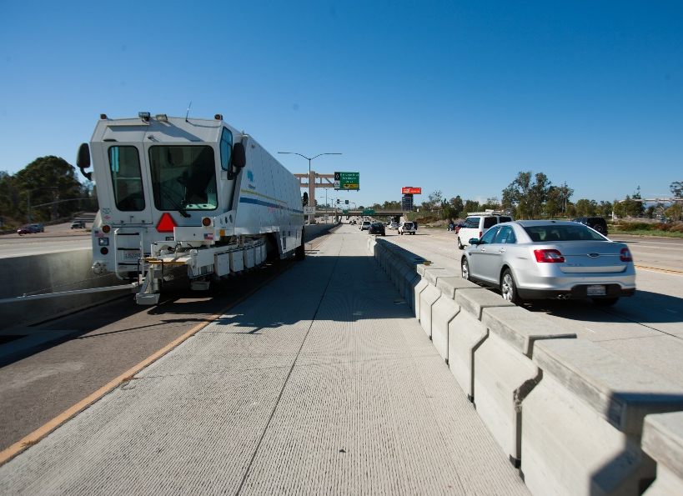
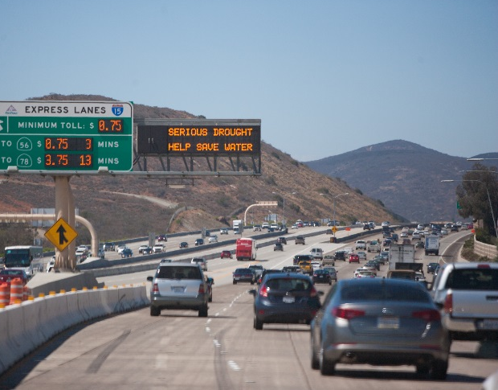
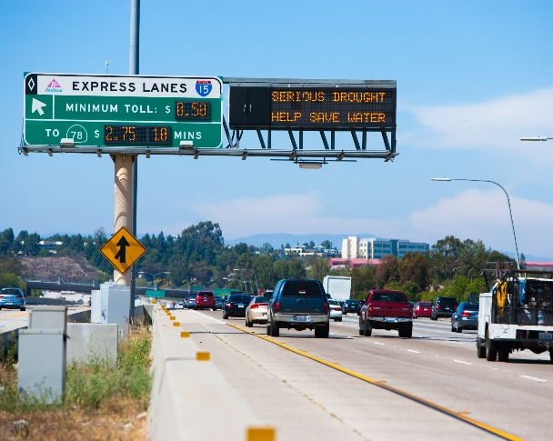
I-15 Express Lanes
Notes:
With 20 access points, the I-15 Express Lanes facility provides vehicles a wide range of options for ingress and egress, including five direct access ramps
Moveable Barrier - reconfigurable twice-daily, or during incident conditions by a barrier transfer machine.
The I-15 Express Lanes facility provides an ideal facility to support early Autonomous Vehicle deployment
For testing, the I-15 Express Lanes can be operated as controlled facility for high-speed testing; or as an open facility, providing real world conditions

Slide 7
South Bay Expressway (SR 125)
Notes:
10-mile tolled facility that provides access to the U.S.-Mexico borderland is wholly owned and operated by SANDAG.
Offers a multi-lane bi-directional ‘at-speed’ toll road facility, with limited development adjacent to the roadway itself.
Facility has 14 interchanges, 18 toll gantries, plus 6 toll plaza gantries
All traffic management assets will be available during testing, including closed circuit television , speed detectors, toll plazas, dynamic message signs, and traffic signals

Slide 8
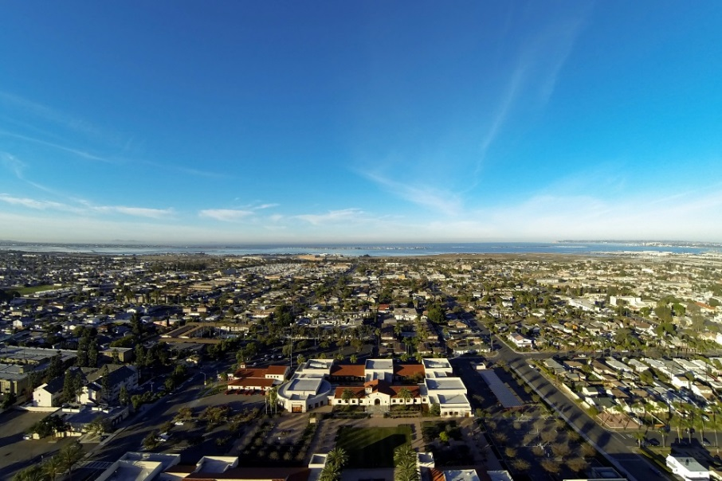
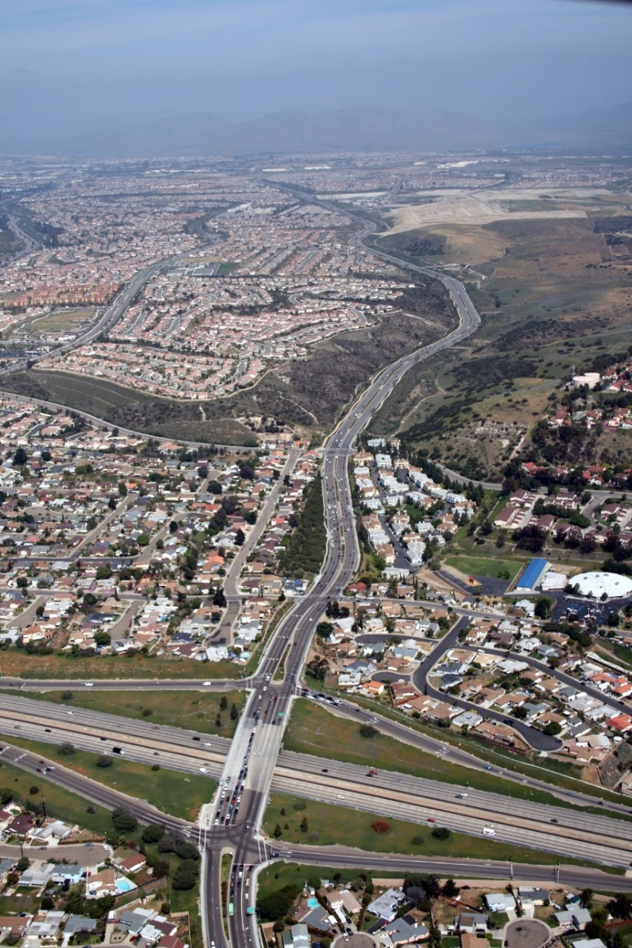
City of Chula Vista
Notes:
The City of Chula Vista is the second largest city within the San Diego region, comprising nearly 10 percent of the regional population
From the traditional grid patterned streets of the historical west side to the master-planned communities in the eastern territories, the variety of facilities provides a robust environment for an AV test bed.
One of the few cities in San Diego with land yet to be developed.
New development in eastern CV will include 20,000 housing units, 30 additional miles of local roads, and a university campus covering 400 acres over the next decade.
Chula Vista Bayfront in western Chula Vista will soon be home to a convention, conference, and resort center, as well as a large scale mixed-use development and park.
These developments provide opportunities for infrastructure design to incorporate the latest in technology as the roadway network develops

Slide 9
Overview of Work Program
Stakeholder outreach and partnership development
Needs assessment
Operating strategy and engagement model
USDOT and community of practice coordination
DMV coordination
Execute Agreements between Partners
Facilities ready for testing
Execute agreements (USDOT/partners)
Communications and public outreach plan
Facilitate deployment of supporting technologies
Safety management plans
Notes:
We developed a comprehensive work program to ensure that the facilities are open and available to the private sector for testing as of January 2018. This slide highlights some of the key activities and deliverables. First and foremost, we are conducting outreach to the auto and tech industries as well as academic institutions to understand their needs and level of interest in the San Diego Regional Proving Ground.
We are coordinating with USDOT and the Community of Practice to execute a Memorandum of Agreement that will outline standards for sharing data across all of the proving grounds.
We are also coordinating closely with the Department of Motor Vehicles (DMV) to ensure compliance with state regulations.
Public outreach is a priority for the USDOT so we have conducted several focus group meetings in the region to understand what the general public feels about connected and autonomous vehicles.
We are also developing our Safety Management Plans.

Slide 10
Feedback Received from Industry
Testing in a real world environment is attractive
Technology companies with a presence in Southern California are most likely to participate
These companies have established relationships with the auto manufacturers
Opportunities for strategic partnerships among affiliates is valuable
Notes:
One of the most important tasks in the work plan is industry and stakeholder outreach to better understand potential affiliate’s level of interest in the San Diego Regional Proving grounds and their needs to help inform our operational model and engagement strategy.
We interviewed over 40 companies ranging from tech, wireless, auto manufacturers and suppliers.
Some highlights from the feedback that we’ve received is that testing and validating in a real-world environment with varying types of facilities is desirable by manufacturers and transportation services providers.
Technology companies with a presence in southern California are most likely to participate and they have established relationships with auto manufacturers and will attract them to the proving grounds
Last, opportunities for strategic partnerships among the affiliates is very valuable and it has been recommended that we form a consortium of affiliates to facilitate these partnerships

Slide 11
The Consortium
Focus on activities with a line-of-sight to commercialization and public benefit​
Solve real-world issues with coordinated pilots, demonstrations, testing, and support activities​
Inform the direction of research, technology, and policy​
Notes:
As a result of input received following the industry interviews, a proving ground consortium kick-off meeting was held on October 19, 2017 at the Caltrans District 11 Headquarters in Old Town. This meeting included representatives from many of the companies that were interviewed and a select group of other companies interested/involved in the AV space.
The concept of the Consortium is different than a testing or proving ground. We envision companies and researchers that will join as affiliates to focus on these three big-picture ideas
Affiliates in the RPG consortium can use the proving ground facilities that include public roadways, including freeways, local roads, on- and off-ramps, and tollways and existing infrastructure to demonstrate autonomous vehicles and connected infrastructure.

Slide 12
San Diego RPG - Next Steps
Continue the development of the Proving Ground with Partners (SANDAG, Caltrans, City)
Continue to meet with other Proving Ground Reps
Next quarterly meeting on June 19, 2018
Continue to involve and educate the community
Continue to engage industry
Next Consortium meeting is on June 20, 2018
Upgrade transportation systems with consideration of RPG, ITS, and other “Smart” technologies
Notes:
We continue to communicate with industry and meet on a regular basis to advance the establishment of the proving ground and the consortium.
The formal agreement between SANDAG, Caltrans and the City of Chula Vista has been signed by all agencies.
Plan projects that take Smart City, ITS, and connected or autonomous vehicles into account.

Slide 13
“Smart”
Transportation Projects
in Chula Vista
Notes:
As a result we have several projects in the works that will provide better services to our residents, but also support the proving ground and our Smart City efforts.

Slide 14
What is the City up to?
New Traffic Signal Communications Master Plan
New Design & Construction Standards
New Smart City Strategic Action Plan
New Traffic Engineering & ITS On-Call Contract
Upgrading all IT network infrastructure
Awarding contract for Telecommunications Master Plan
Smart Transportation Projects
Notes:
Last year we adopted a new Traffic Signal Communications Master Plan. While the Master Plan was being prepared we also upgraded our traffic communications server room and built our new TMC.
We established new standards that include the installation of fiber optic interconnect to every new traffic signal, Ethernet communications hardware, high-definition CCTV cameras at every new signal or major upgrade, new trench detail that requires that our communications conduit be larger and deeper
We are also phasing out the use of bot dots which are not easily detected by autonomous vehicles and are difficult to maintain for our crews
We are using higher quality materials and specs for our signs, striping and pavement markings to reduce long term maintenance costs and, again, support the proving ground
Late last year we also adopted a new Smart City Strategic Action Plan. This document is a high level document that identifies our objectives to become a connected city, responsive city, transparent city, and an innovative city. Along the lines of becoming of a more transparent city and due to the additional data that we are generating through a variety of projects. Our City Council is expected to adopt our new Open Data Policy next week.
To support our ongoing traffic, ITS, and Smart City efforts, we have established a Traffic Engineering & ITS Services On-Call contract with four consultant teams
We are upgrading all of our core IT infrastructure so all switches, firewalls, servers, etc are being upgraded right now. We expect to complete this work by the end of August.
In addition, to add to our Traffic Signal Communications Master Plan, the City’s IT Department is in the process of awarding a contract for a new Telecommunications Master Plan. This will be a comprehensive plan that will look at communications needs for all City departments and also serve as a guide for us to become a more connected city.
Now, I’d like to give you an update on some of the exciting transportation projects that we have going on in the City.

Slide 15
Traffic Signal Communications Master Plan
Adopted in 2017
10-Year Plan
Estimated total cost of $16M
Notes:
The City has a new traffic signal communications master plan which was adopted by the City Council in September 2017.
The Master Plan is an inventory of our existing infrastructure & guide for future improvements
- Phased approach dependent on available funding and shared use agreements:
Phase 1: City-owned Infrastructure
Replace low bandwidth phone lines with high speed wireless
Upgrade existing fiber optic system to Ethernet
Begin replacement of 170 controllers to 2070 ATC
Phase 2: Infrastructure & Priority Corridors Upgrade
Install fiber optic cable in existing empty conduits
Install fiber optic cable and conduit
Partner with private companies who own conduits/fiber
Phase 3: Citywide Buildout
Buildout of the rest of the traffic systems communications network
Deploy more CCTVs and other ITS elements
Complete upgrade to 2070 ATC controllers

Slide 16
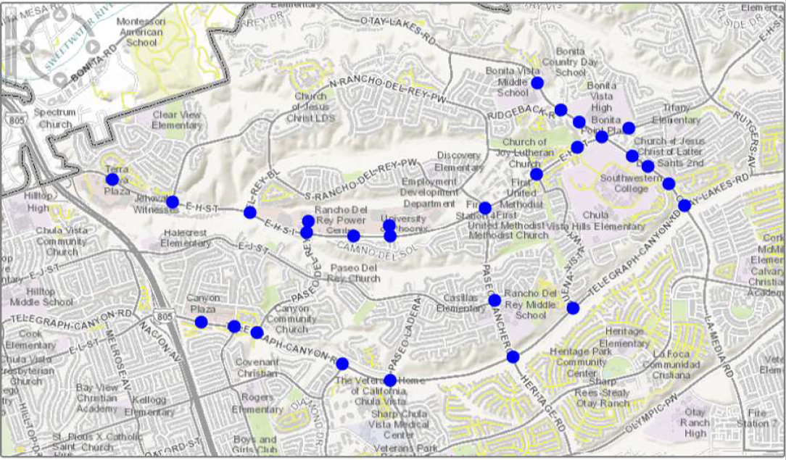
Adaptive Traffic Control System Upgrade & Expansion
East H St, Otay Lakes Rd, Paseo Ranchero, and Telegraph Canyon Rd
Notes:
In 2017, the City selected Trafficware to provide an adaptive traffic control system and ATMS. Construction of new detection systems and a new communications network was handled under a different contract and that work will begin early next month.
Total of 28 Intersections includes replacement of existing SCATS adaptive system (Sydney Coordinated Adaptive Traffic System)
Network communications upgrades to Ethernet
16 CCTV cameras to assist with traffic monitoring
20 Data Collection Devices to gather travel time data

Slide 17
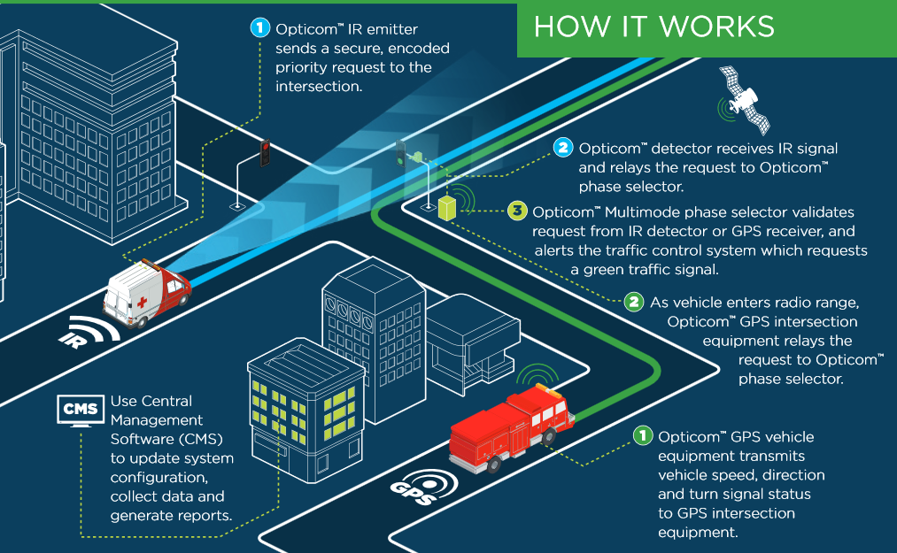
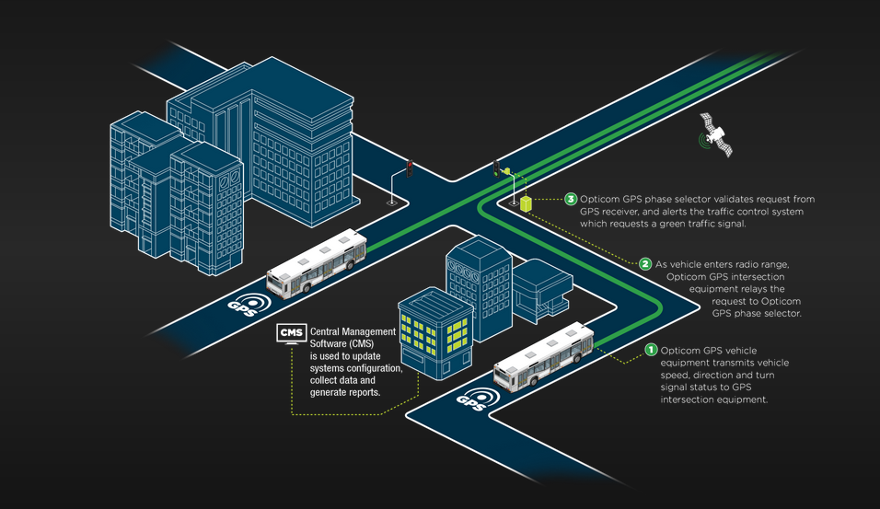
GPS-enabled Opticom Systems
GPS-enabled Fire
Response System
GPS-enabled
Transit Priority System
Notes:
We have funded equipment for about half of the intersections in the City. These new systems will be of great value in support of our Fire department especially since they’ve struggled to meet their fire response times for the past several years. All new Fire department rigs will be equipped with IR and GPS-emitters and they are working on plans to retrofit the rest of their fleet.
In addition, since we have some of the most transit impacted corridors in the region, we are prepping some of the intersections on those corridors with the new GPS-enabled Opticom system so that they will be TSP ready when and if there is a desire by MTS to pursue the implementation of TSP on those corridors.

Slide 18
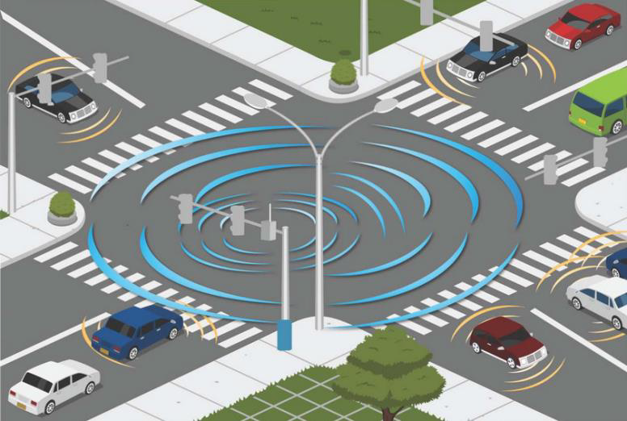
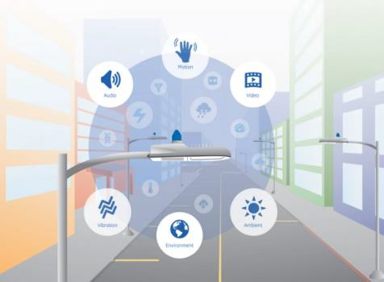
Broadway Corridor Upgrades
Smart Corridor
Intelligent Street Light
System Demo/Pilot
Road Diet and Bike Lanes
Notes:
Smart Corridor on Broadway (13 intersections)
New 2070ATC controllers, DSRC and Cellular Communications
Upgraded controllers and communications network will allow for data sharing of signal timing and phasing to vehicles with on-board monitors or Smartphone Apps
Intelligent Street Lights Demo
Dimming, motion sensing, and metering of electricity usage
Dozens of sensors: traffic volumes, sound, vehicle emissions, and more

Slide 19
Genetec VMS
Complete video
management
solution
Integrate with
Waze and other
traffic data/info
systems
City Standard
Notes:
To make better use of our TMC and field devices, especially our CCTV cameras. We’ve acquired the Genetec Video Management System. In coordination with our Police and IT departments, we selected this product to become the city standard and allow for seamless video sharing capabilities.
In addition, from the traffic management perspective, we are working with the company so they can integrate with Waze, Google maps, and some of our data collection devices to provide us with alarms for unusual levels of congestion and/or accidents and possibly trigger the use of pre-approved timing plans in the future.
Implementation of the Genetec VMS has just begun and we expect to have our system online by mid July.

Slide 20
QUESTIONS?
Eddie Flores, PE
City of Chula Vista
eflores@chulavistaca.gov
Notes:
A project that I did not provide a slide for that is worth mentioning is the South Bay BRT. With construction ongoing and expected to be complete by early next year, this is also an important project for SANDAG, the City, and obviously MTS. The BRT project includes the use of 2070 ATC controllers, peer-to-peer signal operations, and TSP for a more efficient and reliable transit operation on a dedicated guideway and also segments with mixed flow.
Thank you for listening to my presentation. At this time, if there are any questions, I would be happy to answer them.

